Slide 1
Stormwater Management
Carrie Donohoe and Amanda Gramigna
Project Manager and Associate Director, Environmental Health

Slide 2
What is Stormwater?
Stormwater originates from rain, snow, or ice melt
What happens to stormwater?
Infiltrate into soil where it falls (best)
Accumulate in puddles and evaporate
Runoff to sewers, streams, lakes etc.

Slide 3
What happens to Stormwater?
Accumulation
Can damage infrastructure
Can obstruct roads
Runoff
Can clog sewers or drains with debris
Can cause damage by erosion
Infiltration
Capture water where it lands
Filters and replenishes groundwater
Infiltration is usually the best case

Slide 4
How is Stormwater Managed?
Green infrastructure- strategic use of land and natural materials
Rain gardens, bioswales
Dry wells, stormwater vaults
Grey infrastructure- utilizing human made technology
Backflow preventers
Downspout configuration
Sewer maintenance

Slide 5
Benefits of good Stormwater Management
Disconnect Downspouts
Stormwater is managed on property
Reduce stormwater volume in sewers
Reduce 311/Service calls
Chatham target area determined by call volume
Reduce sewer backups
Community Beautification
Reduce water damage to infrastructure
Rain gardens look nice!

Slide 6
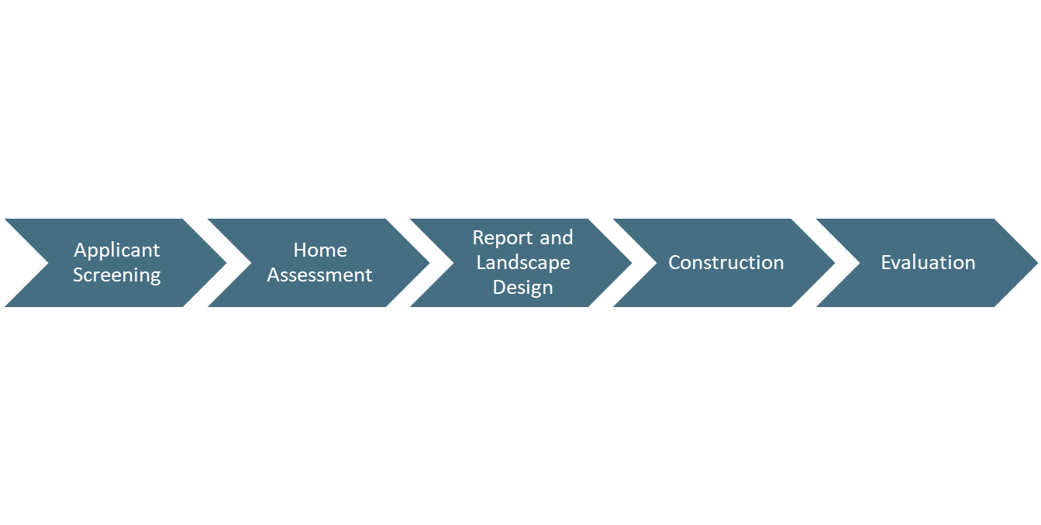
How do Stormwater Management Programs Work?

Slide 7
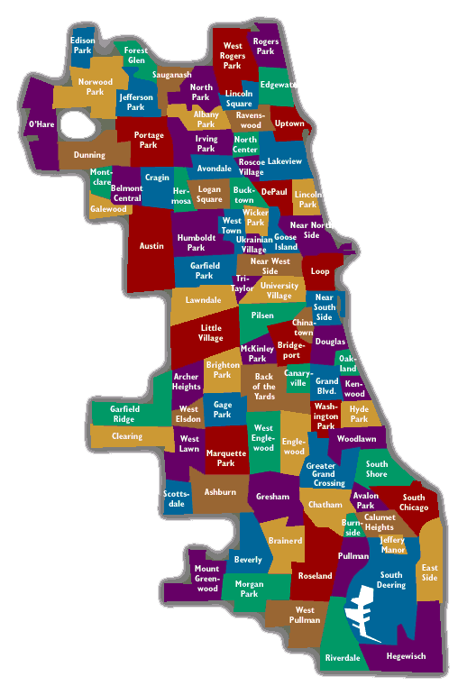
Chatham Example
Contributing factors to flooding
Low-lying topography
Changing climate
Increasing impervious surfaces
Aging and undersized infrastructure
Additional factors to consider
Aging housing stock
Lower income population
Older population

Slide 8
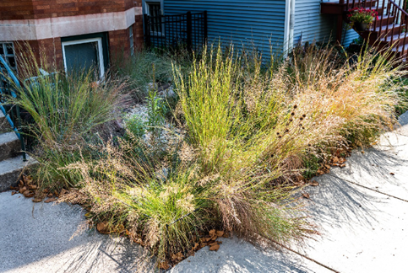
Chatham Example
Program approach
Free program, up front
Prescriptive approach
Pilot period, 20 homes
Program offerings
Exterior- rain garden, bioswale
Interior- backflow preventer
With Injection pump or check valve

Slide 9
Oak Park Comparison
Similar program, different design
Newer housing stock
More affluent community
Active involvement from the Village of Oak Park
Chatham | Oak Park
Free up front | 50% rebate
Grey infrastructure included | Green infrastructure only
Prescriptive offerings | Flexible offerings
Funded by City of Chicago, with other departments | Funded by VOP

Slide 10
Questions?

Slide 11
Contact information
Carrie Donohoe
carrie.donohoe@ElevateNP.org
217-391-4273
Amanda Gramigna
amanda.gramigna@ElevateNP.org
217-391-4273

