Slide 1
Communities Harnessing the Sun:
Becoming solar ready through SolSmart
Zach Greene
Project Manager, The Solar Foundation
June 21, 2017

Slide 2
Common Barriers to Solar
Notes:
The largest driver behind solar’s explosive growth over the past half decade has been shrinking costs. In places around the US where the cost of solar is prohibitive, solar doesn’t get installed.
Lack of education is also a cost. Solar companies have a harder time “selling” solar to customers who don’t have much experience with it, or who don’t see it in their communities.
Policy support can also impact costs positively or negatively. Incentives make solar affordable, but red tape makes solar more expensive by creating hurdles for installers that are passed along to consumers in the form of more expensive solar.
The program we’ll be presenting today is designed to address all of the hurdles listed here at the local level. And when local governments take a look at our technical assistance offering, they’re often left with a sense that their government has much more power to impact the local solar market context than they may have imagined.

Slide 3
The Cost of Solar in the US
No change in soft costs between 2010 and 2012
$3.32
Soft costs remain nearly 2/3s of installed cost
$3.32
$3.28
$1.90
Notes:
SunShot Goals by 2020
$1.50/W for residential systems
$1.25/W for small commercial systems
$1.00/W for utility scale systems

Slide 4
The Cost of Solar in the US
Solar Soft Costs
Source: NREL (http://www.nrel.gov/docs/fy14osti/60412.pdf)
LBNL (http://emp.lbl.gov/sites/all/files/lbnl-6350e.pdf)(http://www1.eere.energy.gov/solar/pdfs/sunshot_webinar_20130226.pdf )
Notes:
The remaining 50% of the costs are commonly grouped together as “soft costs”. These soft costs include the cost of handling processes such as permitting and interconnect, marketing costs including customer acquisition, and installation costs including design, financing, and labor costs.
In the US, we pay a significant premium on these solar soft costs. And local governments play a critical role in reducing these soft costs.

Slide 5
Benefits of Reducing Soft Costs
Streamlining local regulatory processes can reduce the cost of a typical system by $2,500. Onerous permitting procedures, for instance, can add $700 to the installed cost.
Reduced installation costs
Improved financials
Better “value proposition”
More solar
This is a good deal!

Slide 6
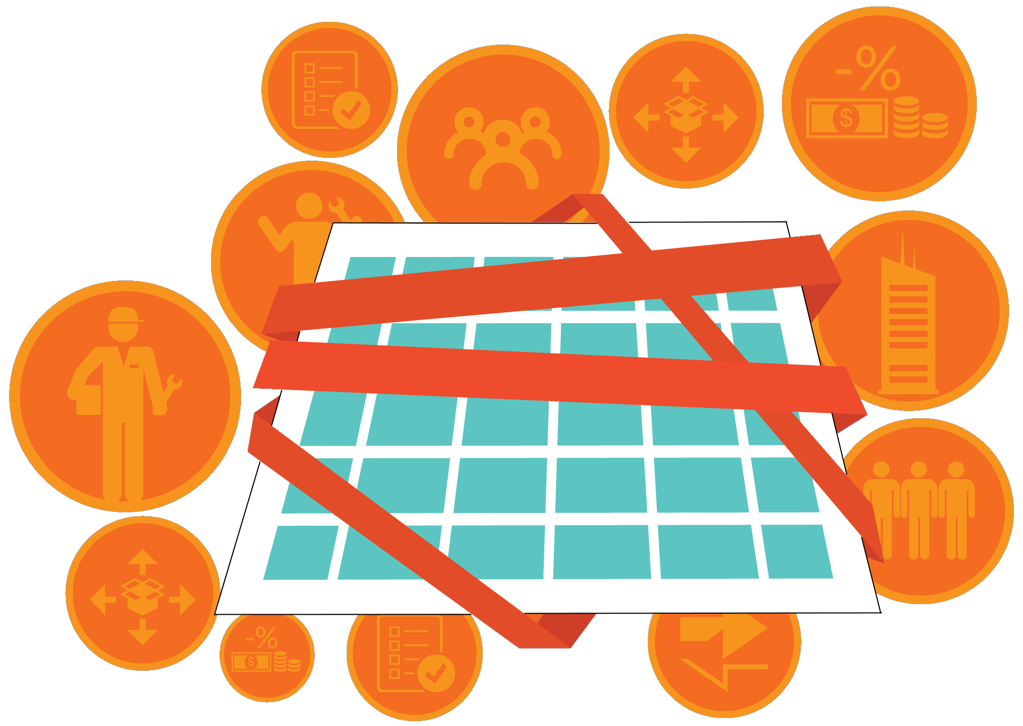
Benefits of Reducing Soft Costs
Streamlining processes at the local level can free up staff time to address other priorities.
Streamlined, transparent processes
Better submittals
Time and money savings
Shorter processing time
Sources: LBNL, IREC

Slide 7
Benefits of Reducing Soft Costs
Support American businesses
8,601 U.S. businesses comprise the solar value chain. All but a handful are small businesses.
Installers avoid multiple jurisdictions in their service areas based on onerous permitting.
Create American jobs
There are over 260,077 solar workers in the U.S.
One in fifty jobs created in 2016 was in the solar industry.
20% annual growth from 2012 – 2015 and another 25% in 2016.
29.4 jobs
Residential solar
15.8 jobs
Non-residential solar
2.8 jobs
Utility scale solar
Sources: Clean Power Finance (Spruce); The Solar Foundation

Slide 8
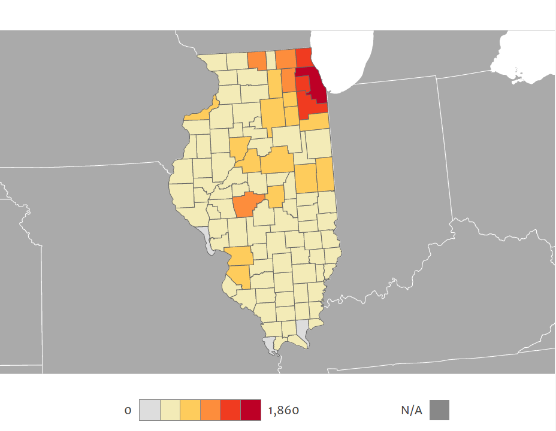
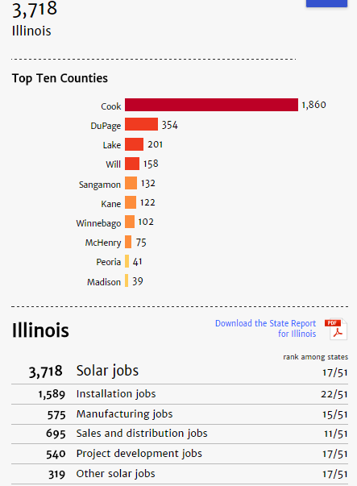
Solar Means Jobs
Learn more at: solarstates.org
Sources: 2016 Solar Jobs Census. The Solar Foundation.

Slide 9
…and Economic Development
Solar’s nationwide effects
Added $84 billion to the GDP
1 solar job → 2.03 jobs elsewhere in the economy
$1 spent on solar → $1.47 in additional spending economy-wide
State-specific effects: Ohio
Ohio had 5,831 solar jobs in 2016
13,000 jobs when taking into account direct, indirect and induced jobs
$1.3 billion in direct sales
$810 million in salaries, wages, and benefits
$1.2 billion to GDP
Sources: Solar Jobs Census – 2016 Economic Impact Analysis, The Solar Foundation.

Slide 10
Takeaways
Soft costs often comprise a larger share of total installed cost than hardware and they slow solar market growth.
Soft costs can artificially shrink the number of places where solar is financially viable, thereby denying communities the economic benefits related to solar.
Local governments have a key role to play in reducing barriers.

Slide 11
SolSmart
How Your Community Can Make a Difference (& Earn Recognition)

Slide 12
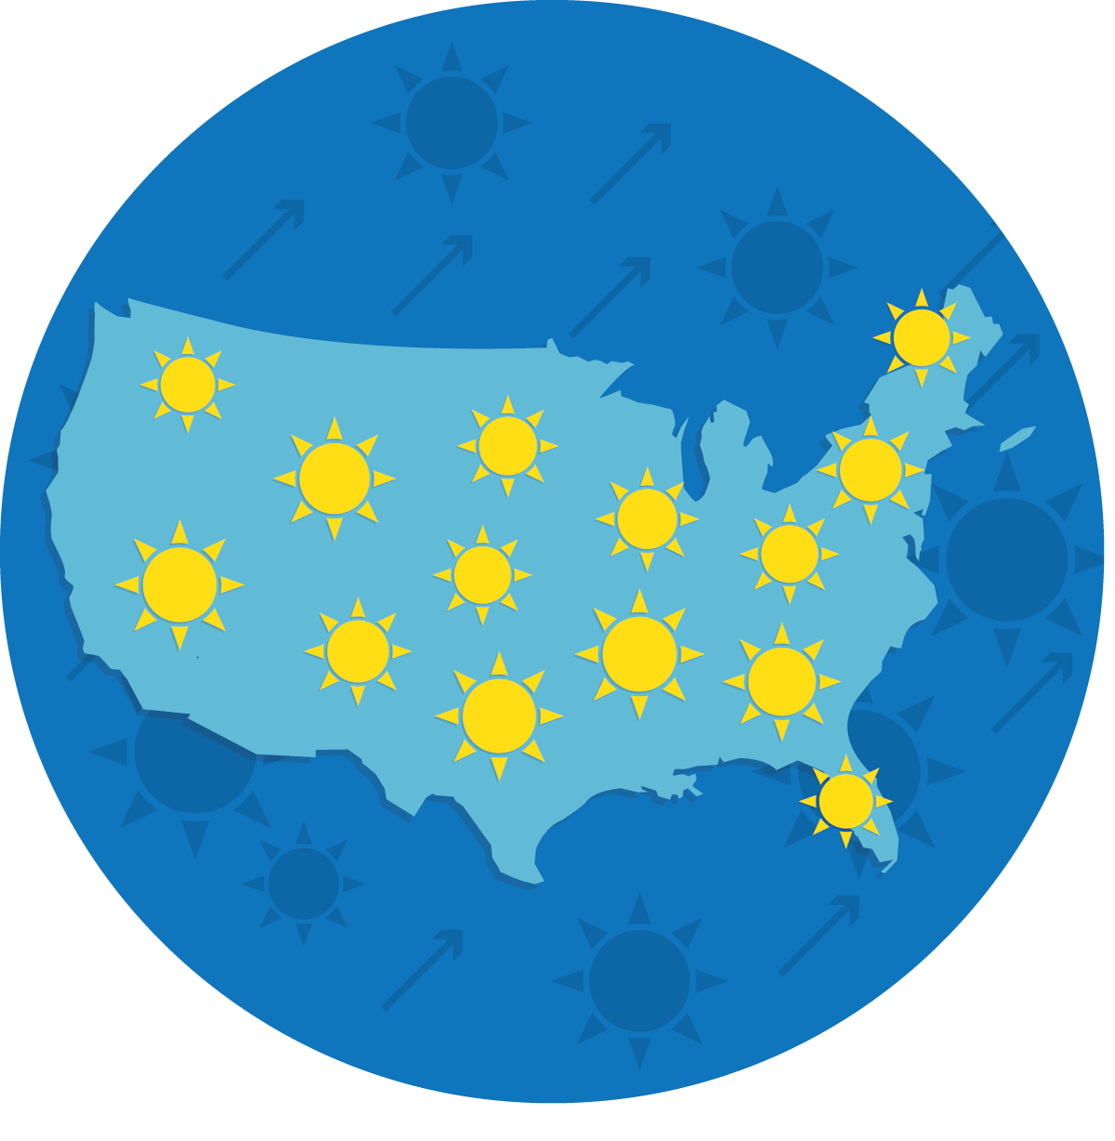
SolSmart Goals & Overview
To make it faster, easier, and more affordable for more Americans to choose solar energy, SolSmart will recognize at least 300 U.S. local governments with a nationally prestigious solar designation.
Designation
Technical Assistance
Earn Bronze, Silver, or Gold designation based on solar-related actions.
Demonstrate that the community is “open for solar business,” making it more attractive to solar industries.
Communities can receive no-cost technical assistance in 8 solar-related categories.
Solar experts will help review local processes, expand solar markets, and earn designation.

Slide 13
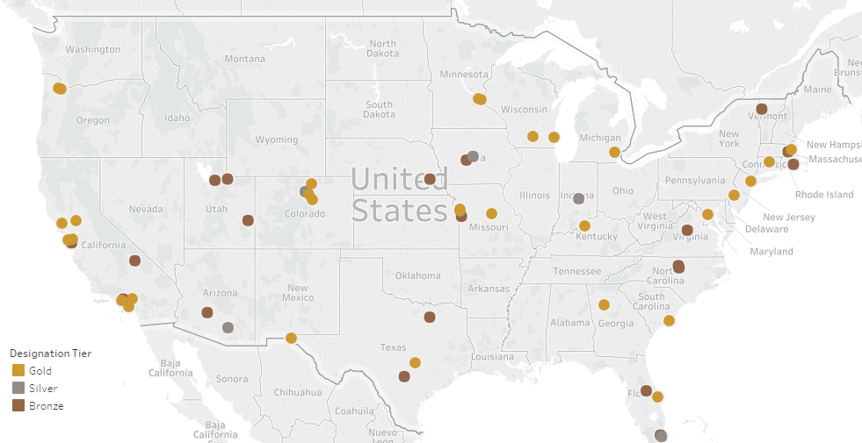
SolSmart Participants
160+ participating AHJs
58 current designees
32 states
Over 50 million Americans

Slide 14
SolSmart Criteria
Designation and technical assistance is tied to these eight categories and their associated actions:
Foundational Categories | Special Focus Categories
Permitting | Solar Rights
Planning, Zoning, and Development Regulations | Inspection
 | Construction Codes
 | Community Engagement
 | Utility Engagement
 | Market Development & Finance
Innovative Actions

Slide 15
Designation Structure
Address 3 prerequisites
20 points in Permitting
20 points in Planning, Zoning, & Development Regulations
60 total points
Earn SolSmart Bronze
Address 2 prerequisites
Earn 100 total points
Earn SolSmart Silver
Address 1 prerequisite
Earn 200 total points

Slide 16
Path to SolSmart Bronze
STEP 1: Cut critical red tape via prerequisites.
STEP 2: Earn 20 points in the Permitting category.
STEP 3: Earn 20 points in the Planning, Zoning, and Development Regulations category.
STEP 4: Earn 20 points across any of the six “Special Focus” categories.

Slide 17
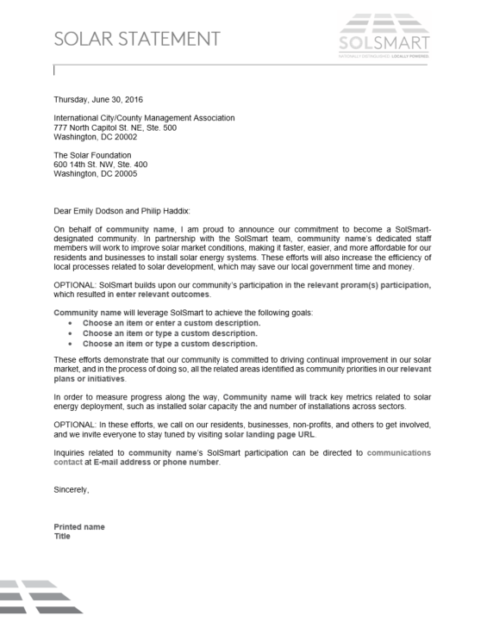
Path to SolSmart Bronze
STEP 1: Cut critical red tape via prerequisites
Provide a statement of your community’s solar goals, including commitments to earn designation and to track key solar metrics.
Create and put your community’s solar permitting checklist online.
Review zoning requirements and identify restrictions that intentionally or unintentionally prohibit solar PV development.
STEP 1: Cut critical red tape via (3) prerequisites.

Slide 18
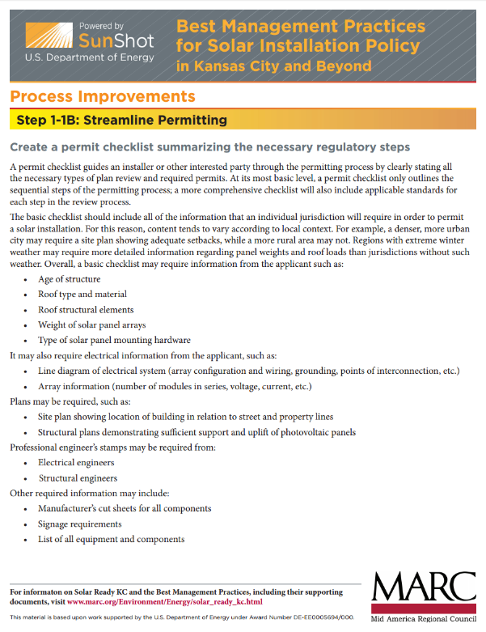
Path to SolSmart Bronze
STEP 1: Cut critical red tape via prerequisites
Provide a statement of your community’s solar goals, including commitments to earn designation and to track key solar metrics.
Create and put your community’s solar permitting checklist online.
Review zoning requirements and identify restrictions that intentionally or unintentionally prohibit solar PV development.

Slide 19
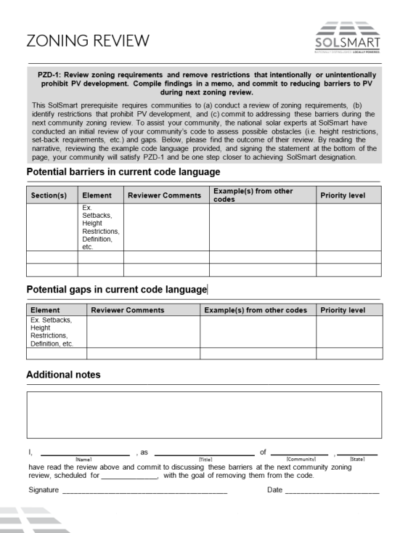
Path to SolSmart Bronze
STEP 1: Cut critical red tape via prerequisites
Provide a statement of your community’s solar goals, including commitments to earn designation and to track key solar metrics.
Create and put your community’s solar permitting checklist online.
Review zoning requirements and identify restrictions that intentionally or unintentionally prohibit solar PV development.
STEP 1: Cut critical red tape via (3) prerequisites.

Slide 20
Path to SolSmart Bronze
STEP 1: Cut critical red tape via prerequisites.
STEP 2: Earn 20 points in the Permitting category.
STEP 3: Earn 20 points in the Planning, Zoning, and Development Regulations category.
STEP 4: Earn 20 points across any of the six “Special Focus” categories.

Slide 21
Path to SolSmart Bronze
STEP 2: Earn 20 points in the Permitting category.
Require no more than one application form for a residential rooftop PV project. (5 PTS)
Review solar permit fees for residential and commercial solar. (5 PTS)
Train fire and safety staff on solar PV. (10 PTS)
Review permitting process for efficiency improvements and reduce processing time to 10 days or fewer. (10 PTS)
Train permitting staff on best practices for permitting solar PV and/or solar and storage systems. (10 PTS)
NOTE: This is not a prescribed path, just an example.
OR

Slide 22
Path to SolSmart Bronze
STEP 1: Cut critical red tape via prerequisites.
STEP 2: Earn 20 points in the Permitting category.
STEP 3: Earn 20 points in the Planning, Zoning, and Development Regulations category.
STEP 4: Earn 20 points across any of the six “Special Focus” categories.

Slide 23
Path to SolSmart Bronze
STEP 3: Earn 20 points in the PLANNING, zoning, and development regulations category.
Train planning staff on best practices in planning and zoning for solar PV. (10 PTS)
Provide clear guidance for solar in historic and special-use districts. (10 PTS)
Allow solar by-right and as an accessory use in all major zones, and implement any zoning ordinance adjustments identified through the zoning review to improve solar-friendliness. (20 PTS, SILVER+GOLD PREREQ.)
NOTE: This is not a prescribed path, just an example.
OR

Slide 24
Path to SolSmart Bronze
STEP 1: Cut critical red tape via prerequisites.
STEP 2: Earn 20 points in the Permitting category.
STEP 3: Earn 20 points in the Planning, Zoning, and Development Regulations category.
STEP 4: Earn 20 points across any of the six “Special Focus” categories.

Slide 25
Path to SolSmart Bronze
STEP 4: Earn 20 points in SPECIAL FOCUS categories.
Create a solar landing page on local government website with goals and local resources for solar development. (10 PTS)
Discuss community or shared solar programs with the local utility. (U-2: 10 PTS)
Provide consumer protection resources on solar. (5 PTS)
Make inspection requirements for PV available online. (10 PTS)
Provide resources on active solar installers and/or local incentives for solar. (5 PTS)
NOTE: This is not a prescribed path, just an example.
OR

Slide 26
SolSmart
Technical Assistance

Slide 27
No-Cost Technical Assistance
All communities pursuing SolSmart designation are eligible for no-cost technical assistance from national solar experts.
TA providers have decades of combined experience in solar energy, along with thousands of hours of previous TA provision to municipal governments.
On average, a community can expect 100 hours of technical assistance.

Slide 28
No-Cost Technical Assistance
TA provision through a variety of means:
Online
Resource catalog
Email
Webinars
Over the Phone
Clearinghouse calls
Conference calls
In person
Site visits
Technical workshops/seminars
Advisors
Peer-to-peer
STEP 1: Cut critical red tape via (3) prerequisites.
TA providers are creating templates to assist communities, and to provide them with a more transparent experience.

Slide 29
Will County, IL
Will County joined SolSmart in June 2016.
Since joining SolSmart, program staff have assisted Will County staff with:
Determining their path to designation.
Reviewing the county zoning code, specifically as it pertains to solar as a primary use.
Developing a checklist to make the solar permitting process more transparent.
Identifying appropriate documentation to receive points. Will County entered the program having already attained several criteria.
Will County is poised to earn a Silver SolSmart designation.

Slide 30
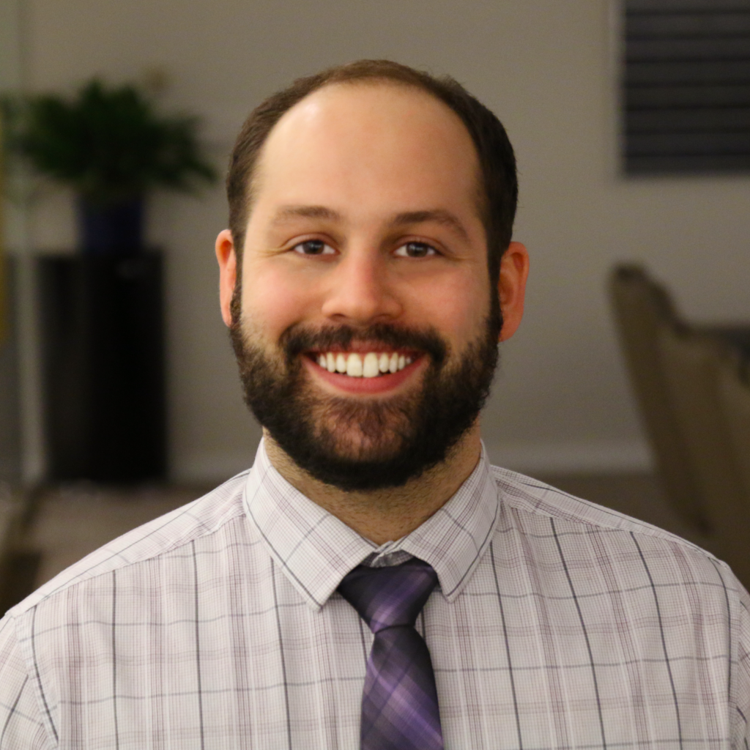
Q & A
Zach Greene
Project Manager, SolSmart Technical Assistance Provider
The Solar Foundation
202-866-0895
zgreene@solarfound.org

