Slide 1
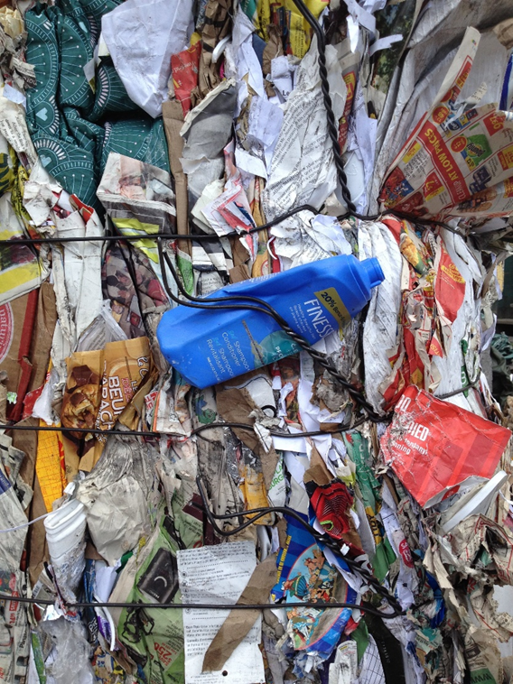
The problem with PLASTIC.
Environmental Defenders of McHenry County

Slide 2
UPDATE FROM MCHENRY COUNTY
The Environmental Defenders of McHenry County's single-use plastic reduction program has set out a few goals for the next three years. We will continue to advocate for the reduction of single-use plastic use - at restaurants and stores through direct connection between our non-profit and those establishments and through advocating for ordinances that bring about change town-wide throughout our county (such as a fee.) We also will continue to strive to educate the public about changing habits, thereby reducing the demand for single-use products through our campaign that reminds people to bring their own...bottles, container, bag, etc.

Slide 3
CITY OF WOODSTOCK, SINGLE-USE BAG FEE!

Slide 4
Why are you doing this?
The Mission of The Defenders is to preserve and protect the environment for all living things (since 1970!). Reducing single-use plastic is paramount - both as mitigating a waste stream that is unnecessary, cutting down on recycling costs and keeping a product from harming wildlife, polluting our planet's water systems and even harming humans as more and more nano-plastics enter our foodstream. I started our BYOBag program as a volunteer in 2013 because plastic grocery bags are completely unnecessary and I just had to start something up in our county to address it. Thankfully, The Defenders were extremely receptive and we went on to receive grants totaling $7,000 for the project. I also feel it's vital that we wean the public from thinking that it's fine to use something once since it can be recycled. That doesn't mean it's the right choice and we work at educating people about alternatives to recycling...like reducing and reusing. And, of course, we all know that recycling isn't always successful.

Slide 5
Who is involved?
Our Waste Reduction Committee of The Defenders works on plastic reduction issues - from our BYOBag campaign, to plastic straw reduction program to education about other means to live without plastic and helping bring about change to daily habits and shopping habits of consumers. We partner with municipalities, advocate for ordinances, and work with estalbishments that want to see the same change we do.

Slide 6
PLASTIC STRAW FREE

Slide 7
What results have you seen?
I can certainly say that since 2013, fewer people are accepting plastic bags. It's hard to quantify since we do not have the staff to collect data, but our educational signs from our 2013 BYOBag campaign are still up at many places around the county from stores to city/village halls. Over the years, we have sold and given away decals for shoppers' cars reminding them to bring their bags to store from the car. Restaurants are actively getting rid of plastic straw use and those establishments will be published in our fall edition of our newsletter, EarthConnect and also receive our "Plastic Straw Free" clings for their front door/window to help connect all those that are moving away from plastic. We advocate for something other than Styrofoam use, and some restaurants offer other materials for take-home containers, for example. Just through actively being a part of our community, I see change at churches, dental offices, coffee houses, business offices and restaurants. But, there's much, much more to be done and many, many people who need to be engaged.

Slide 8
What is single-use?
For health reasons, a product that should only be used once. i.e. plastic water bottles
An item that is often tossed after one use or reused but still ends up in a landfill. i.e. plastic bags
An item that is used once and discarded. This item is also NOT recyclable or recoverable. i.e. plastic straws and polystyrene.

Slide 9
More plastic in our oceans than land on Earth.
18 BILLION LBS ANNUALLY
18% (??) OF PLASTICS ARE RECYCLED – UP FROM ZERO IN 1980

Slide 10
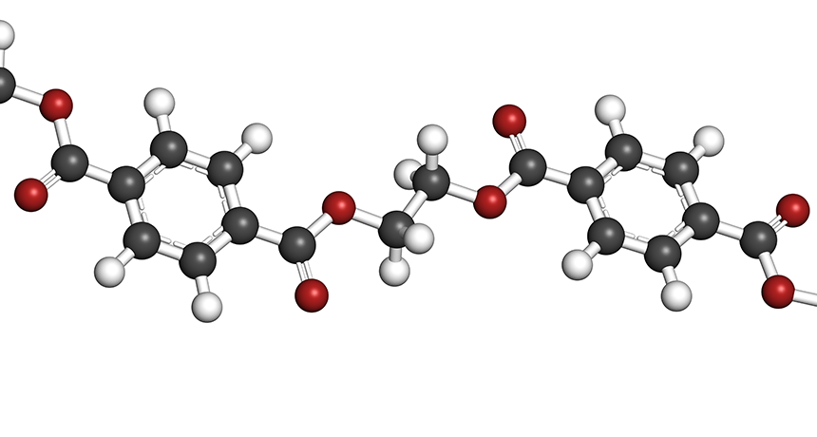
What is plastic?
PET 11%
HDPE 14%
PVC 5%
LDPE 20%
PP 19%
PS 6%
OTHER 24%
Product of fossil fuel
Polymers – long chain molecules made of repeating links.
Malleable
GOOD & BAD FOR SAME REASON

Slide 11
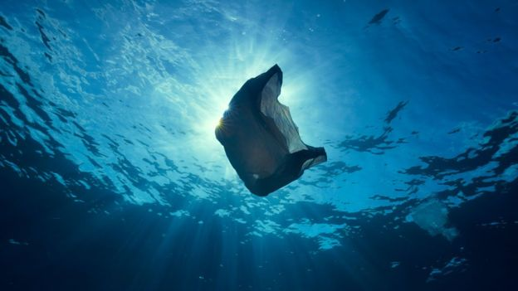
HALF OF PLASTIC EVER MANUFACTURED HAS BEEN MADE IN PAST 15 YEARS.

Slide 12
“Every year, more than eight million tons ends up in the ocean, costing billions of dollars in damage to marine ecosystems and killing an estimated one million sea birds, 100,000 sea mammals and untold numbers of fish, studies have shown.”

Slide 13
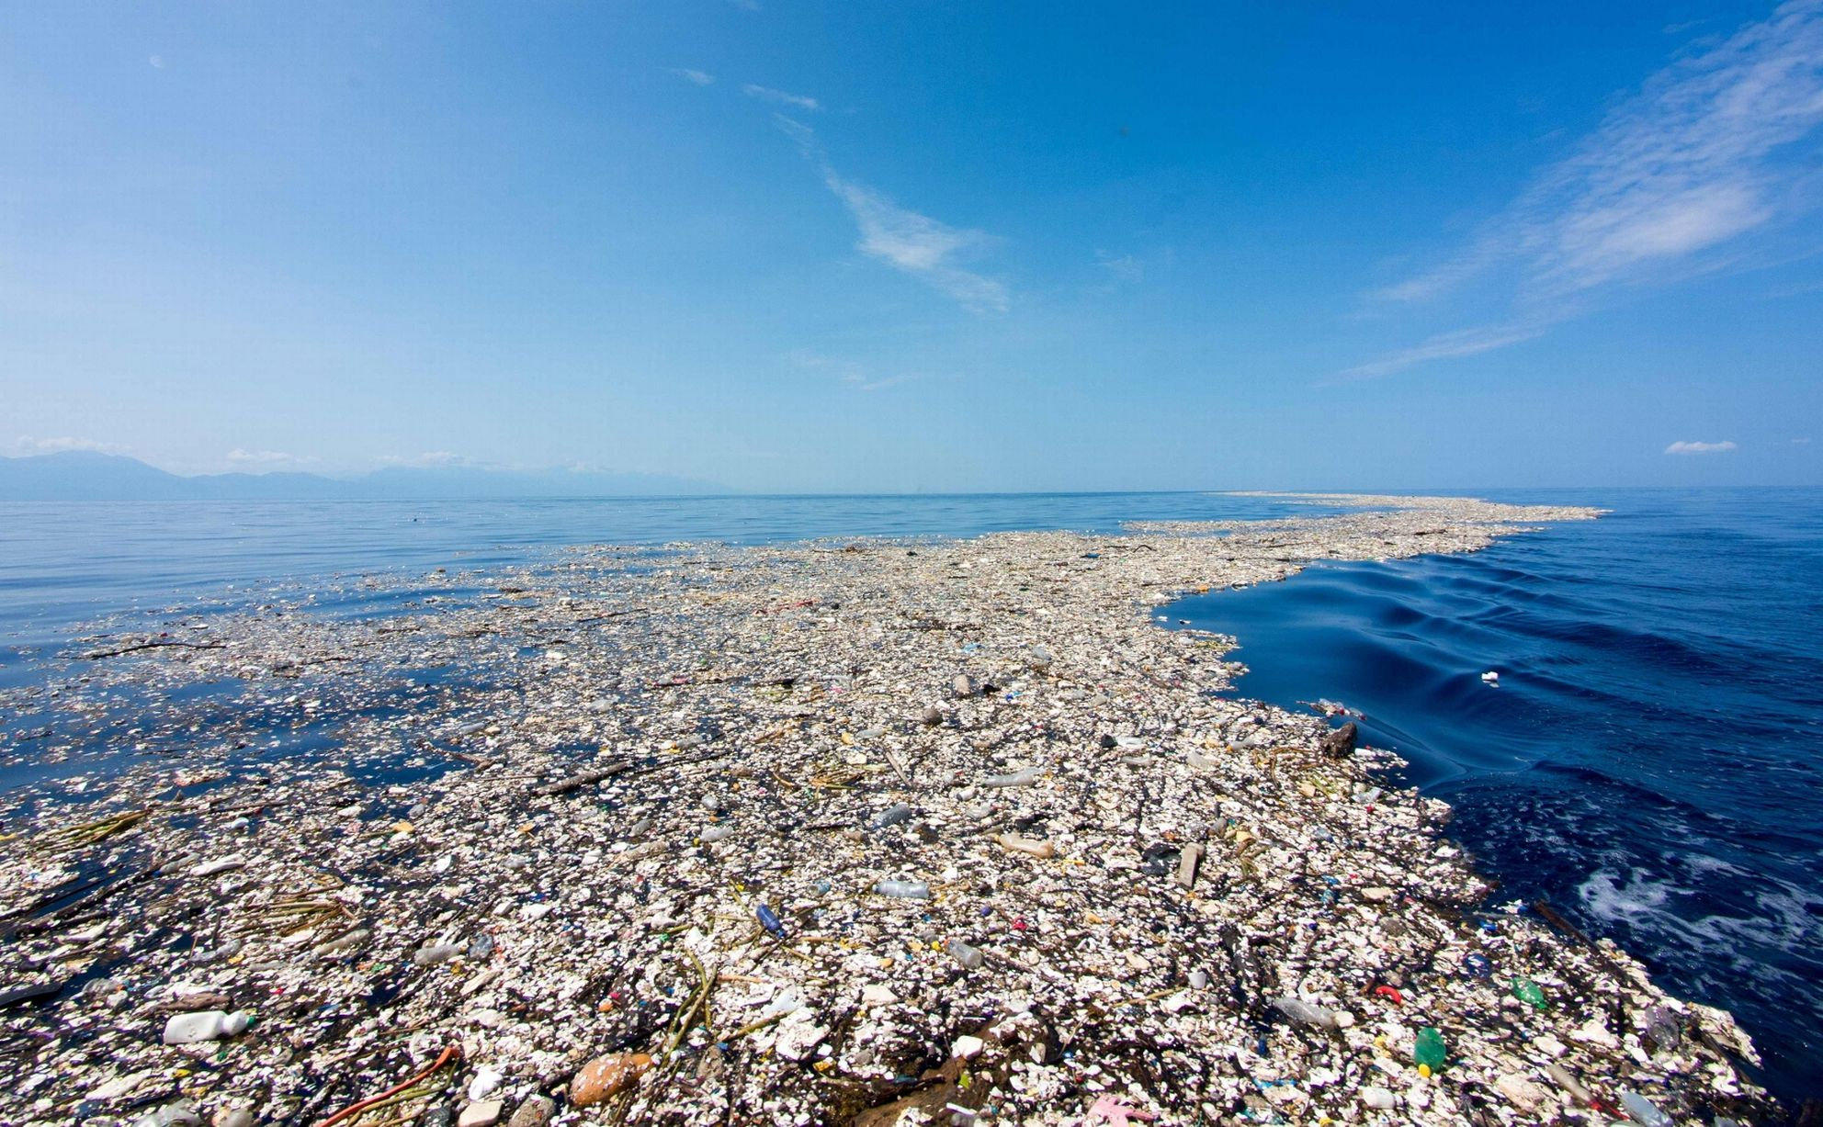
OFF THE COAST OF ROATAN, HONDURAS

Slide 14
The evolution of a nano and micro-plastics
Plastic enters waste stream
Enters watershed and open ocean
Breaks down from the sun into smaller and smaller particulates
Chemicals in the environment bond with plastic, causing additional concerns to endocrine systems of fish and mammals.
Where does it go?

Slide 15
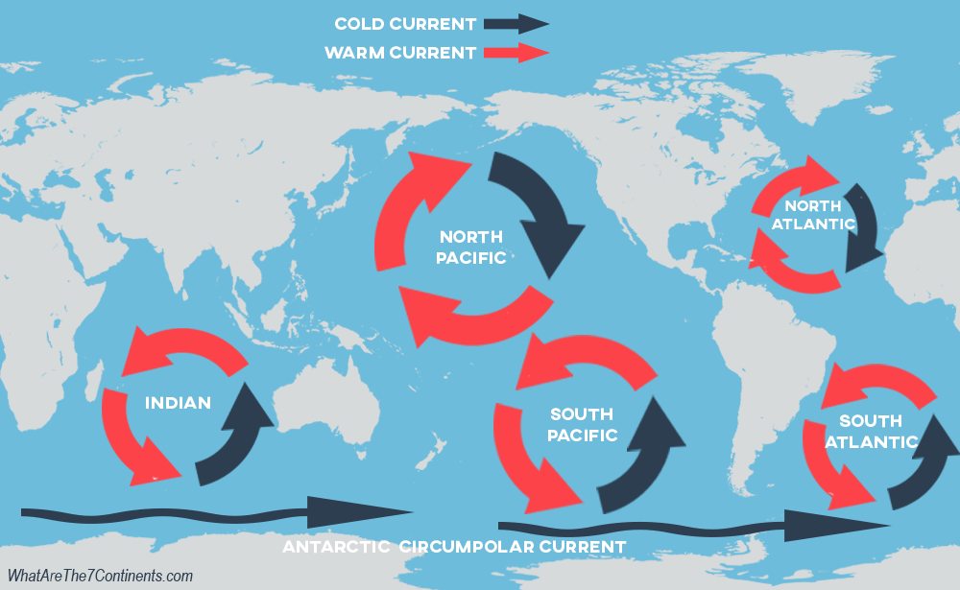

Slide 16
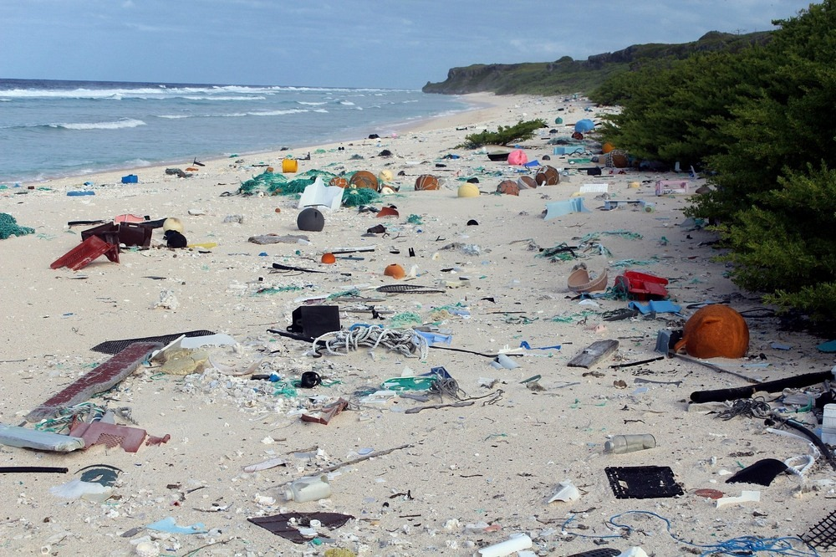
38 billion pieces of plastic on the isolated HENDERSON ISLAND.
PARADISE LOST?

Slide 17
SUNLIGHT, WIND, WAVES & HEAT

Slide 18
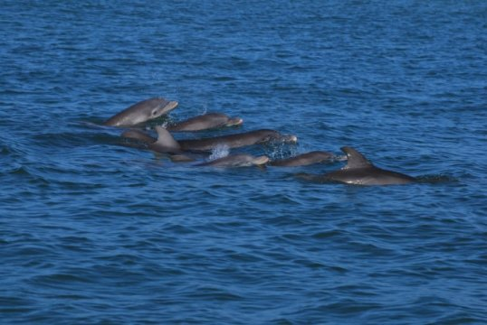
71%
“Elevated concentrations in dolphin urine of a specific phthalate compound most commonly added to plastics hinted at plastic waste as a possible source of exposure for the dolphins.”

Slide 19
Did you know?: Illinois became the first U.S. state to enact legislation banning the manufacture and sale of products containing microbeads; the two-part ban goes into effect in 2018 and 2019.

Slide 20
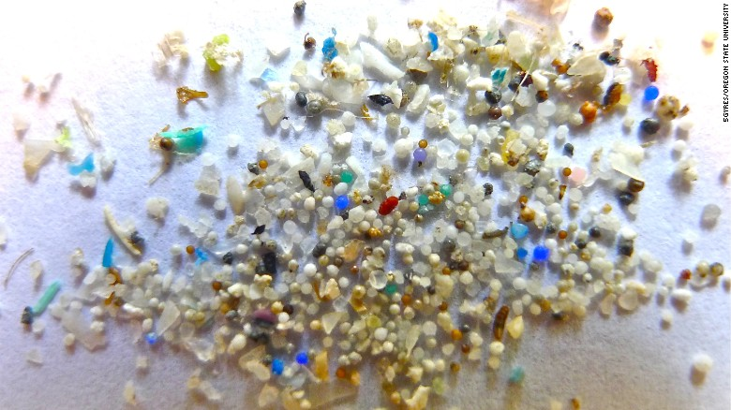

Slide 21
The food chain
US
Smaller fish
Microplastics
toxins
Large fish, tuna…
Krill
Bottom feeders, shrimp
Fish
Larger fish
Humans

Slide 22
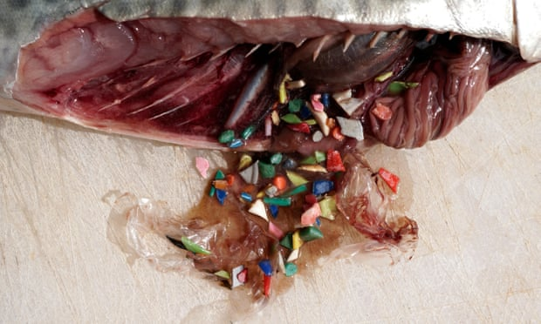
PLASTIC COVERED IN BIOLOGICAL MATERIALS ATTRACT OCEAN LIFE, SUCH AS FISH.

Slide 23
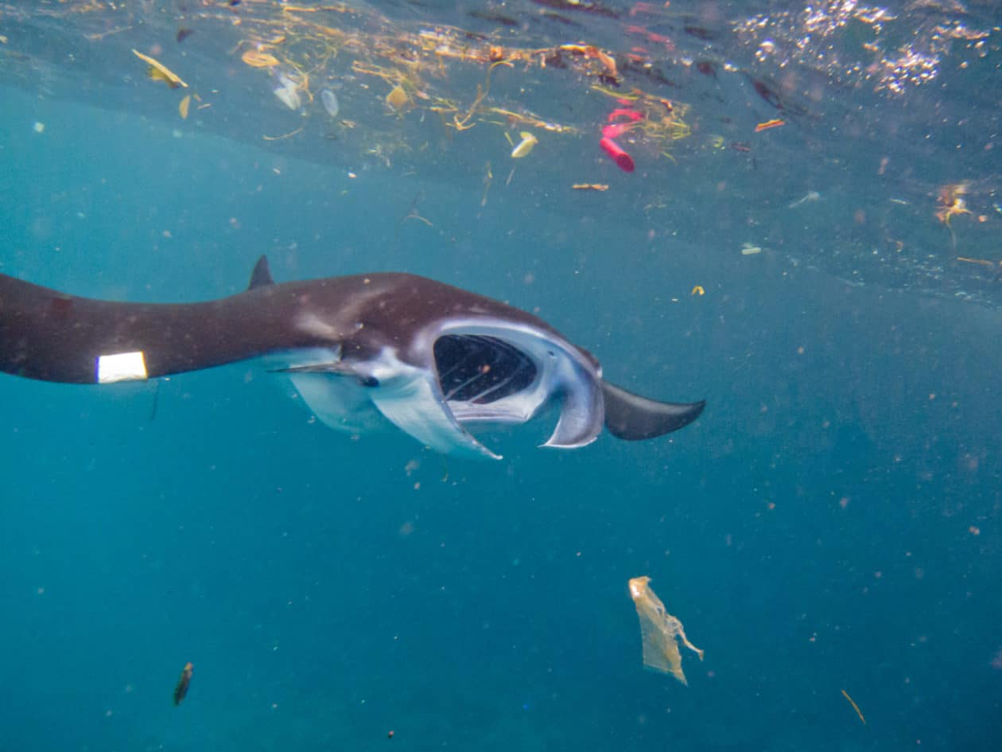
FOOD FOR THOUGHT…

Slide 24
“Microplastics can transfer up the food chain from fish to top predators, such as seals, reveals new research by Plymouth Marine Laboratory (PML), University of Exeter and the Cornish Seal Sanctuary.” Read more at: https://phys.org/news/2018-02-evidence-consume-microplastics-prey.html#jCp

Slide 25
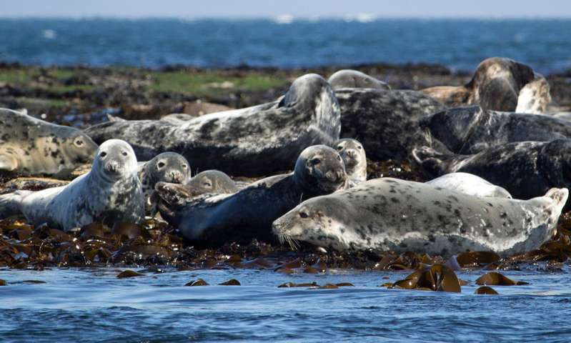
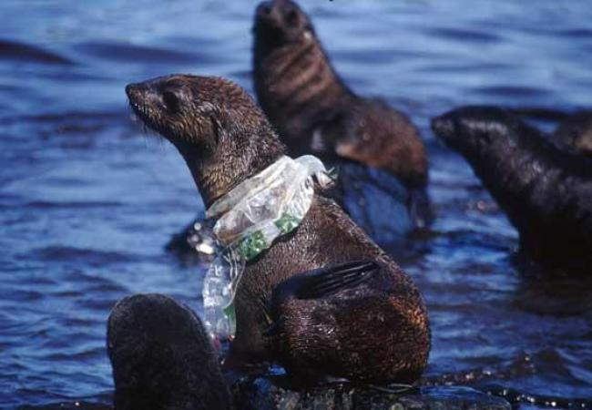
PLYMOUTH MARINE LABORATORY, FEBRUARY 2018

Slide 26
HUMAN HEALTH – ARE WE EATING PLASTIC?
SCIENTISTS HAVE FOUND MICROPLASTIC IN 114 AQUATIC SPECIES WITH MORE THAN HALF ENDING UP ON DINNER PLATES.
SMALLER THAN 1/5 OF AN INCH
Shrimp and bi-valves have plastic fibers, fragments or microbeads.
Studies suggest that patches of floating plastic trash might act as olfactory traps for susceptible marine wildlife such as seabirds. Those species that have evolved to use dimethyl sulfide (DMS) as a sign of food can be tricked by marine plastic debris that also emits DMS.”

Slide 27
FRESH WATER RESEARCH ON THE RISE

Slide 28
“Endocrine disruptors may be found in many everyday products– including plastic bottles, metal food cans, detergents, flame retardants, food, toys, cosmetics, and pesticides. NIEHS supports studies to determine whether exposure to endocrine disruptors may result in human health effects including lowered fertility and an increased incidence of endometriosis and some cancers.”

Slide 29
WHAT ARE WE DOING?
Single-Use Plastic Reduction Committee

Slide 30
BYOBAG MCHENRY COUNTY 2/3 of towns have have had BYOBag proclamations since October 2014.
VILLAGE OF ALGONQUIN
CITY OF HUNLTEY
VILLAGE OF LITH
CITY OF CRYSTAL LAKE
CITY OF MCHENRY
VILLAGE OF SPRING GROVE
VILLAGE OF ISLAND LAKE
CITY OF WOODSTOCK (YEAR-LONG)
COUNTY WIDE IN AUGUST 2016
FIRST ORDINANCE IN MCHENRY COUNTY: City of Woodstock

Slide 31
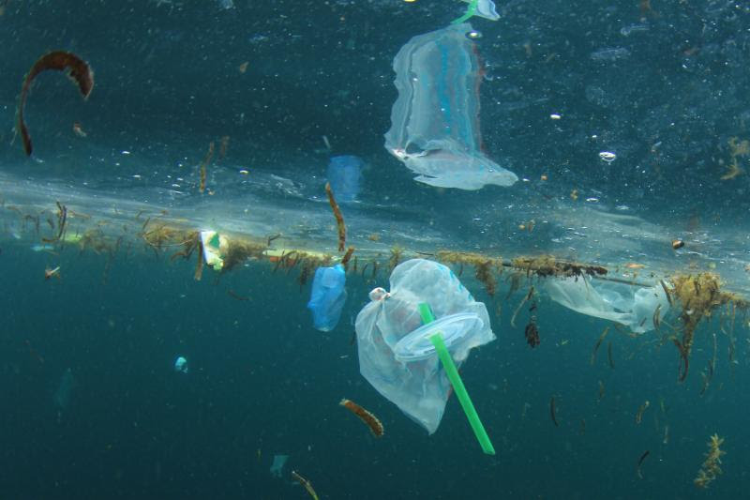
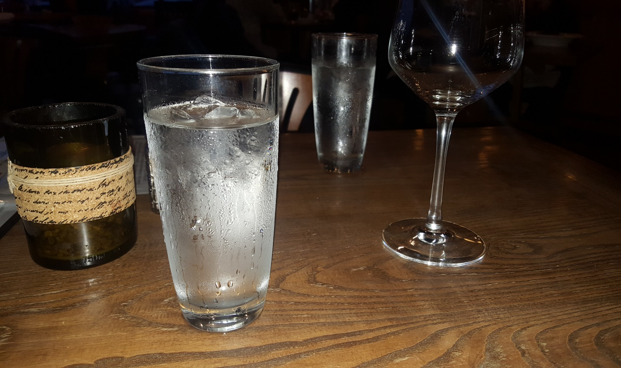
THE LAST STRAW PROJECT

Slide 32
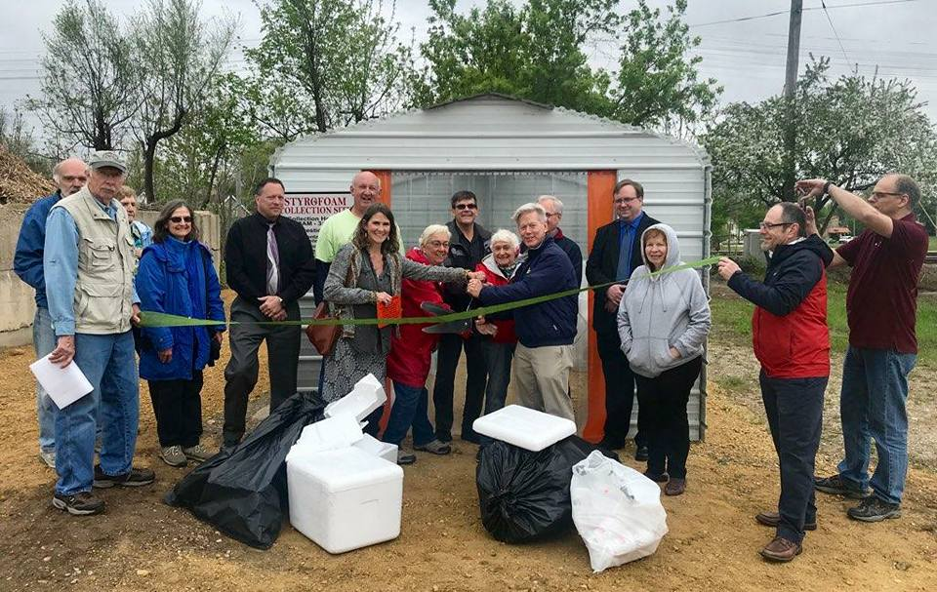
STYROFOAM COLLECTION & REDUCTION PROGRAM

Slide 33
HUMAN & ANIMAL WELFARE
WHAT CAN YOU DO?

Slide 34
CLIP SIX-PACK PLASTIC WASTE

Slide 35
CLIP MILK BOTTLE RINGS

Slide 36
DECLINE THE PLASTIC BAG

Slide 37
GO REUSABLE..NOW

Slide 38
IT’S OUR RESPONSIBILITY

Slide 39
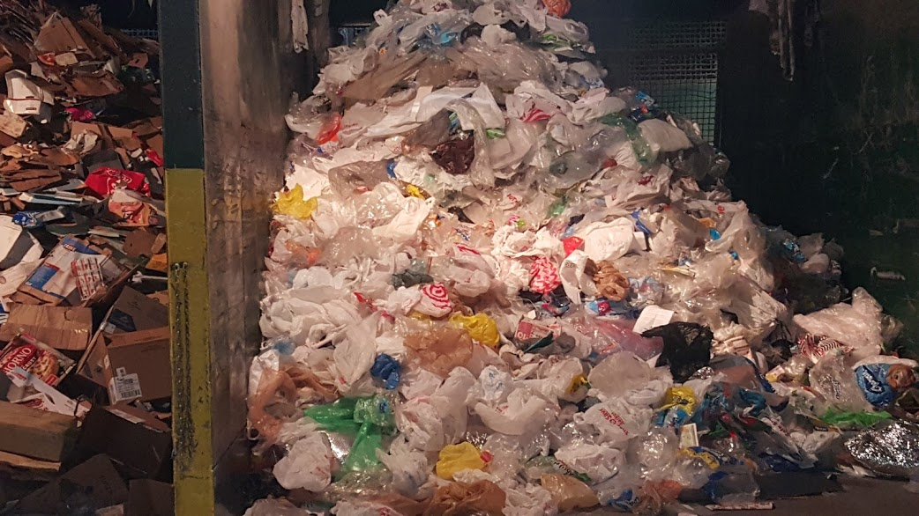

Slide 40
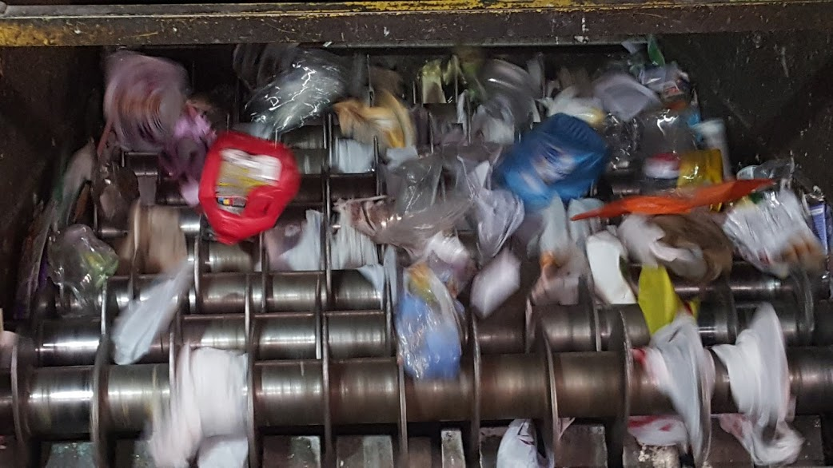
GRAYSLAKE WM SITE…IT COSTS NEARLY $1,500 PER HOUR WHEN MACHINES FORCED OFF

Slide 41
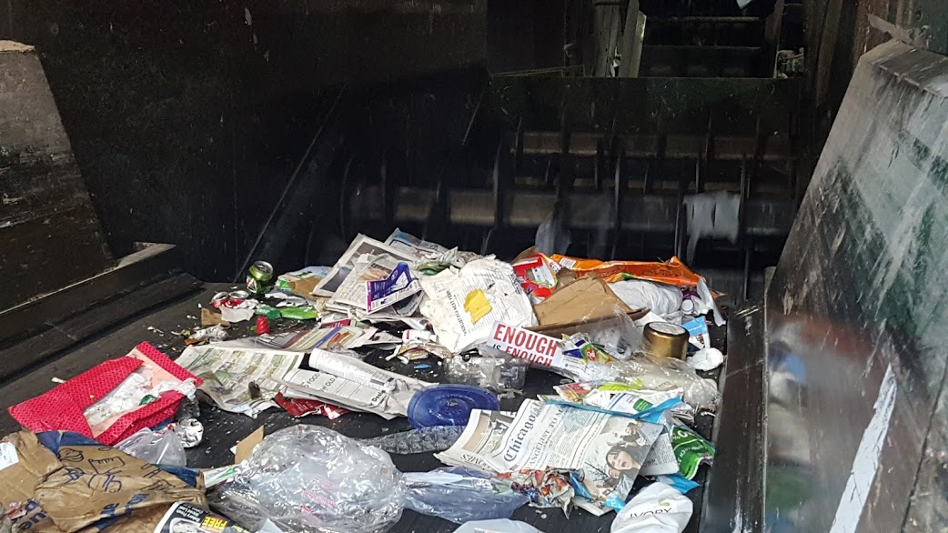

Slide 42
INDUSTRY MUST MOVE TOWARD COMPOSTABLE ITEMS AND AWAY FROM PLASTICS
WHAT CAN WE DO?
SUPPORT LEGISLATION THAT REDUCES SINGLE USE PLATIC WASTE
BRING YOUR OWN BAG
NO THANK YOU TO STRAWS
BRING YOUR OWN REUSABLE WATER BOTTLE AND COFFEE CUP WHEREEVER YOU GO
BE CONSCIOUS OF PLASTIC PURCHASES..LOOK FOR LESS!
PICK UP WHEREVER YOU SEE PLASTIC DEBRIS

Slide 43
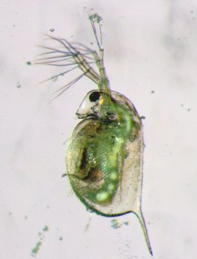
WATER PLANET: OUR CLOSED SYSTEM FROM THE TINIEST INHABITANT TO THE LARGEST.

Slide 44
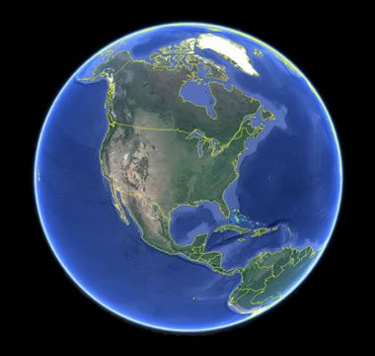
OUR WATER PLANET: EARTH

