Slide 1
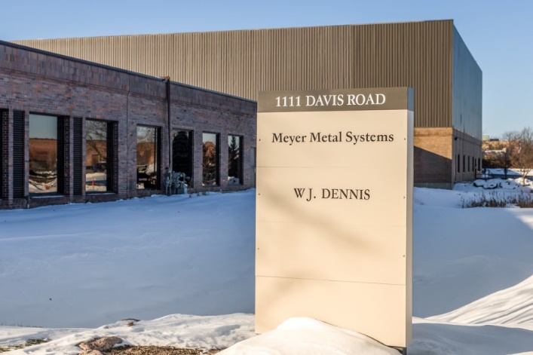
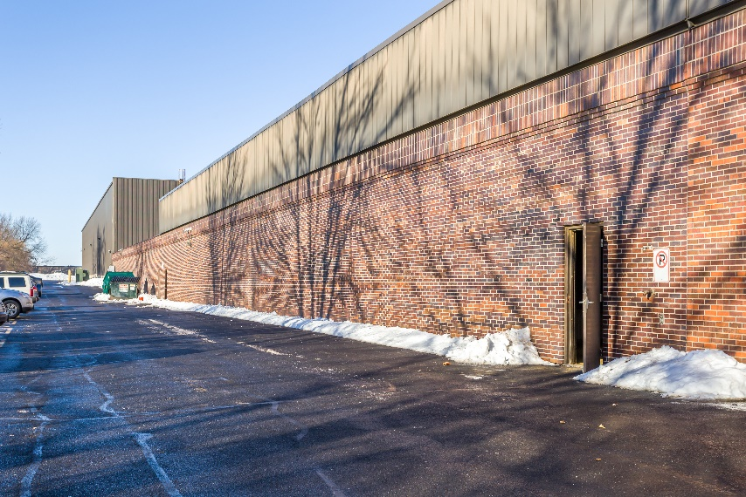
1111 DAVIS SOLAR

Slide 2
Preliminary Design – 1,188-kWp

Slide 3
Community Solar (up to 2-MWp)
Jobs Energy Act–
Federal ITC Credit- 30%
SRECs- 15 year strips paid in the 1st 4
IPA- one time incentive
Sell the power at a profit “Roofless”
Run by utilities- paid for by YOU
Add it all up roughly put in 1, get app 2 out plus ongoing renewable free power
Sec 1-75(c)(1)(N) (p 101)

Slide 4
The TEST
Buy a building- $3.5M
Partner with a developer / designer / engineer
Build a $5.5M Utility scale RETAIL system on the roof
One of if not the 1st in the state to test the new laws
Take proof and rapidly replicate with $50-$100M of projects
Sec 1-75(c)(1)(N) (p 101)

Slide 5
What I want from my group
Devise a strategy to rapidly move forward assuming test plays out including: (In code this means all the crazy things swirling around in my ADHD head right now-
Investors- what kind of returns we offer and when paid?
Buy the buildings / use banks to build solar?
Goto existing building owners and “rent” their roof like cell towers used to?
Use investor companies to essentially risk no capital but reduce profits?
Farms?
Exit Strategy- what to do with all these fully paid off power plants?
Potentially a new class of commercial real estate
Sec 1-75(c)(1)(N) (p 101)

Slide 6
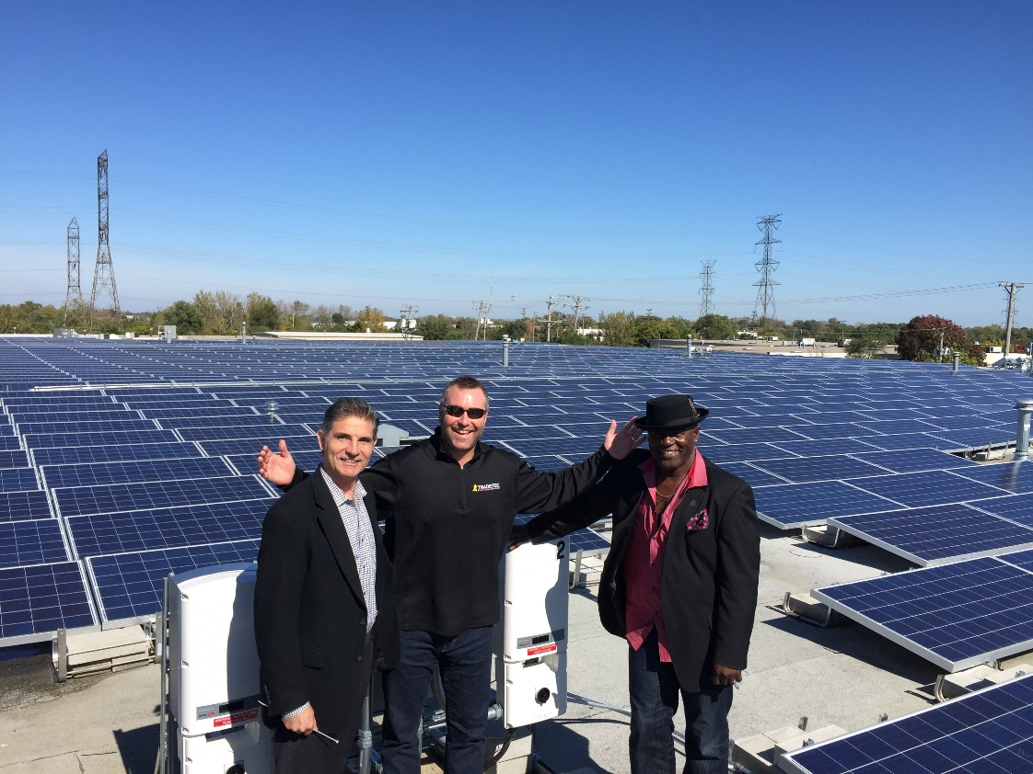
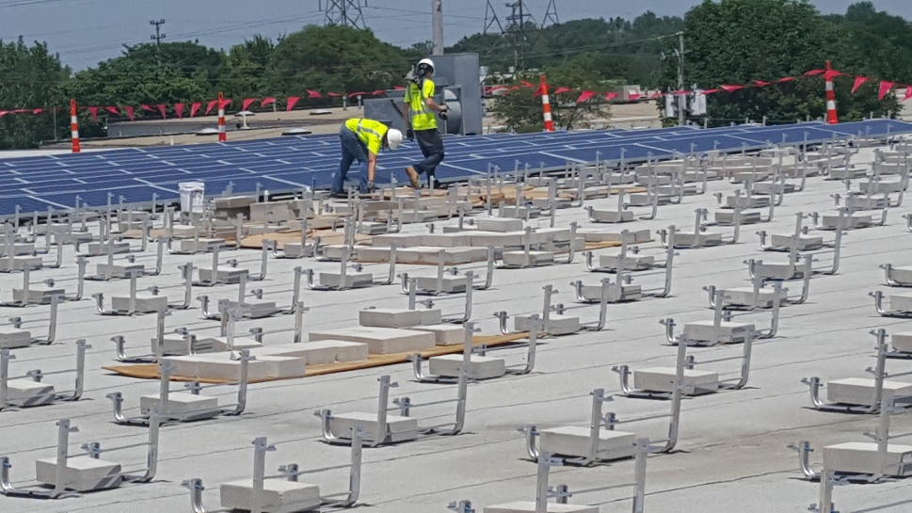
Rainy Solar Project: TradeTec 2 ROOFTOP SOLAR PLANT

Slide 7
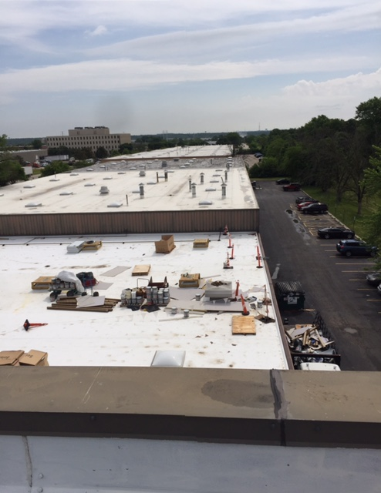
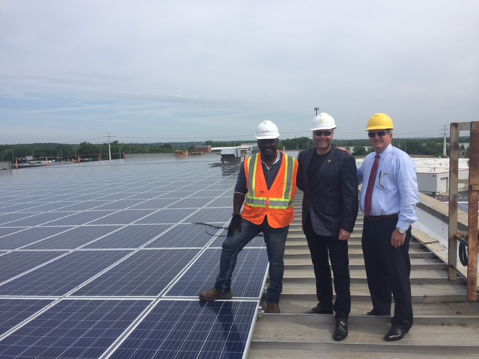
Building right now- Field TRIP!!
Sec 1-75(c)(1)(N) (p 101)

Slide 8
Building right now- Field TRIP!!
Sec 1-75(c)(1)(N) (p 101)

