Slide 1
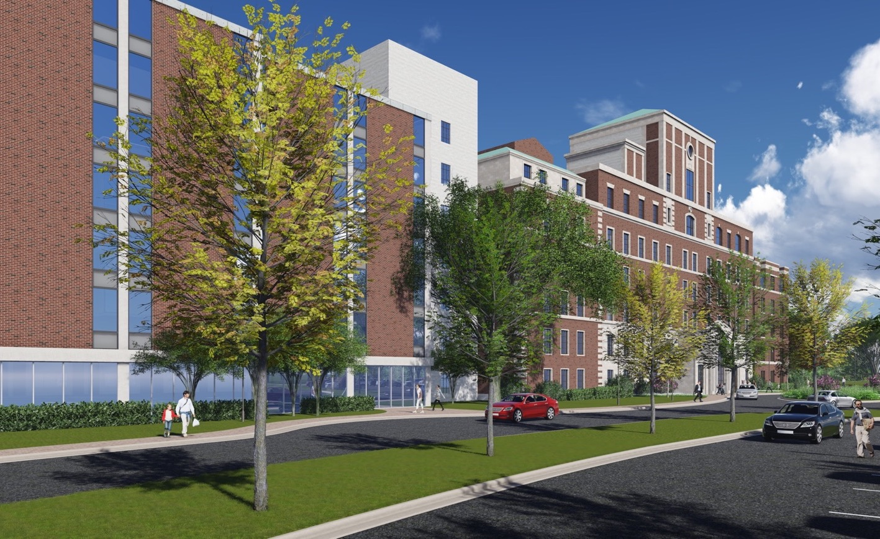

foxvalleydevelopers.com
Fox Valley Sustainability Network
-November 21, 2019

Slide 2

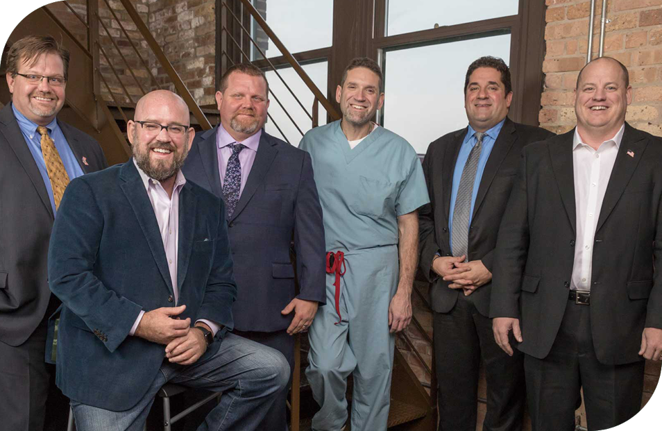
v
INTRODUCING FOX VALLEY DEVELOPERS
Fox Valley Developers is an Aurora-Centric group of business leaders who have come together with the shared purpose of preserving, restoring and repurposing the historic campus to transform and renew the Bardwell neighborhood.
The partners in the group are three sets of brothers who all share deep connections to Aurora and have achieved professional success in their respective fields.
After watching the Bardwell Copley campus decay over the past several decades, these life-long friends decided to do something about it and offer the City of Aurora a new path that would deliver immediate results for the community.
We assembled team of complimentary advisors to make redevelopment of the campus a reality.
www.foxvalleydevelopers.com

Slide 3
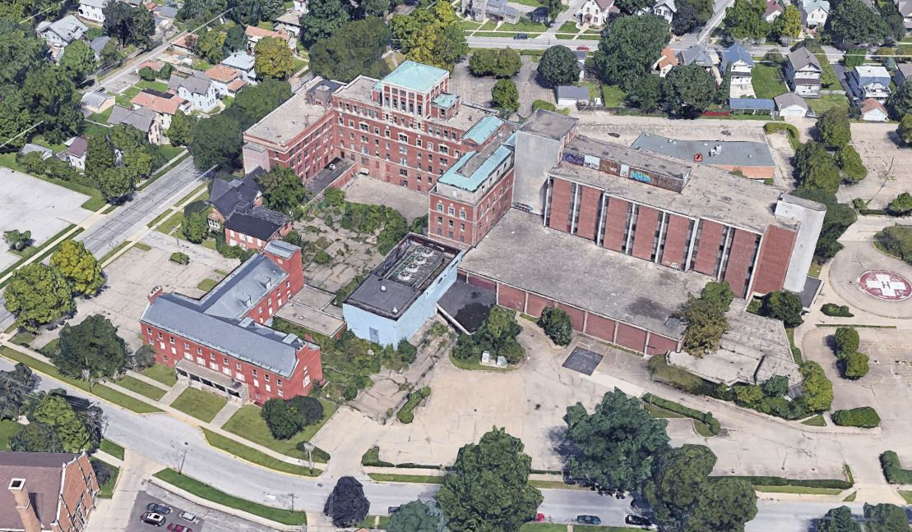
1916 Block
1932 Block
1947 Block
1888 Block
1970s Block
1957 Nurses Dormitory
1932 Power House – Demolished
1980 Block (Cancer Center)
– Demolished
The Problem: Decades In The Making
The campus sat abandoned and fell into a state of disrepair. Toxic legacy building materials were adjacent to the Bardwell elementary school.
| 3

Slide 4
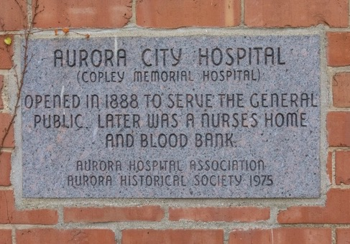
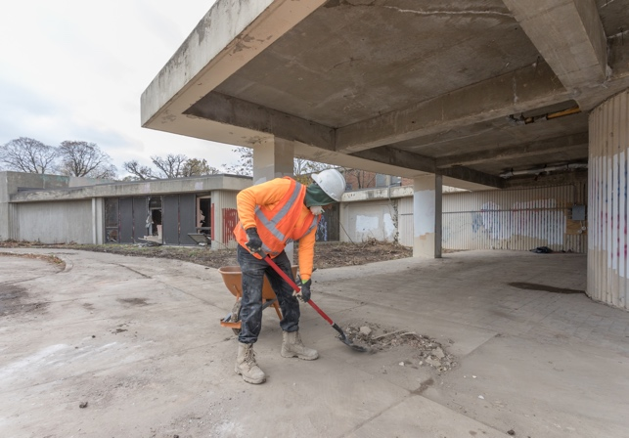
The History Of the Property
Vacant for Decades
The property sat vacant for decades falling into despair and suffering from extreme decay and vandalism. Fox Valley Developers began cleaning, remediating and preparing the campus for development in fall of 2018.
Campus Dates Back To 1888
The legacy campus is a historically landmarked former hospital that dates back to 1888. In total, nine structures were erected between 1888 and 1980, before the nine-acre property was vacated by Rush-Copley Hospital in 1995.

Slide 5
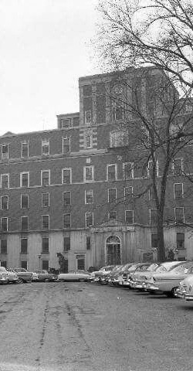
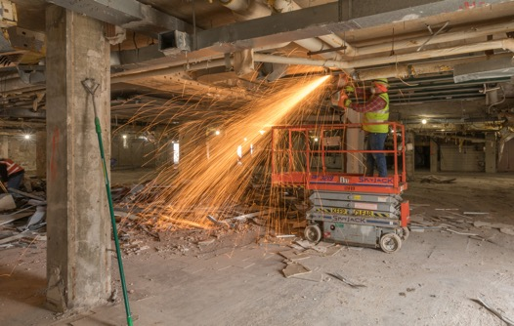
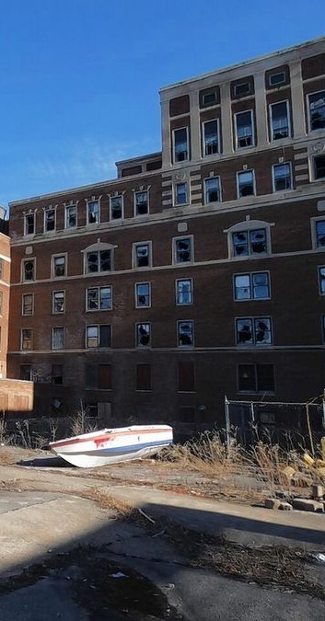
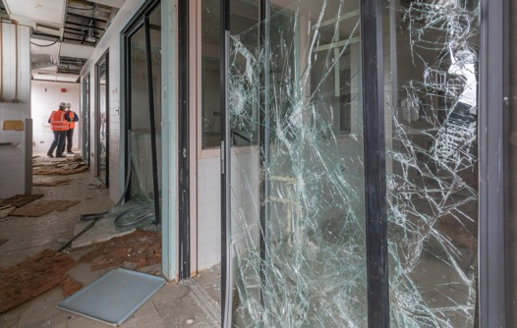
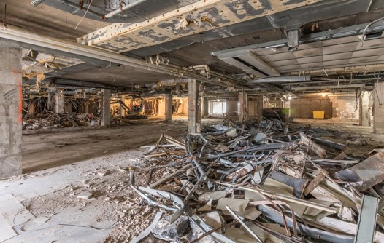
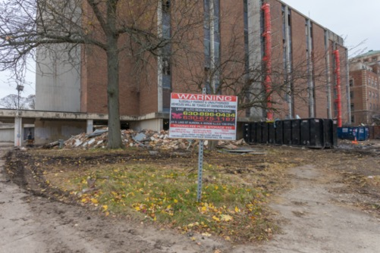
A Labor Of Love

Slide 6

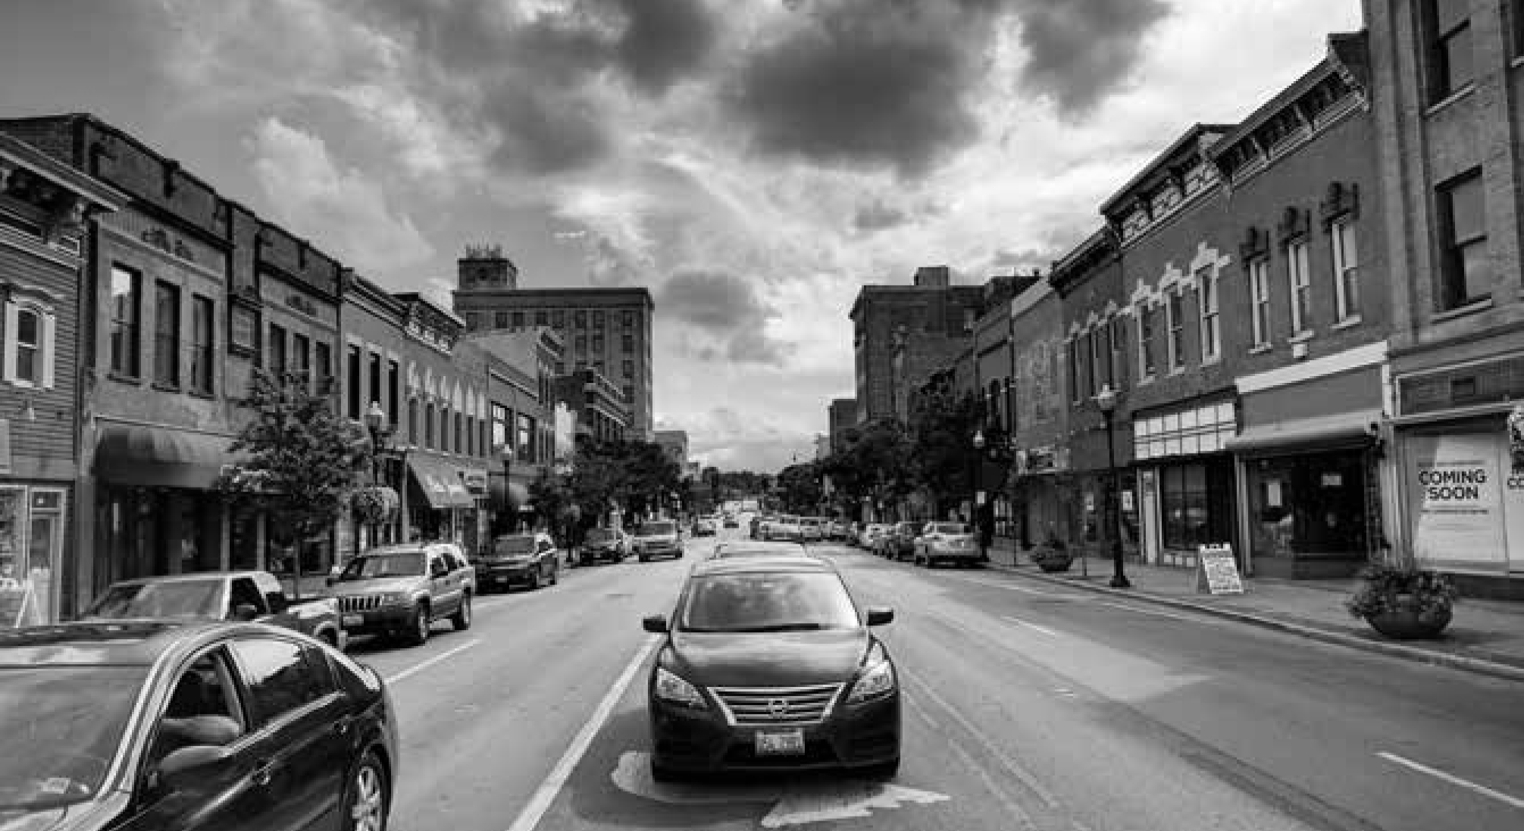
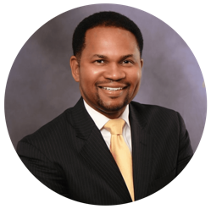

From Mayor Richard Irvin
“
The Rebirth and Rebuilding of Bardwell:
After decades of decay and delay, the City of Aurora is taking definitive steps to ensure that the Bardwell neighborhood is no longer burdened with an abandoned hospital campus. We are bringing together all our partners to create a new community in this neighborhood that returns pride, prosperity and purpose to this historic campus.
| 6

Slide 7

Adaptive Reuse:
The Planned Transformation
| 7

Slide 8
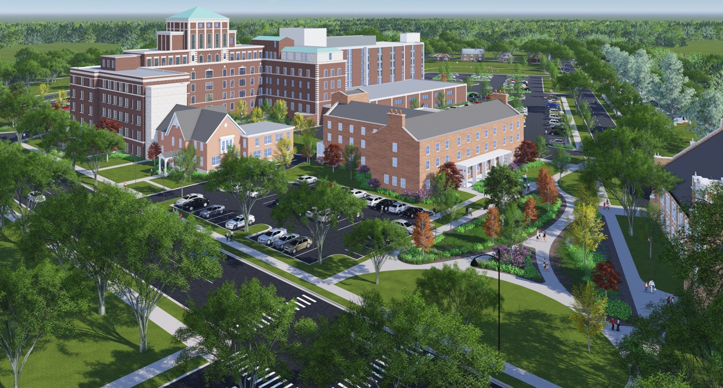
The upper four floors of the1970s Block will be renovated into an independent apartment community – Aurora Life.
The 1916, 1932, and 1947 Blocks will be renovated into Gardant Senior Living Community Housing; a mix of Independent, Assisted Living, and Memory Care.
The lower two floors of the 1970s Block will house a variety of health services including an Urgent Care and Surgery Center.
The 1888 Block will be restored, potential uses include a Pharmacy and additional spaces to support the Senior Living Community.
The current asphalt paving will be removed at the center courtyard and redeveloped into a landscaped amenity space including a single story addition to for a new dining room space.
The 1957 Nurses Dormitory will become the new Administrative Center for East Aurora School District 131 and will include a building expansion.
| 8

Slide 9
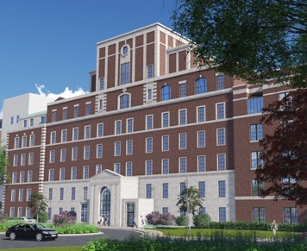
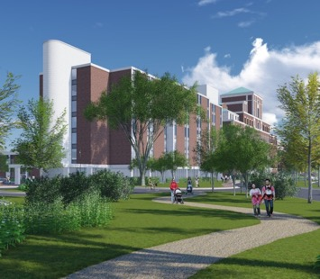
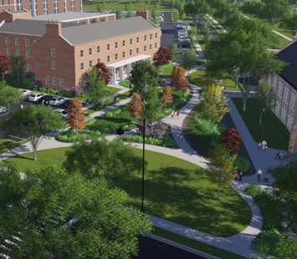

The Transformation:
Up to 155 residential units
Up to 102 Units
53 Units
Education & Health Care
Senior Living Residences: Up to 102 apartments serving the aging population with a mixture of independent, assisted-living and memory care units available.
Aurora Life: An Independent Apartment Community: A 53-unit apartment community to serve adults with cognitive and developmental disabilities with low support needs (I/DD).
Commercial: Commercial space used for education and medical offices. East Aurora School District #131 has a lease. The envisioned health care services for residents are an urgent care center, various medical offices and surgery center.

Slide 10
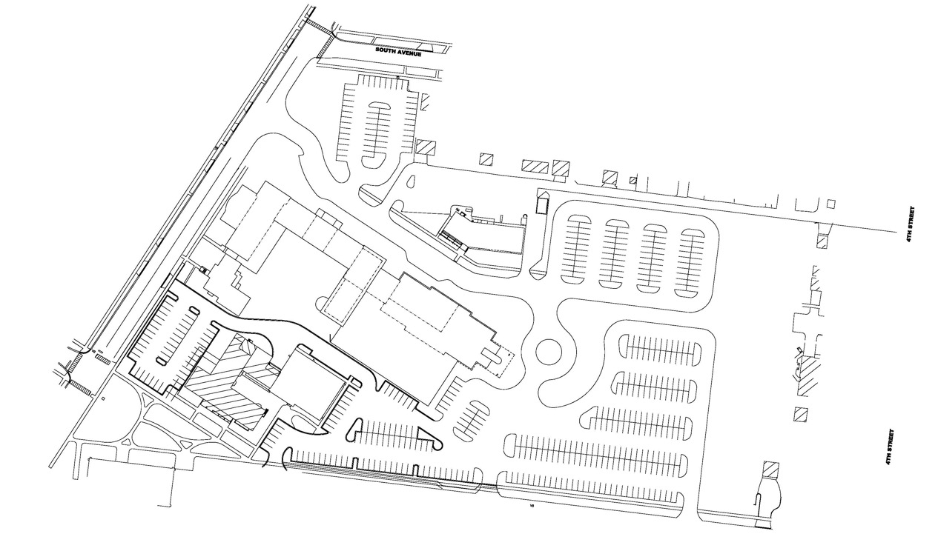
South Avenue
Realign the vacated Weston Ave to serve as the main entry to the campus
New green space to become neighborhood park
Lincoln Avenue
Maintain the existing helipad as a site feature at the center of a round-about
New connection and park entrance for Bardwell Elementary and EA HQ
Seminary Avenue

Slide 11

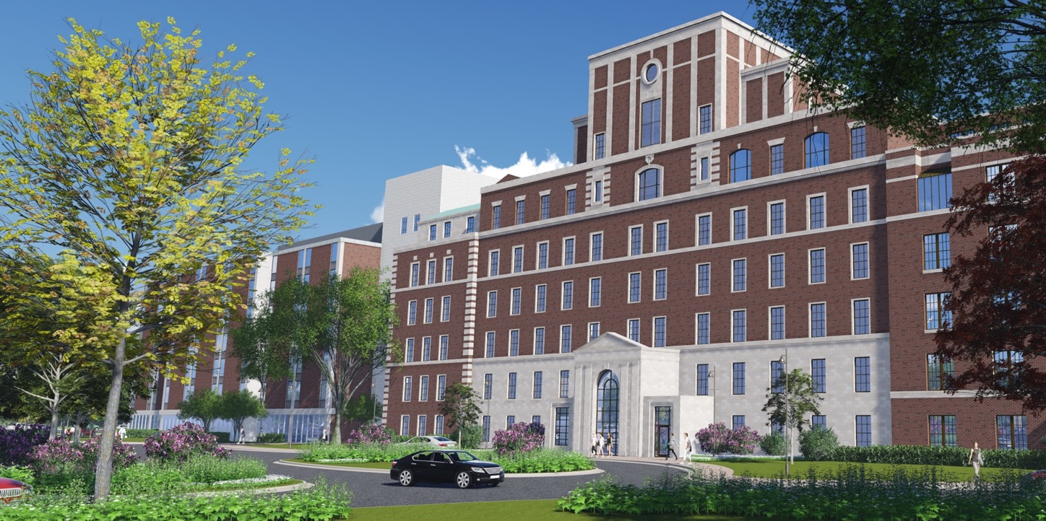
A Renewed & Repurposed Campus:
We fundamentally believe that reinvesting and repurposing this historic structure – rather than see it torn down, was the most sustainable and appropriate path forward. The renewed campus:
Utilized building material debris and repurposed it on site as filler in portions of the basement– rather than sending it to a landfill, etc.
PACE - Modern and efficient HVAC, plumbing, electrical, etc. – an entirely new campus within the historic structure
Partnership with OnLight Aurora for ultra-high speed connection, enabling deployment of ‘internet of things’ tools in senior living, IAC and across the entire campus
| 11
| 11

Slide 12
New Public Amenities
| 12
| 12

Slide 13

Unlock The Potential Of
The Bardwell Neighborhood
Through this partnership, a campus that suffered endless delay and decay for a quarter-of-a-century will be redeveloped with the following additional public benefits:
  New consolidated headquarters for East Aurora school district
  New public parks and open space in Bardwell neighborhood
  Provide neighborhood access (once again) to health care through new medical center
  One-time economic stimulus from construction
  Permanent economic benefits from new jobs and disposable income
  Creation of a new Innovative Living Community
| 13

Slide 14
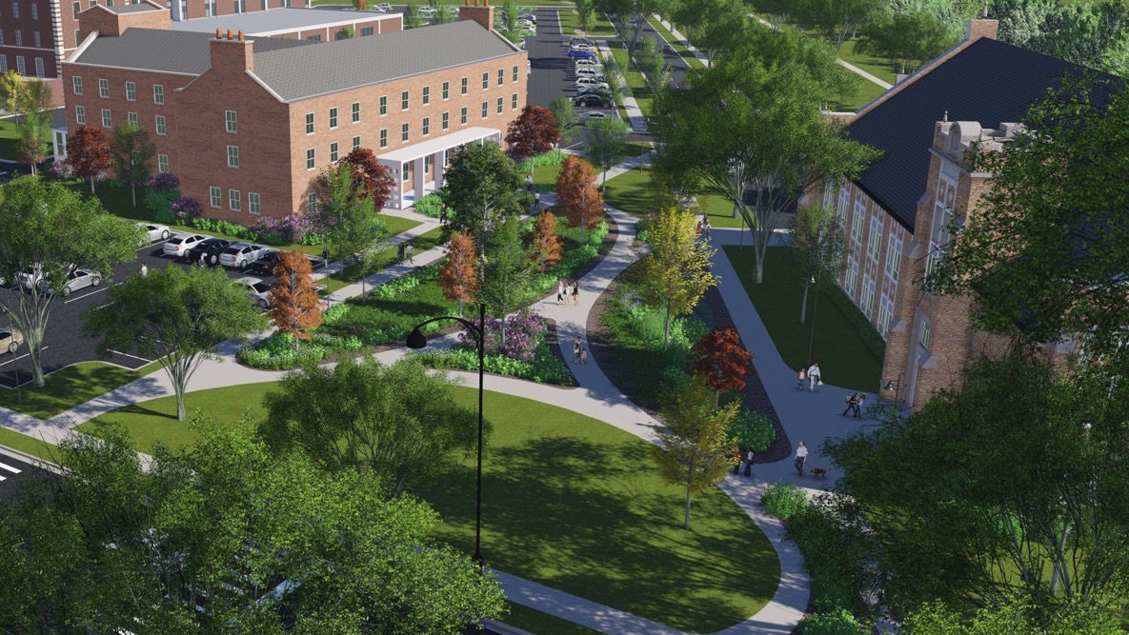
The Administrative Center and Bardwell Elementary will be be connected through a new open space park through the already-approved intergovernmental agreement.
| 14

Slide 15
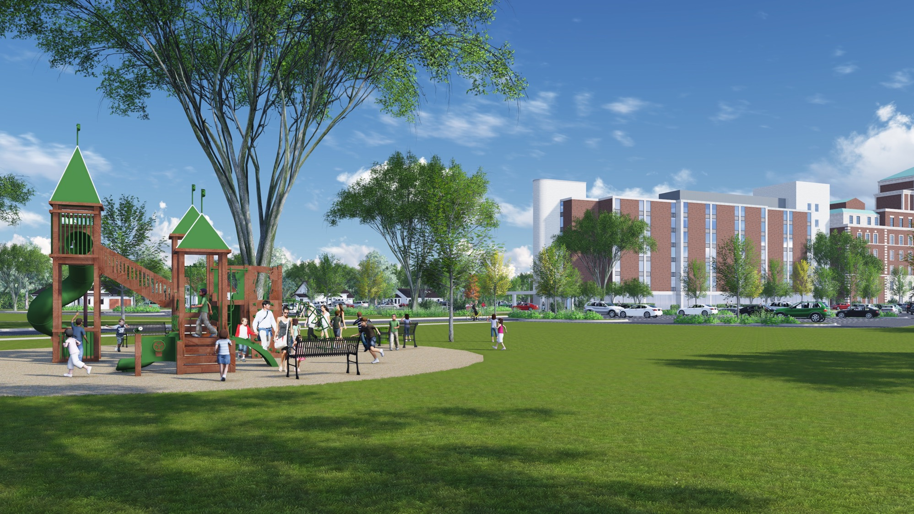
FVD acquired adjacent land and master planned for additional parks to address a deficiency in the area.
| 15

Slide 16
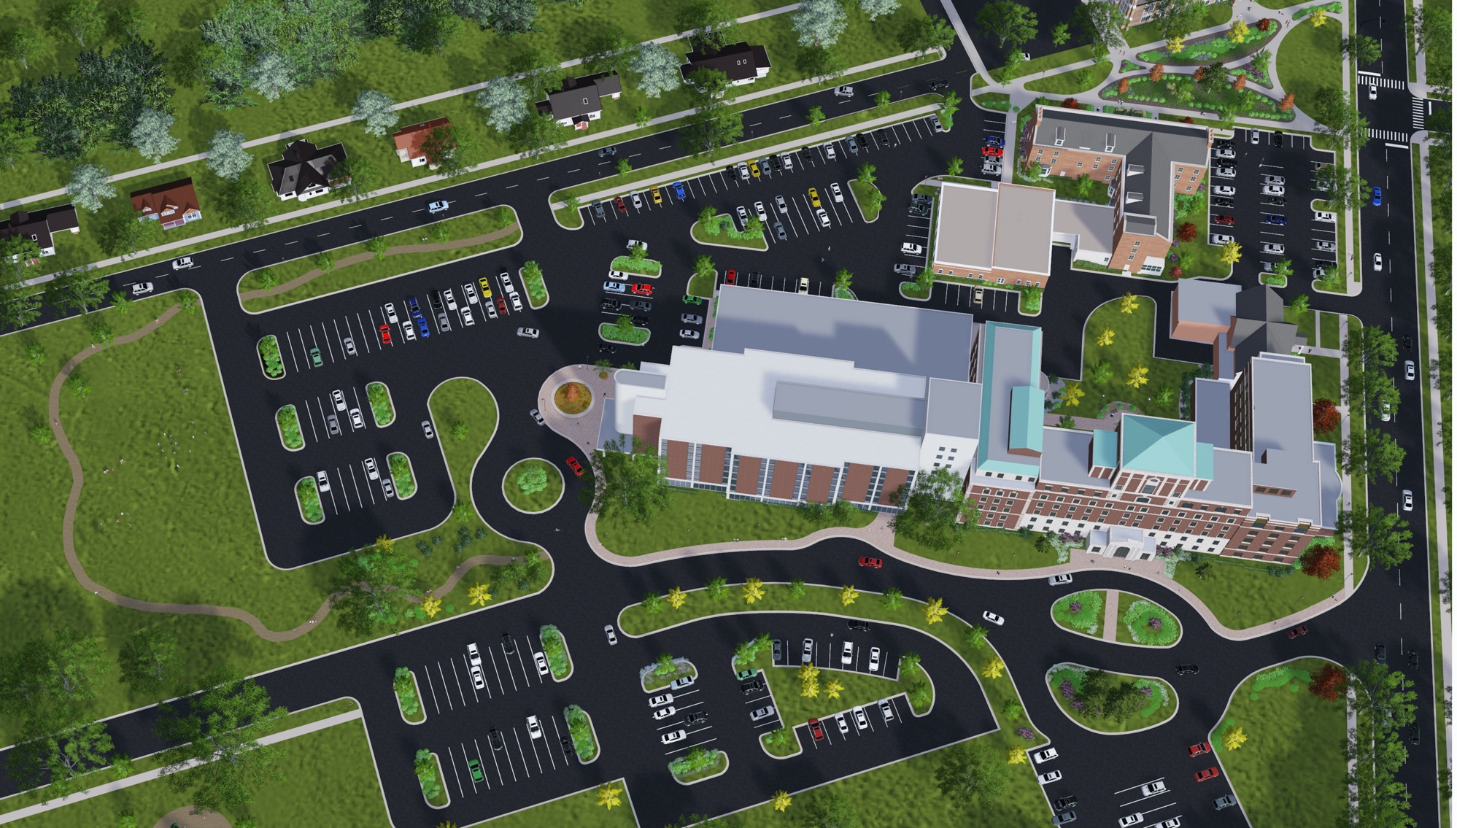
The adaptive reuse will reconnect the campus to the neighborhood, increasing walkability, livability and improving the quality of life for the entire neighborhood.
| 16

Slide 17
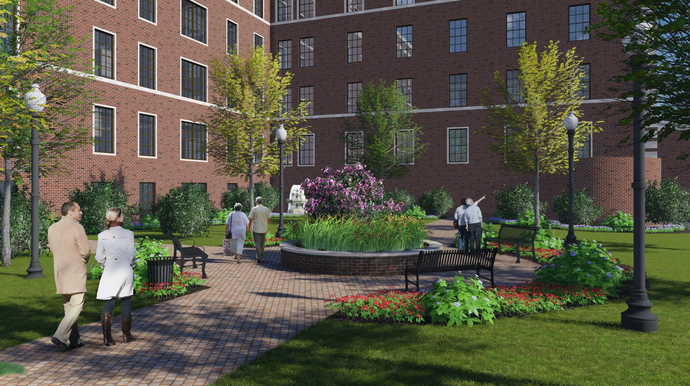
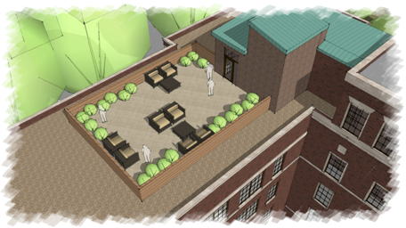
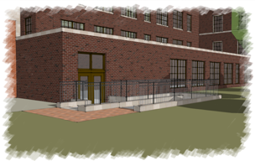
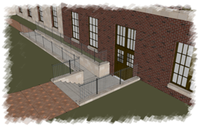
Campus Design Enhancements
View of Roof Top Courtyard
Courtyard Ramp Concept
| 17

Slide 18
The Critical Role of
Tax Credits

Slide 19
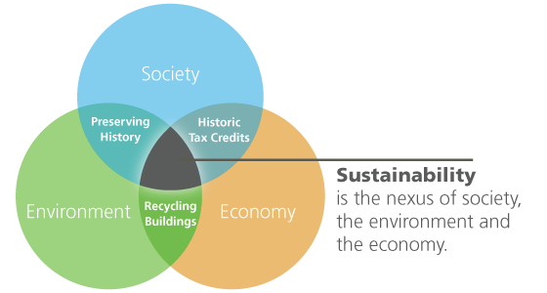
Historic Tax Credits
“The greenest building is the one that’s already built.”
Source: https://www.nps.gov/tps/sustainability.htm
| 19

Slide 20
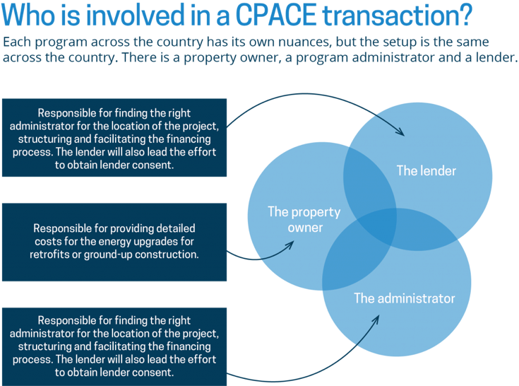
Kane Energy Efficiency Program –
Commercial Property Assessed Clean Energy
We are excited to utilize the KEEP / C-PACE program to help make this historic campus energy-efficient.
We hope to be a demonstration project for other property owners in the area and encourage others to take advantage of this new opportunity.
| 20

Slide 21
Adaptive Re-use Spurs
Economic Impact

Slide 22
It’s Not A Cost – It’s An Investment
There are some that view projects like this as a cost, burden or obligation for local leaders. We believe that re-use should be a catalyst for renewed prosperity and deliver clear benefits to the community.
It’s not a cost – it’s an investment in a brighter future, with clear and quantifiable economic benefits!
| 22

Slide 23

Reuse = Renewed Economy
$52.5 Million in new local personal income between 2019-2021
$21.7 Million of additional indirect and induced spending in economy during construction
The renewed campus is projected to create $16.9 million in annual local labor income for area residents
By 2026, the campus’ annual property tax payment will be the equivalent of 25 years worth of the property’s current property tax payment
Reinvestment in the property will create:
739
Jobs In The Community
| 23

Slide 24
Lessons Learned

Slide 25
What Adaptive Reuse Could Mean For Your Community
There are unique structures throughout our communities that can be repurposed and find new life. After decades of decay and delay, we are moving forward and delivering progress for the citizens of Aurora:
  P-P-P, public-private-partnership essential or it cannot be done
  Bring together experts who know every tool in the toolbox
  Establish goals for public benefits
  Re-use can spur one-time economic stimulus from construction
  Re-use can provide permanent economic benefits from new jobs and disposable income
  Creativity and determination can overcome obstacles and naysayers
| 25

Slide 26






Project Leadership
Fox Valley Developers
Project Development and Construction
Project Development and Strategy
Project Development and Operations
JASON
KONRAD
RUSSELL WOERMAN
MICHAEL POULAKIDAS
PAUL
KONRAD
DR. STATHIS POULAKIDAS
RONALD WOERMAN
JOHN
DAVIS
JOHN
JANSA
Strategic Advisors & Partners
BRACKET PARTNERS, LLC
John Hoffman, CPA
Project Consultant/Accountant
NEALIS & GARROW
Allan Garrow
Corporate Counsel
ANDY CONOVER, MEd
St. Louis Life
Aurora Life Founding Consultant
& Project Advisor
KONRAD CONSTRUCTION
General Contractor
MACKIE CONSULTANTS
Civil Engineering Services
STERLING BANK
Construction Lender
MACROSTIE HISTORIC
ADVISORS
Historic Tax Credit Advisors
VALERIE S. KRETCHMER ASSOCIATES
Valerie Kretchmer
Senior Housing Consultant
SMART POLICY WORKS
Aurora Life – I/DD Housing Strategy & Policy Advisor
KWCC, Inc.
Preferred Project Subcontractor
CORDOGAN CLARK
& ASSOCIATES
Architects & Engineering Services
MAHONEY, SILVERMAN
& CROSS, LLC
Project Attorneys
KLUBER ARCHITECTS
+ ENGINEERS
Mike Elliot & Jeff Bruns
Architecture & Engineering Services
COVETED FINANCIAL
SERVICES
Debt Finance Consultant
GINSBERG JACOBS, LLC
Darryl Jacobs
Historic Tax Credit Attorney
ENHANCED CAPITAL
National Asset Manager
(Capital Investment Firm)
PRISM HEALTHCARE
PARTNERS, LTD
Patrick Simmers
Health Care Center Consultant
GARDANT MANAGEMENT SOLUTIONS
Senior Living Management Firm

Slide 27
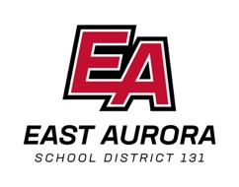






It’s Truly A Community Partnership
This project would not have moved forward without the partnership and support of local, state and national officials and programs. We are incredibly appreciative of the support of the following organizations and entities:

Slide 28
Thank You
foxvalleydevelopers.com

