Slide 1
Property Assessed Clean Energy” (PACE)
And the
Kane Energy
Efficiency Program
(KEEP)
Fox Valley Sustainability Network
February 8, 2019

Slide 2
Nationally known as
“Property Assessed Clean Energy” (PACE)
Kane Energy Efficiency Program
(KEEP)
Is more descriptive and would not be confused
with PACE Suburban Bus Service

Slide 3
What is KEEP and
Property Assessed Clean Energy ?
Is a voluntary program authorized by the State of Illinois in 2018.
Is a financing option for commercial property owners to fund energy efficient measures for their properties.
Offers 100% funding through local and state governments (Bonds).
Improvements are permanently affixed to the property.
Most commercial property types are acceptable including:
Retail.
Industrial Facilities.
Multifamily (greater than 4 units).
Hospitality.
Office.
Affordable Housing (greater than 4 units).
Other Types on Case-By Case Basis.

Slide 4
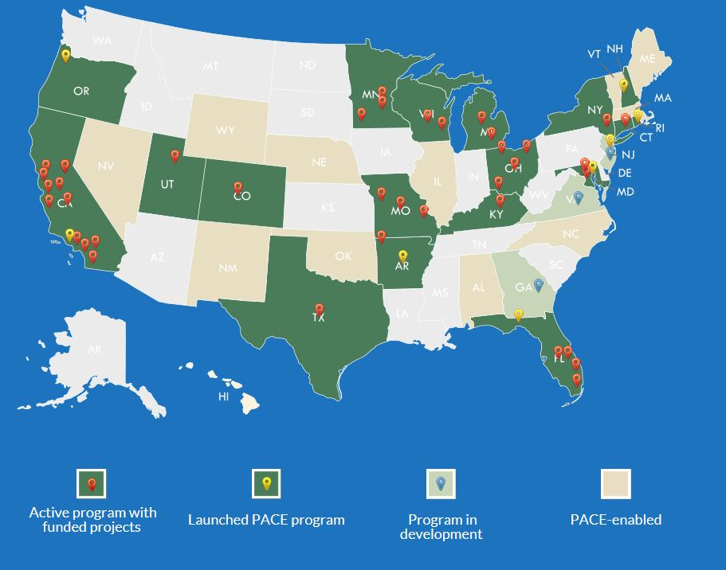
Property Assessed Clean Energy Nationally
Commercial programs are active in 16 states: AR, CA, CO, CT, FL, KY, MD, MI, MN, MO, NY, OH, RI, TX, UT, WI, and DC.
Residential PACE is offered in CA, FL, and MO.
States with PACE-enabling legislation: 33 plus D.C.
States with active PACE programs: 19
Municipalities with PACE programs: 2,500+

Slide 5
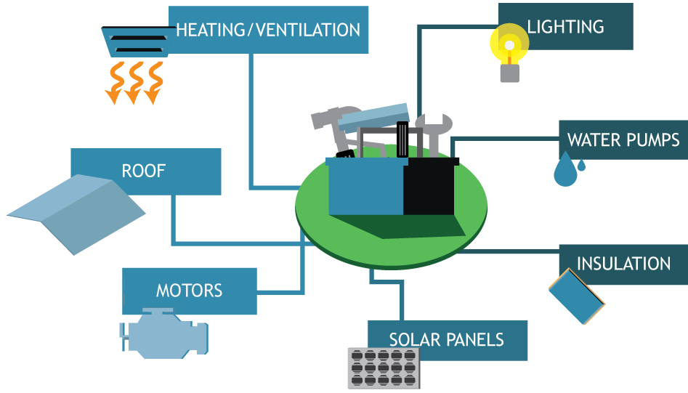
KEEP Eligible Improvements

Slide 6
KEEP Process
Purchase
Bond
Upfront Financing
Lender/
Investor
Government
Issues Bonds /
Administers Program
Real Estate
Borrows Funds
Bond Payment
Repaid on Tax Bill

Slide 7
Why KEEP? Property Owner Perspective
No upfront capital needed- 100% financing
Allows access to energy efficient technology, that might have been unavailable to the property owner before.
Energy savings can increase a property value and cash flow.
Lien runs with property not with property owner (non-recourse and off Balance Sheet).
Up to 25 years term fully amortizing.
Assessment term matches the useful life of improvements.

Slide 8
Why KEEP? County Perspective
$O net costs to “Issuer”/Government Body.
Economic development and job creation within the approved area.
Available to all constituents with qualifying properties.
Increased property value due to modernization.
Beneficial for environment.
Implements goals in the Kane County 2040 Energy Plan and the Kane County 2040 Plan

Slide 9
PACE Program Options
Program Self Administered by Local Government
Program sub-contracted by a local government to an independent administrator
This model has been put in practice when a local government recognizes the benefits and intends to make it available to property owners, but lacks the resources or expertise to sponsor a program in-house.

Slide 10
Kane Energy
Efficiency Program
(KEEP)
Launching in 2019
Administered by the
Illinois Energy Conservation Authority
(IECA)
As a third party administrator

Slide 11
PACE in Illinois
Updates thanks to Anna Maria Kowalik
SVP Dir Business Development
INLAND GREEN CAPITAL LLC
DuPage has also selected the IECA (Illinois Energy Conservation Authority) as Program Administrator and after a final vote (anticipated this month), IECA will be launching both programs with website, information, process, and documents
Inland Green Capital LLC is now accepting project opportunities for review of potential financing to be accomplished at the launch
The Cook County and the City of Chicago are working on their own PACE Programs
No other Counties have launched programs yet, so there are no other weblinks or other information available to the public
Will County is having discussions surrounding PACE
Lake County businesses have shown interest in participation in a Program

