Slide 1
Community Solar Clearinghouse Solution: Initial Assessment Review
The Power Bureau

Slide 2
Overview
Introductions
CS2 Program
CS2 Initial Community Reports
Conclusions

Slide 3
Introductions
Mark Pruitt
  Current - Principal, The Power Bureau
  Past
    Director, Illinois Power Agency
    Program Manager, Energy Resources Center
    Power Project Developer, Nicor Energy Solutions
  Other Activities
    Board Member, Midwest Renewable Energy Association
    Researcher, Argonne National Laboratory
    Advisor, Clean Energy Challenge
    Lecturer, Masters of Energy Engineering Program - University of Illinois

Slide 4


Community Solar Clearinghouse Solution (CS² Program) for Municipalities
Metropolitan Mayors Caucus
  Role: CS² Program Sponsor
  Objectives:
    Secure cost benefits for members
    Assist members meet Greenest Region Compact 2 goals
The Power Bureau
  Role: CS² Program Manager
  Responsibilities:
    Procurement – forming pools of buyers and sellers
    Contract management – facilitate contracts and billing

Slide 5
CS² Program: Solution to the Challenges of Community Solar in Illinois
Economics
Complexity
Low Subscription value
  Wholesale supply
  Wholesale supply + capacity
Subscriptions yield savings…sometimes
  Account size
  Supply arrangements
Long term Subscribers are required
  Cannot finance on short term Subscriptions
  Need credit rated Subscribers
Rules and Limitations
  40% maximum subscription
  Lottery (non-qualitative) project selection
Development Realities
  Very high interconnection costs may kill
  projects that are selected in the Lottery
Transaction Structure
  Lease, purchase, pay-as-you-go
  Subscription payment is new transaction

Slide 6
CS² Program: Overview
Community Solar Clearinghouse Solution (CS²)
Analysis
Procurement
Account Management
Create system to simplify Community Solar bill credits and payments
Competitive bidding to identify qualified community solar developers
Evaluate rules of Adjustable Block Program (ABP) by Illinois Power Agency
Identify how municipalities can best participate
Set a single price
Set common contract terms
Provide reporting and Subscription adjustment

Slide 7
CS² Program: Objectives
Promote Sustainability
Protect Consumers
Acquire community solar through a competitive process
Demonstrate progress towards GRC2 and ‘100% Renewable’
Support renewable energy development in Illinois
Facilitate billing and payment to ensure accuracy and value
Community Solar Clearinghouse Solution (CS²)
Capture Savings
Identify savings
Secure long-term cost savings through community solar subscriptions

Slide 8
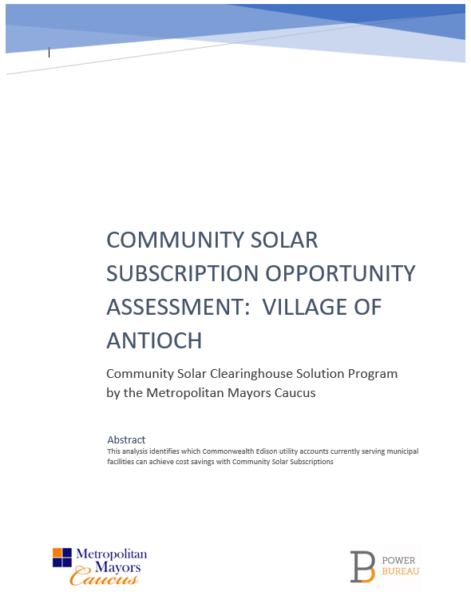
Initial Opportunity Assessment Reports
Free report for individual municipalities
Based on account information provided by municipality
Explains the community solar opportunity and identifies which accounts can achieve cost savings with Subscriptions

Slide 9
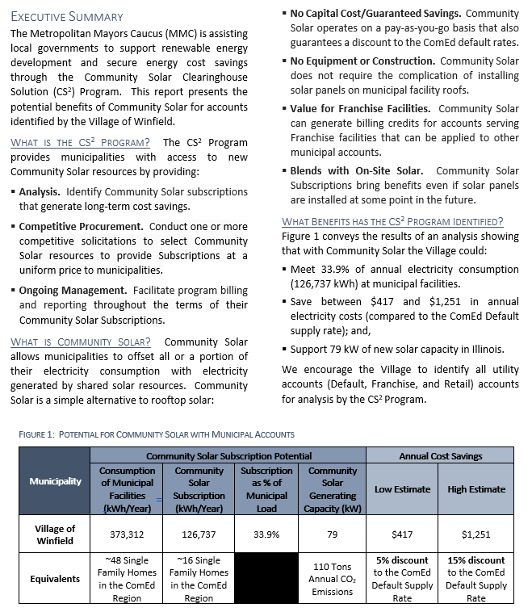
Initial Report: Executive Summary
2
1
3
CS² Program Services
General Benefits of Community Solar
Specific Benefits for Community
Summary Table
4

Slide 10
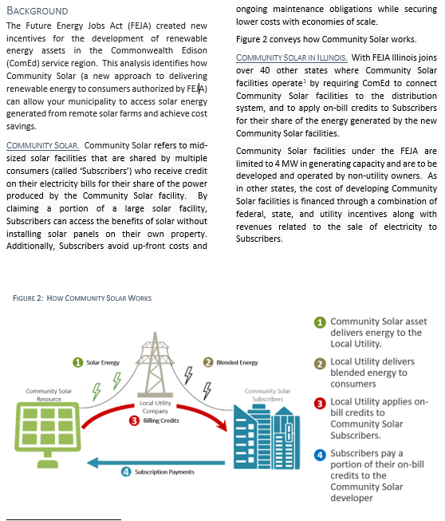
Initial Report: Background Section
2
1
Community Solar Subscriptions
Future Energy Jobs Act (FEJA) and Community Solar resources
General Community Solar Subscription structure
3

Slide 11
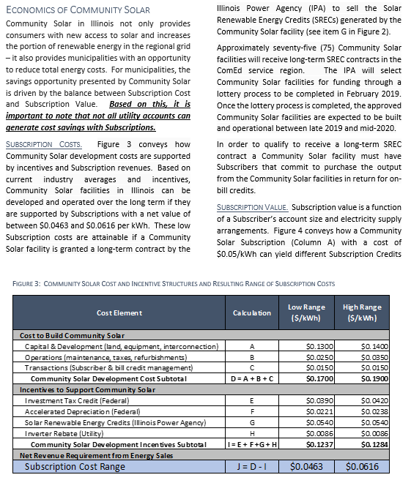
Initial Report: Subscription Costs
1
3
Economic Value definition for Community Solar
Basis for Community Solar Subscription Costs
Role of Community Solar Subscribers
2

Slide 12
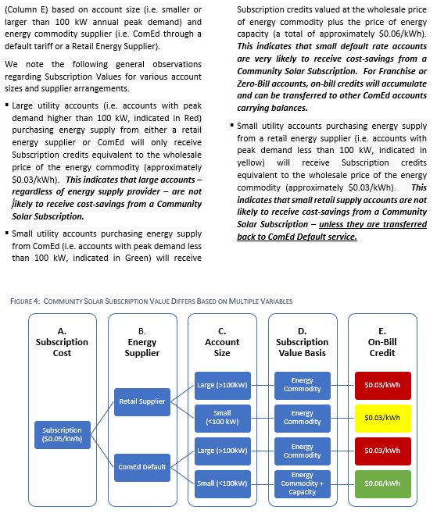
Initial Report: Subscription Benefits
3
2
4
Basis for Subscription Credit Value
Economics for large accounts (>100 kW)
Economics for small accounts (ComEd)
Economics for small accounts (retail supplier)
1

Slide 13
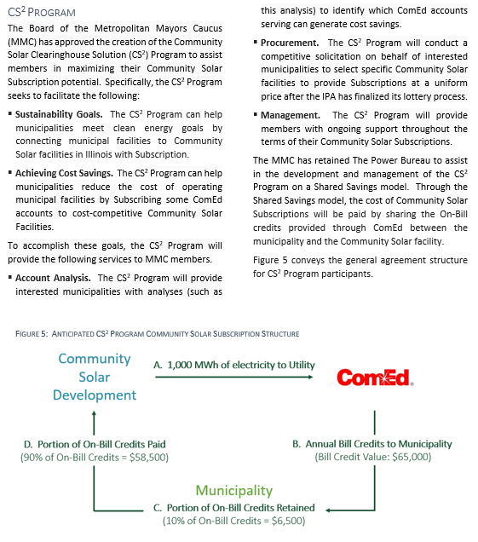
Initial Report: Subscription Benefit Delivery
2
Shared Credit Approach
  Municipality - retains a portion of the monthly Subscription bill credits (5-15%). This provides a NET savings for the municipality on the ComEd rate.
  Developer - receives remainder of monthly Subscription Credits in lieu of Subscription payments.
Procurement Process will set the municipality share of Subscription Credits
1

Slide 14
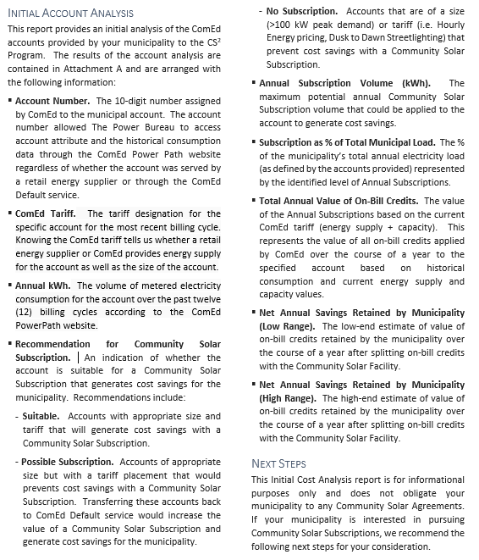
Initial Report: Analysis & Recommendations
3
1
4
Data we used
Positive recommendations
Negative recommendations
Metrics for recommendations
2

Slide 15
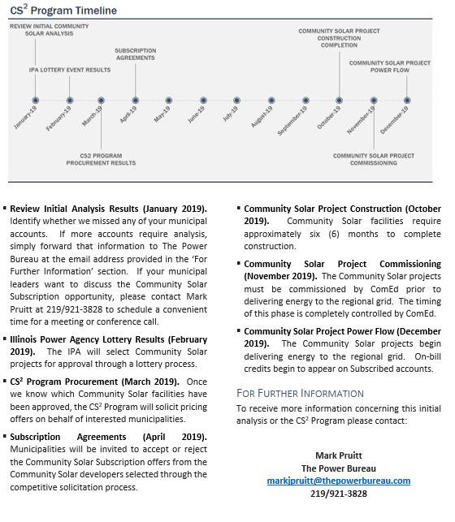
Initial Report: Analysis & Recommendations
4
IPA Process
CS² Procurement
Agreements
Construction
Commissioning
Flow of Power and Credits
5
1
6
2
3

Slide 17
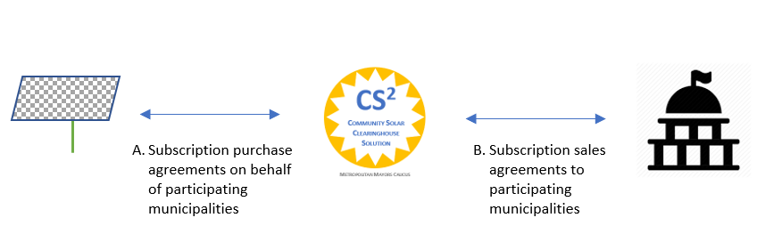
Other Benefits: Simplified Contracting
CS² Program is central counterparty
Benefits For Municipalities
  No need for multiple Subscription agreements
  Allows adjustment of subscription levels and account assignment
  No credit posting
Benefits for Developers
  Single agreements
  Expedites Subscription assignment and management
Solar Developers
Municipalities

Slide 18
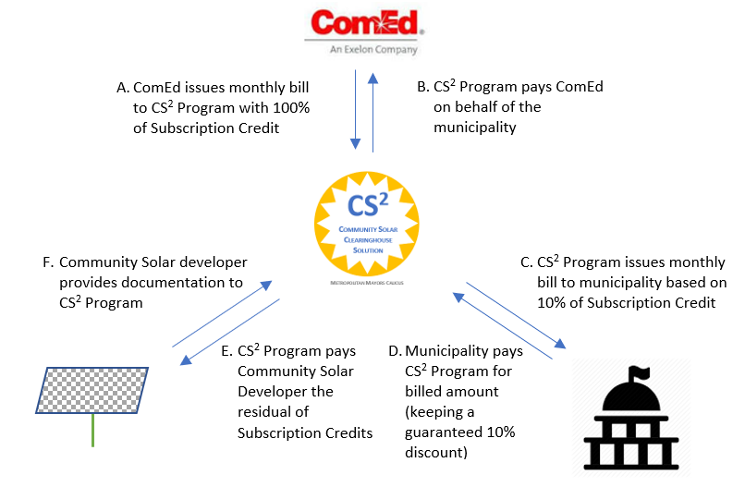
Other Benefits: Payment Management
CS² Program is central counterparty
Benefits For Municipalities
  No additional billing or payments to manage
  Subscriptions are paid from savings
  Guarantees delivery of discount before payments to Developers
Benefits for Developers
  More simplified and stable revenue flow

Slide 19
Conclusions
Municipalities
  Are the stable and creditworthy Subscribers that Community Solar developers are seeking
  Can capture billing credits on paid accounts to reduce total monthly invoices
  Can capture billing credits on Franchise accounts (then transfer credit balances to paid accounts)
CS² Program
  Performing the analysis to help municipalities make smart choices
  Managing procurement and billing to reduce costs and administrative burden
  Developing options to secure replacement RECs so that municipalities can achieve sustainability goals that depend on REC certifications

Slide 20
For Discussion Now and Later
Edith Makra
Metropolitan Mayors Caucus
P. 312/454-0400
E. emakra@mayorscaucus.org
Mark J. Pruitt
The Power Bureau
P. 219/921-3828
E. markjpruitt@thepowerbureau.com

