Slide 1
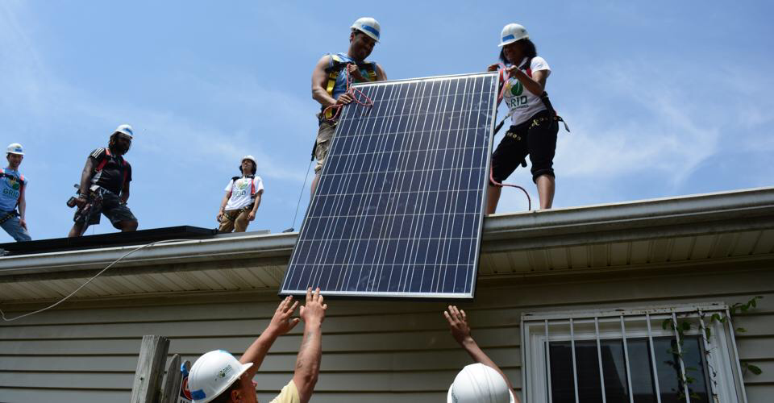
Start of the Illinois Solar Journey
Mark Burger, Solar Consultant, Seven Generations Ahead

Slide 2
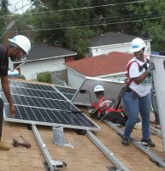
Illinois solar market just getting started
Thru late 2018 (SEIA.ORG)
0.08% of Illinois electricity generated 2018
2,718 installations
100.5 megawatts of capacity
147,000 megawatt hours generated

Slide 3
Numerous market segments to develop solar electricity, either onsite or offsite
Power Purchase Agreement
Ownership
Community Solar Subscription
Lease
Lease - Purchase
Municipal Aggregation

Slide 4
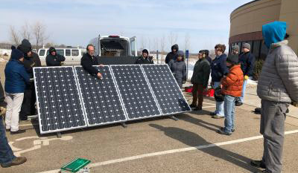
Approved Vendors
Businesses vetted by Illinois Power Agency with installers certified by Illinois Commerce Commission are deliverers of solar

Slide 5
Different market segments of supply and SREC funding in early stages of FEJA
 | RESIDENTIAL | COMMERCIAL | COMMUNITY
In ComEd interconnection queue | 398 Projects 4 Megawatts | 103 Projects 72 Megawatts | 642 Projects 1,214 Megawatts
IPA Adjustable Blocks 1-3 Allocation | 117 Megawatts | 117 Megawatts | 117 Megawatts
In IPA process as of 2/7/19 | 192 Projects 1.2 Megawatts | 67 Projects 24 Megawatts | 209 Projects 410 Megawatts

Slide 6
Going forward…
Follow the action at Illinois Power Agency www.illinoisabp.com www.illinoissfa.com
Also follow these organizations
ElevateEnergy.org
CitizensUtilityBoard.org
Environmental Law & Policy Center elpc.org

Slide 7
Going forward…
Municipalities
Get your regulatory house in order – solar permitting, inspections, review, etc.
Become a SolSmart.org partner, like Kane County and City of Aurora
Solar Actions – online permitting, streamlined processing, eliminate barriers like unnecessary special permitting or hearings.
Municipal Aggregation - consider incorporating solar for residential/small commercial market in existing or as a way to revive inactive programs

Slide 8
Going forward…
Organizations and Individuals
Start planning NOW for solar procurement
Tax credits start phasing out in 2020
Decide on-site or off-site
Plan on a competitive procurement process

Slide 9
THANK YOU!

