Slide 1
Illinois Farm to School Network
Programs to promote local food, kid’s health and gardens.

Slide 2
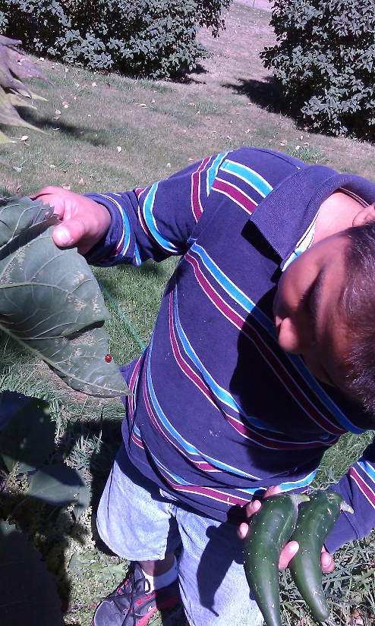
Top 5 Reasons to Incorporate Farm to School Education
Memorable, tangible experiences encourage students to:
Enhance overall academic achievement
Improve healthy eating behaviors
Promote active lifestyles
Increase students’ food knowledge
Increase life and social skills & self-esteem
Notes:
Join students of all ages, along with individuals across the Midwest, in celebrating National Farm to School Month by crunching into locally grown apples at NOON on Thursday, October 22, 2015.
This collective crunch encourages healthy eating and supports farm to school and other local food purchasing initiatives throughout the region. It’s also a fun way to connect food and nutrition to all kinds of classroom curricula – from science to art! The Great Apple Crunch provides your school, district, county or organization the framework to host a successful local food promotion event this October.

Slide 3
What is the Great Apple Crunch?
The Great Apple Crunch is a one day effort when students will ‘crunch’ into local apples and schools will celebrate Midwestern farms. It’s also a day to do additional nutrition lessons with free materials provided by Agriculture in the Classroom of Illinois.
The Crunch is in it’s fourth year in states such as Wisconsin, Michigan, Minnesota and Ohio.
In 2015, we celebrated with 90,000 school children in 34 districts.
In 2016, we celebrated with 339,103 school children in 1080 schools across Illinois.
Notes:
Join students of all ages, along with individuals across the Midwest, in celebrating National Farm to School Month by crunching into locally grown apples at NOON on Thursday, October 22, 2015.
This collective crunch encourages healthy eating and supports farm to school and other local food purchasing initiatives throughout the region. It’s also a fun way to connect food and nutrition to all kinds of classroom curricula – from science to art! The Great Apple Crunch provides your school, district, county or organization the framework to host a successful local food promotion event this October.

Slide 4
What is the Harvest of the Month program all about?
Celebrating local food
Teaching kids about seasonal eating
Peaking interest in other farm to school activities
Making it easy for school to bring food education into the cafeteria and the classroom
It’s a great place to get started with farm to school!
Nationwide programs
A tool for schools to drive up the enjoyment of required fruits and veggies.
Notes:
The Illinois Farm to School Network has adopted the Harvest of the Month program as a simple way for schools to try their hand at Farm to School. This program is flexible and easy to utilize.
Each month, participating schools source the local/regional fruit or vegetable listed on the annual Harvest of the Month calendar. Each month will have a spotlight item, and an alternate item. Each school decides its level of participation for the month, whether it be a cafeteria tasting, a fresh feature on the salad bar, an added item on the lunch menu, or perhaps a classroom or garden lesson. Printed materials, recipes and lessons are available on our website for each months harvest selection.
The monthly spotlight and alternate fruit or vegetable items are available to procure through a variety of methods including DOD purchases.

