Slide 1


Katie Kaluzny, Associate Director
Illinois Green Alliance

Slide 2
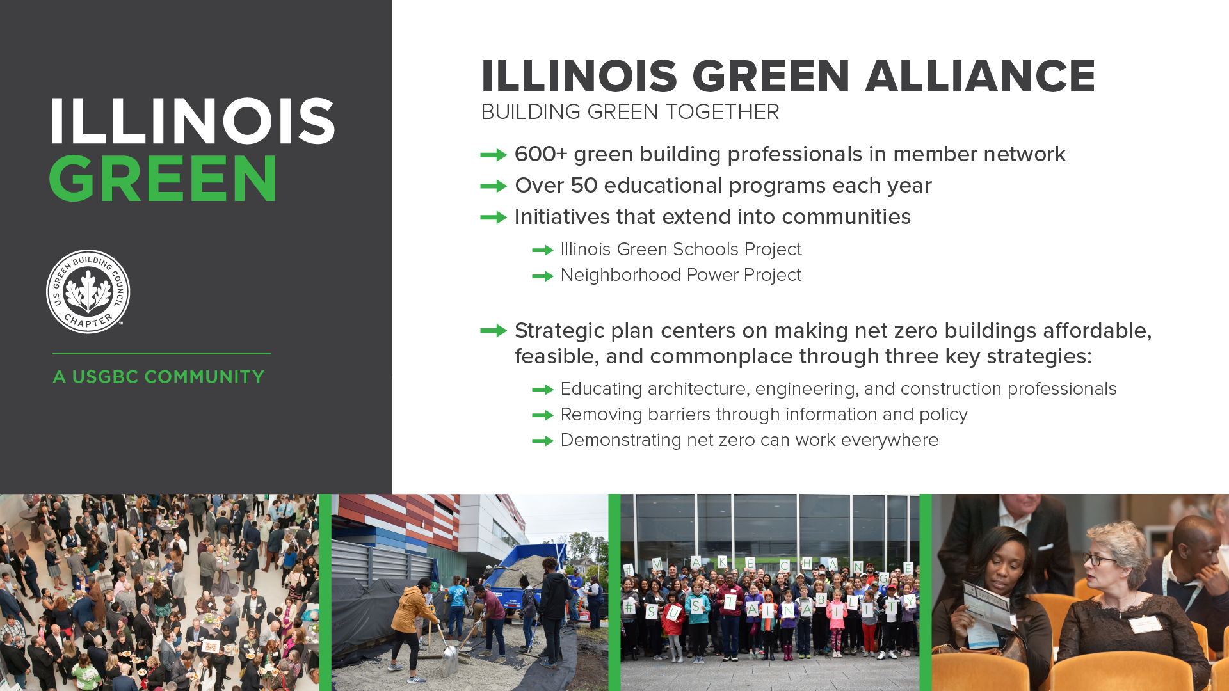
Notes:
Illinois Green Alliance is a membership driven non-profit organization that advances green buildings and sustainable communities for all.
Our recently launched five-year strategic plan pushes the green building industry to meet or get on the path to net zero. We achieve this work through:
Educational events such as panels and building tours
By engaging communities and partnering with organizations across Illinois
And by advocating for new policies and legislation
Members can view our recorded webinars, including today’s program on our on-demand webinar library.
Next webinar: [Insert webinar name, date, time]
Check out IGA’s events calendar and our connect & learn online page for upcoming webinars!
Sign up for Illinois Green’s list to receive emails about our upcoming events
Insert link into chat: bit.ly/IllinoisGreenNewsletter

Slide 3
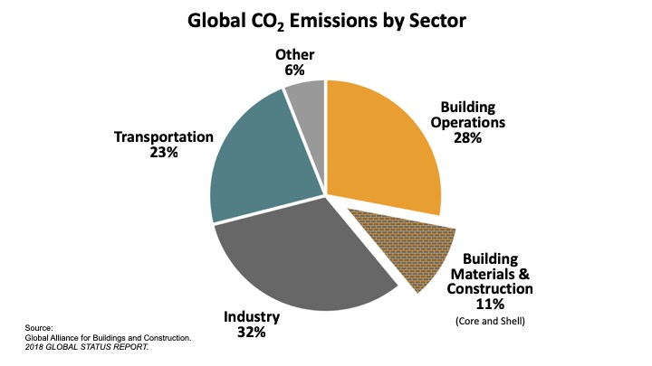
Buildings are the largest source of carbon pollution
Notes:
Mike – Ending a wild year in better shape than we started!

Slide 4
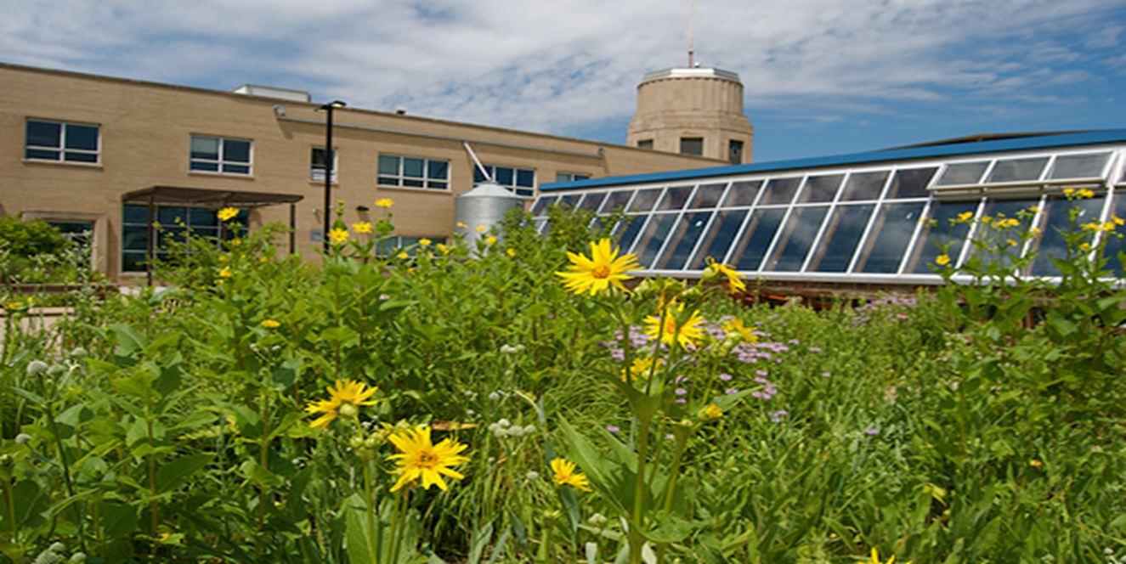

The Center for Green Technology, the first LEED Municipal building in the world, became a signature project and living laboratory.
Mainstreaming Net Zero Buildings
CARBON DRAWDOWN
ACCESSIBLE
TO ALL
LEED

Slide 5

2021 – 2025 Strategic Plan
To combat climate change in Illinois, it’s time we made net zero buildings feasible, affordable, and so commonplace that every building in Illinois by 2050 is net zero.
Notes:
Kathia - new strategic plan & what’s on the horizon

Slide 6
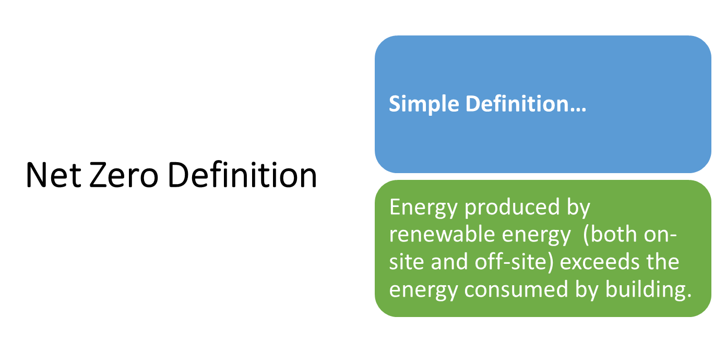
Getting to Zero…
Notes:
Defining Net Zero: Illinois Green’s goals align with the reduction of global carbon emissions and net zero buildings. Whether net zero carbon, net zero energy, net zero waste, or net zero water, buildings in pursuit of net zero play an outsized role in achieving our goals. Definitions for net zero terms are nuanced throughout the industry and IGA supports programs and regulation that are moving in this direction. Typically, buildings that set these ambitious targets are highly energy efficient, may produce on-site, or purchase, renewable energy, consider strategies to reduce embodied carbon, conserve water, and minimize waste, amongst other strategies.

Slide 7
Getting to Zero…
Building Electrification
The terms “building electrification,” “beneficial electrification” and “building decarbonization” all describe shifting to use electricity rather than fossil fuels for heating and cooking. The goal of such a transition: all-electric buildings powered by solar, wind and other sources of zero-carbon electricity.
Stretch Codes

Slide 8
Getting to Zero…
Stretch Code
Stretch code is simply a code that is more energy efficient than the model code.
  Some states do not allow local jurisdictions to adopt stretch codes.
  Some states have a statewide code but allow municipalities to adopt their own code (Ex: MA, NY, WA, CO, TX)
  Home Rule states do not have a statewide code, municipalities can just simply adopt their own code.
  Municipalities with a Stretch Code include:
    Seattle (commercial only)
    Denver
    Austin
    Boulder
Stretch Codes

Slide 9
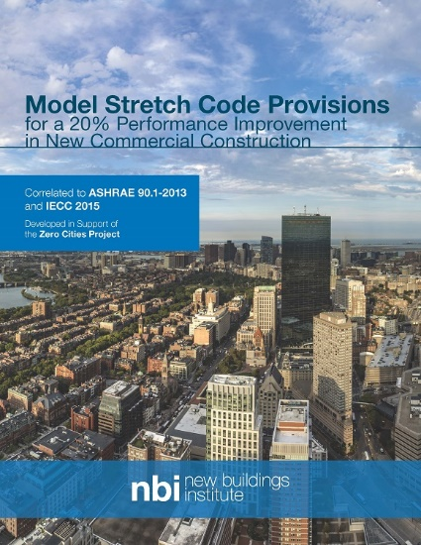



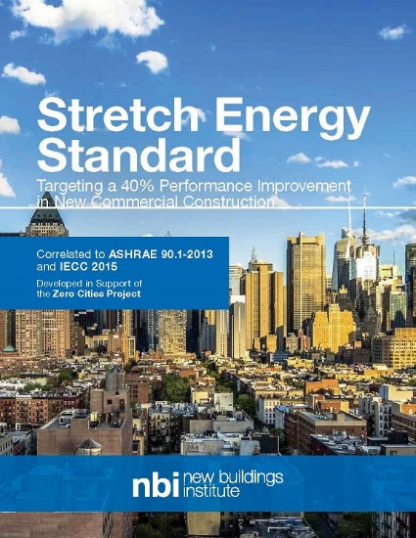
New Buildings Institute Code & Policy Resources
Learn more:
NBI codes and policy resources – tools & guides
NBI Zero energy policy tools & guides

Slide 10
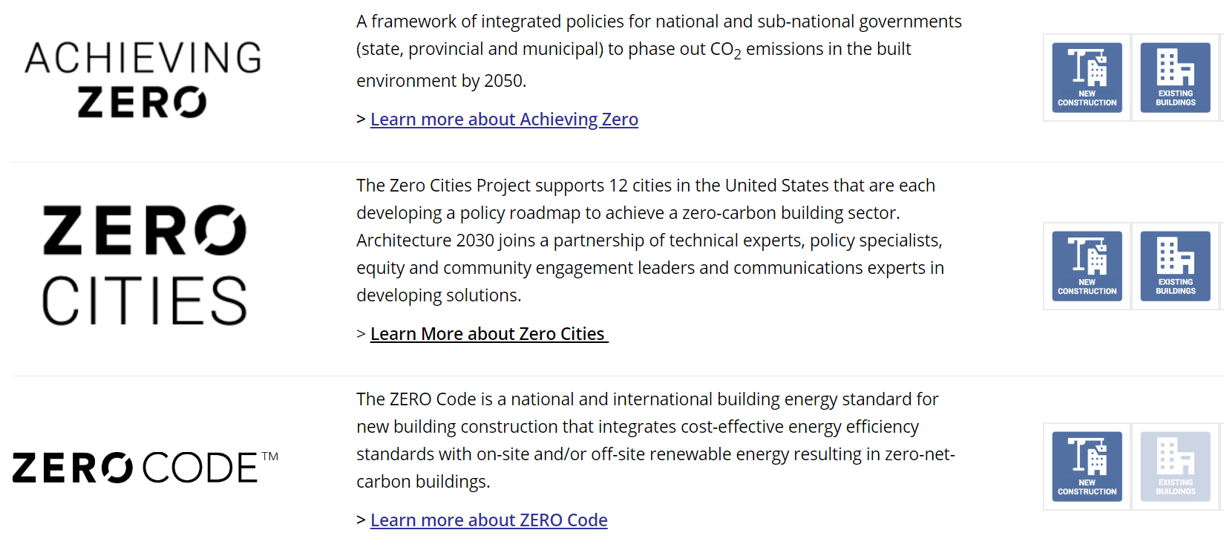
Architecture 2030 Zero Carbon Policy Resources
Learn more: Achieving zero carbon through government policy

Slide 11
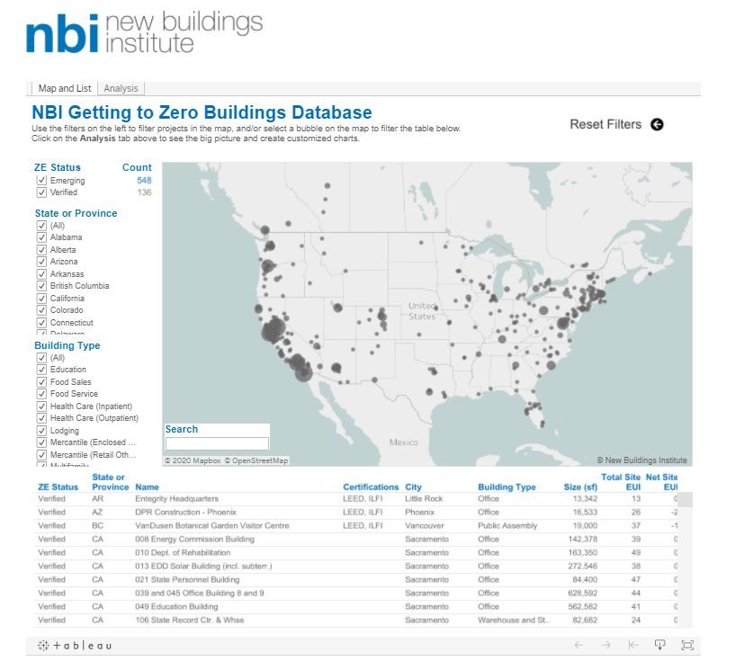
New Buildings Institute Code & Policy Resources
Add to the list:
Do you know about a low or zero energy building not listed here? Submit the building to their registry.

Slide 12
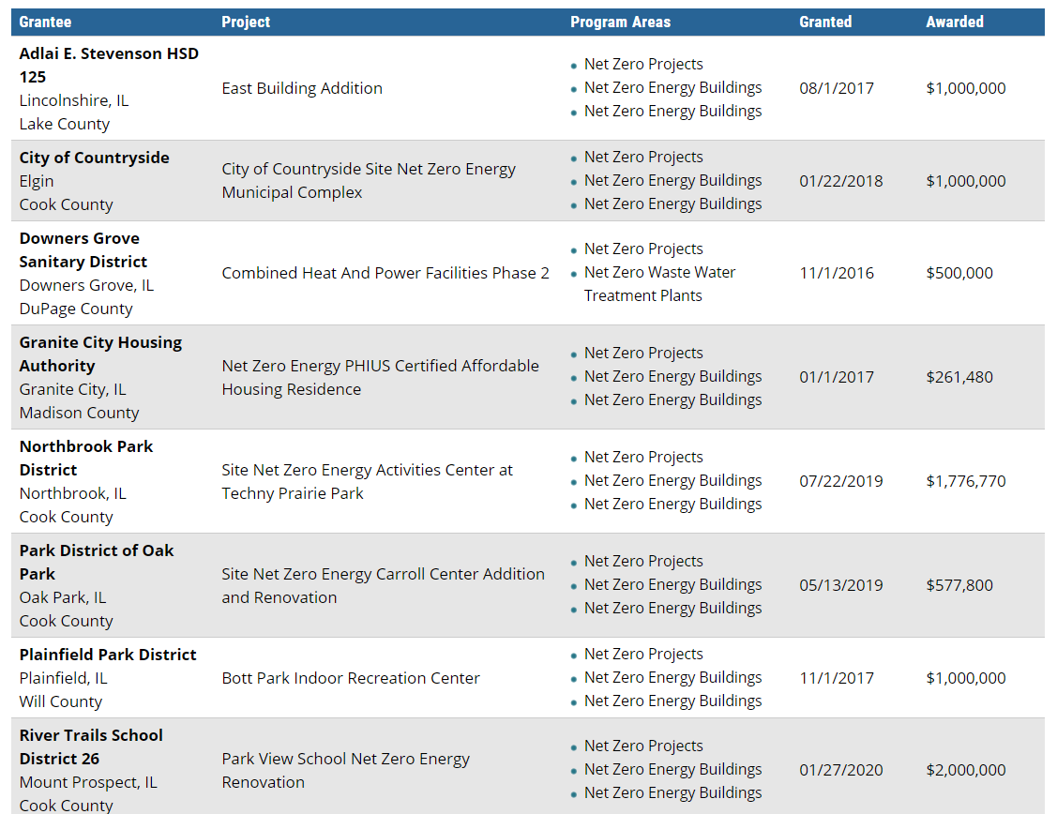
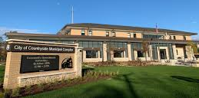
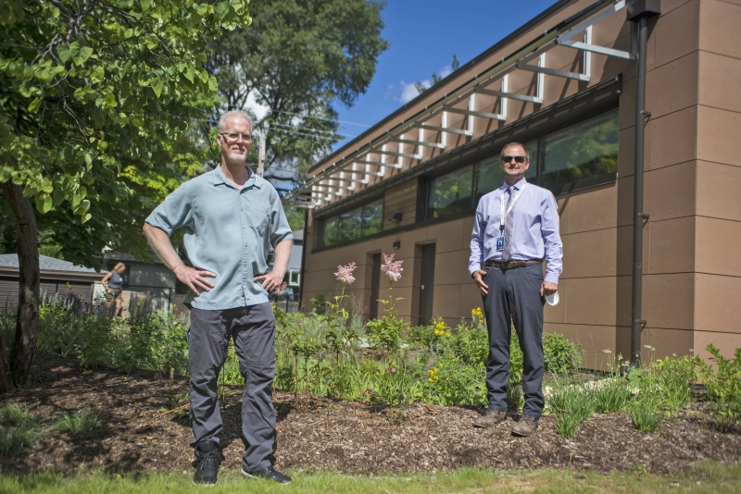
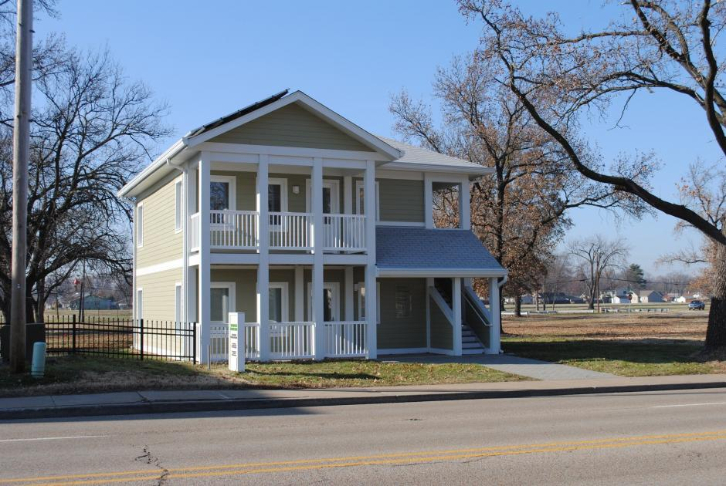
Illinois Clean Energy Community Foundation
Notes:
Applicants
501(c)(3) nonprofit organizations
Local government agencies serving Illinois residents
Colleges and Universities

Slide 13




Zero Energy or Carbon Ratings / Verifications
LEED Zero Carbon
LEED Zero Energy
ILFI Zero Carbon
ILFI Zero Energy
PHIUS+ Source Zero
PHIUS+ Getting to Zero
DOE Net Zero Energy Ready Homes

Slide 14
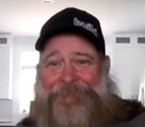
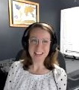

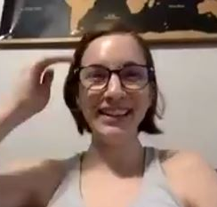
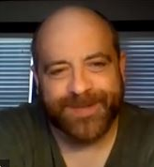
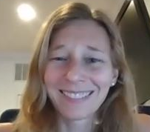
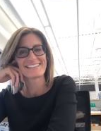


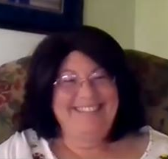
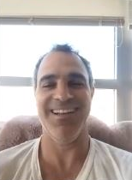
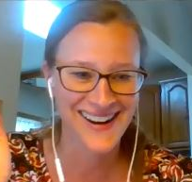
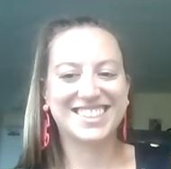
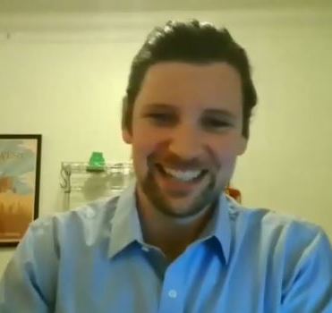

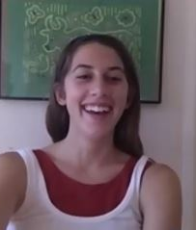
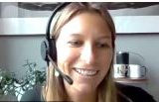

Slide 15
Katie Kaluzny
kkaluzny@illinoisgreenalliance.org
www.illinoisgreenalliance.org
Notes:
Brian – thank you & close out

