Slide 1
Sustainable Economic Development:
Success Stories to Lead the Fox Valley Region
Christopher Toth & Mark VanKerkhoff
Kane County Development & Community Services Department
Cecilia Govrik
Kane County Division of Environmental & Water Resources

Slide 2


Sustainable Economic Development Convening
Nationwide conference held in September 2016 in Cleveland
Cooperative effort:
  Urban Sustainability Directors Network (USDN)
  International Economic Development Council (IEDC)
25 communities participated → 3 from Illinois
Grant from USDN Innovation Fund

Slide 3
Goals of USDN Conference
Develop a common understanding of Sustainable Economic Development (SED)
Learn from SED success stories from the USA and Canada
Identify projects that can be accomplished at the municipal, regional, or network level

Slide 4

Defining Sustainable Economic Development
The creation and retention of jobs and wealth in ways that maintain or improve social and natural environments now and into the future.

Slide 5
Defining Sustainable Economic Development
The investment in business, social, built and natural environments that creates increasing prosperity for all, now and into the future.

Slide 6

Kane County’s Foundation for Sustainable Economic Development
Kane County 2040 Plan adopted in 2012
Key areas to support SED
  Economic Prosperity (Section 2.11)
  Sustainability and Energy (Section 2.9)

Slide 7
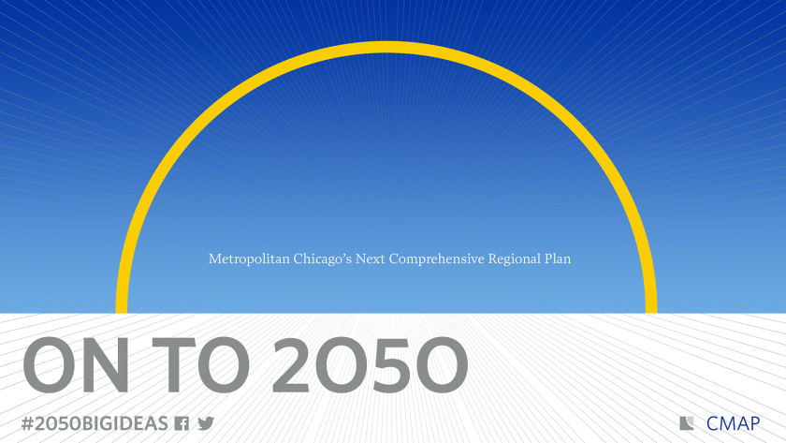
Opportunities for Sustainable Economic Development
Kane County 2050 Plan
  Expand economic development goals for Kane County
  Integrate SED concepts when planning & implementing economic development projects in the future

Slide 8

Success Story #1: Austin, Texas
“Reverse Pitch Fest”
Businesses with byproducts ask for pitches for free access to byproducts for further commercial use
Media attention was strong
Program’s success gave Austin the will to look into crowd sourcing and “bounty hunting” to solve problems
Learn more at http://reversepitch.org/

Slide 9

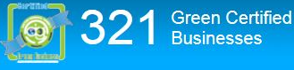


Success Story #2: Montgomery County, OH
“Dayton Regional Green – People, Profit, Planet”
County partnership with local utilities allowed for leverage of strengths
Free and low cost energy audits, partnered with college students, encourages more businesses to take advantage
Learn more at www.drg3.org

Slide 10
Success Story #3: Lucas County, OH
“Sustainable Business Recognition Program”
Businesses that exemplify:
  Responsible use of natural resources
  Equitable employment practices
  Economic prosperity that benefits community
Variety of participants—industrial, retail, healthcare, schools, etc.
Free sustainability assessments to look at 8 metrics
Better Buildings of NW Ohio
  Connect businesses with PACE financing
  $20.5 million in projects completed → using $12.5 million in financing
Learn more at www.toledoport.org/BBNWO

Slide 11

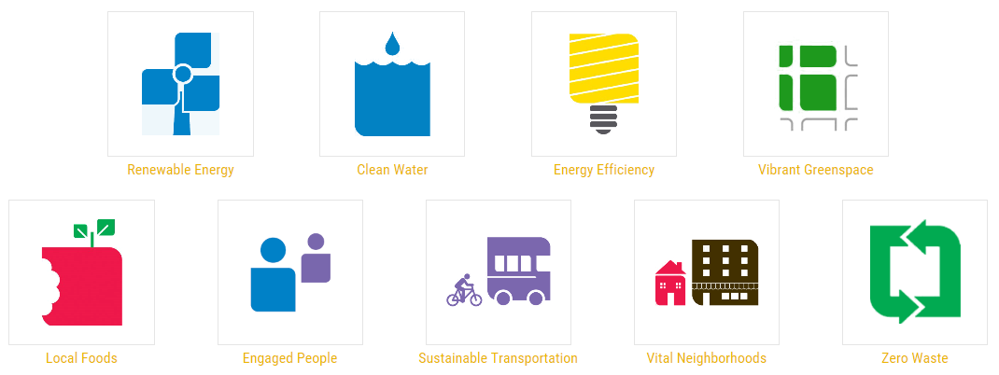
Success Story #4: Sustainable Cleveland
Ambitious initiative to transform Cleveland into a “Green City on a Blue Lake” in 10 years
9 action areas → extra focus on one area each year
Progress Dashboard
  Business, Social, Built, and Natural
  Environments
  28 indicators
Learn more at www.sustainablecleveland.org

