Slide 1
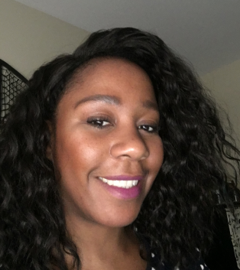
Elevate Vetia Hill, Community Resource Coordinator

Slide 2
Who We Are:
Elevate wants everyone to have access to clean and affordable heat, power, and water in their homes and communities. We’re centering equity in the climate conversation.

Slide 3
What We Do
Energy Efficiency
Smart Electricity Options
Multi-Family home savings
Solar
ILSFA (Illinois Solar For All)
Water
Water Efficiency
Storm Water Management
Communities
Municipal Climate Change
LED Streetlighting

Slide 4
How Do We Support Social Equity?
Focus on making meaningful change that reflects the values, needs, and priorities of communities that need it the most.
Prioritization (and incentivization) of clean energy projects that provide new technology and affordable, clean power to everyone
Energy and water efficiency
Affordability solutions that focus on the heating, cooling, and water needs of affordable housing and shared public buildings

Slide 5
Contact information
Vetia Hill
Vetia.hill@Elevatenp.org
773-299-7652

