Slide 1
Illinois Solar for All
The future of Solar in Illinois
the very near future…

Slide 2
What is Illinois Solar for All?
Illinois Solar for All provides incentives for solar (PV) projects developed for the benefit of low-income customers, environmental justice communities, and non-profit/public sector facilities.
It parallels the Adjustable Block Program (ABP) the Market Rate solar program in IL.
Both programs were created by the Future Energy Jobs Act
ABP is starting now, ILSfA is scheduled to start in April

Slide 3
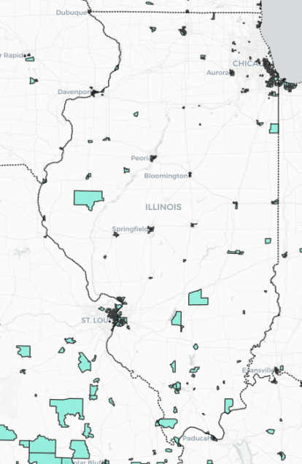
Program Details
Serving Low Income
Distributed Generation
Nonprofit/Public Facility
Community Solar
<80% AMI
Incentives in the form of higher REC values
Engagement with community organizations to develop projects
Incorporate job trainees
Goal of 25% of $ in each category for environmental justice communities
$30 million/year
22.5% of funds = to $7.5 million per year
Multifamily buildings are eligible; must demonstrate benefit to low-income tenants
No upfront cost to home/building owner
100% savings on electricity usage (SF)
15% of funds = to $5 million per year
Installed on facilities of qualifying entities
No upfront cost for system
50% savings on electricity usage
37.5% of funds = to $12.5 million per year
Installed in low-income communities and/or subscribed to by low-income customers
No upfront cost to customer
50% savings on electricity usage

Slide 4
What are the roles?
Elevate is the Program Administrator
This is a different role than our energy efficiency programs (IEMS, PHES)
Approved Vendors (Solar Financing/Installing/Managing Entity) deal directly with customer in an open market
Approved Vendors
Adjustable Block Program (ABP) and ILSfA “contractors” are called Approved Vendors.
State incentives are paid to Approved Vendors and economic benefits are passed through to participants

Slide 5
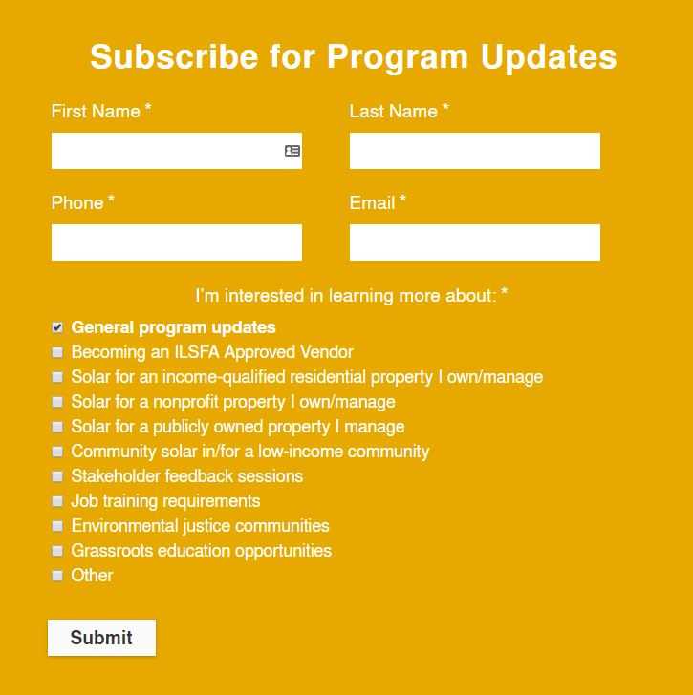
What can I do now?
Follow APB and ILSfA website
Follow APB website and notification signup @bottom of page:
https://illinoisabp.com/
Follow ILSfA website and notification signup @bottom of page:
https://www.illinoissfa.com/

