Slide 1
Northern Illinois Food Bank
Food Recovery
Fox Valley Sustainability Network Waste Reduction Forum
May 23, 2019

Slide 2
Food Recovery Overview

Slide 3
Retail Recovery Program
2018 – Retail Recovery Operations Northern Illinois Food Bank
10 trucks – 45 stops per day / 203 per week
4 day per week pickup Mon/Fri & Tue/Thu
4,725 pounds recovered PER ROUTE PER DAY
10 trucks average 810 miles per day
2018 - Retail Stores With Direct Connect Partners
415 retail stores in our 13 county service area
37,289,16 MILLION pounds recovered in 2018
165 Direct Connect partners
Meets the needs of store partners to recover additional food

Slide 4
Retail Partners

Slide 5
Retail Recovery Opportunities
Present and future challenges
Prepared and perishable offerings are expanding. More consumers are eating healthier, and the retail store size and layouts are starting to change with a reduction of real-estate allocated to shelf-stable products and a continued expansion of perishables.
Store level markdown programs are becoming more sophisticated and retailers are becoming more disciplined with the timing and execution of the markdowns. Recovery of product after markdown programs can mean a shorter shelf life necessitating the need to pick up more often while recovering smaller quantities.
As traditional retail continues to change and adapt, alternative channels are evolving and new formats are being created. Ex: E-Commerce (Direct to consumer), meal kits, a reimagining of convenience stores. Technology allows for these models to expand at a rapid pace. It is vital for Food banks to subsequently create new distribution models to feed our food insecure neighbors, while being cost and time effective.

Slide 6
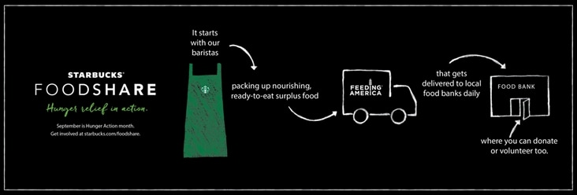
Starbucks FoodShare Program
• 70 stores recovered, 2 routes ~ 7 days per week / overnight
• Morning Star Mission Joliet recovers from 11 stores
• Program funded by Starbucks, we are on year 2 of program
• Dropped nightly to Wayside Cross (Aurora) Serenity House (Addison) Some used for Winnebago market in Rockford

Slide 7
Manufacturing Recovery
Week of Wednesday, April 10th to Wednesday, April 17th 2019
Description | Pallets | Cases | Pounds | Inbound
Mixed Paper Product | 39
Sauerkraut | 8 | 520 | 13,000
churros | 2
Uncrustables | 37 |  | 14,487
Mixed Product | 16 |  | 18,301
Pizza | FTL
Mixed Dairy | 22 |  |  | 4/15/2019
Mixed Product & Water | 88 |  | 116,447 | 4/17/2019
Mixed Meat |  |  |  | 4/12/2019
Mixed Product | 48 |  | 43,324
Cereal | 4 FTL
Ice Cream | 4 |  |  | 4/16/2019
Carrots and Juice | 20 |  |  | 4/15/2019
Mayo | 8 |  | 10,240
Cauliflower | 3
Cauliflower | 5
Cake, Muffin, & Brownie Mix | 17 |  | 16,785
Cream Style Corn | 2 FTL
Cake & Oreos | 7 |  | 2,378
Mixed Product | 6
Bacon Bits | 4
Shoe String Chips | 1
Hams |  | 87 | 443
Granola baras, oatmeal, cereal & mis.
Water | 16 |  | 37,685
 | 2

Slide 8
Network Sharing, Source to Excess!
Week of Wednesday, April 10th to Wednesday, April 17th 2019
Partner | Pallets
Regional Food Bank of Oklahoma | 26
Tri-State Food Bank | FTL
Regional Food Bank of Oklahoma | 23
Greater Chicago Food Depository | FTL
Feeding South Dakota | FTL
The Food Bank for Central & Northeast Missouri | FTL
Food Bank of Central New York | FTL
Second Harvest Foodbank of Southern Wisconsin | FTL

Slide 9
Other Sources of Food
Amazon, 3PL’s, “walk in’s”
Purchased = 11% of our food (basics, peanut butter, oil, bulk pasta, soup, jelly) High volume items less frequently donated through traditional recovery
Gov’t EFP = 9% of food received
The Emergency Food Program is a USDA food commodities program administered by the Illinois Department of Human Services with distribution through regional foodbanks ~ through qualified Pantries
Examples of USDA commodities used in the EFP include frozen meats, canned beef and pork, rice, milk, fruit juices, dried pasta, beans, canned fruits and vegetables.

Slide 10
Food Recovery Challenges
“Hunger is not a matter of quantity, but distribution”
Prepared Food
Convenience stores
Institutions
Schools, Hospitals, Gov’t, Universities
Distribution models of recovered food

Slide 11
How You Can Help!
Volunteer
Group and Individual Opportunities
Food/Non-Food Packing Shifts
Skills-Based Volunteers
74 full time staff replaced by volunteers in 2018
Advocacy & Education
FoodKeeper app for shelf-life education
Work with retailers and restaurants to develop a waste commitment goal
Donate
Host a Food & Fund Drive
Donate funds directly to our programs
Get Involved!
Visit SolveHungerToday.org

Slide 12
Questions!

Slide 13
Tia Aagesen
taagesen@northernilfoodbank.org
312-929-6406
Chad Steward
csteward@northernilfoodbank.org
630-715-9243

