Slide 1
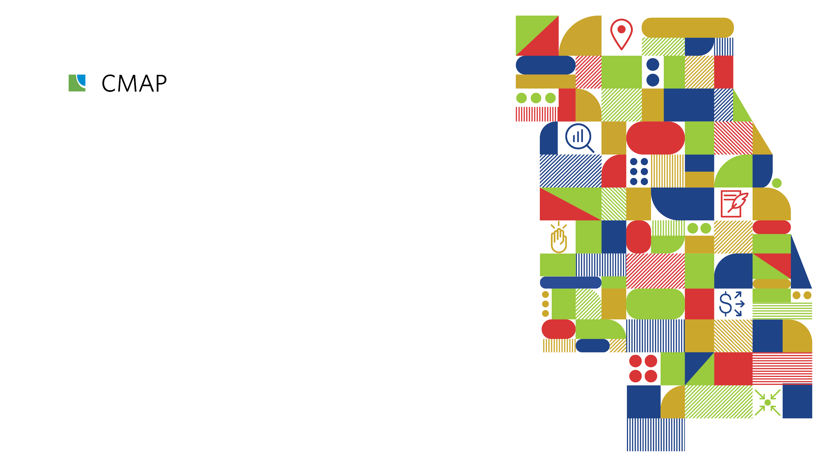
Going ON TO 2050 The new comprehensive plan for Chicagoland
Fox Valley Sustainability
Network
October 23, 2018
May 6, 2020

Slide 2
Agenda 1) CMAP overview 2) Climate trends 3) Strategies

Slide 3
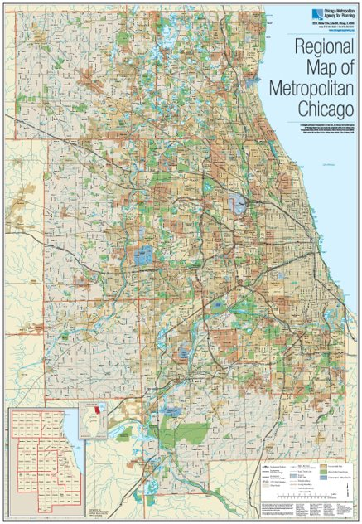
Who is CMAP?
Regional planning agency for the 7 counties of northeastern Illinois
Transportation programing
Land use planning and analysis
ON TO 2050
Resilience
Inclusive Growth
Prioritized Investment

Slide 4
Climate trends

Slide 5
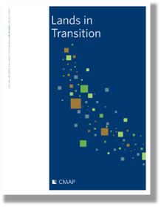
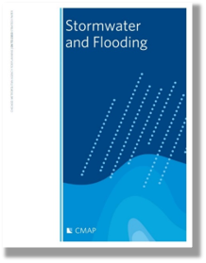
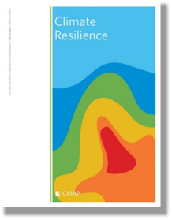
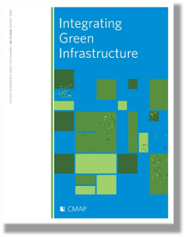
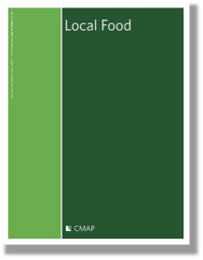
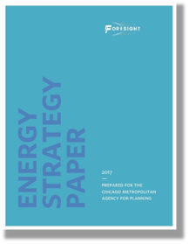

Slide 6
Warmer Wetter More variable

Slide 7
Warmer Wetter More variable

Slide 8
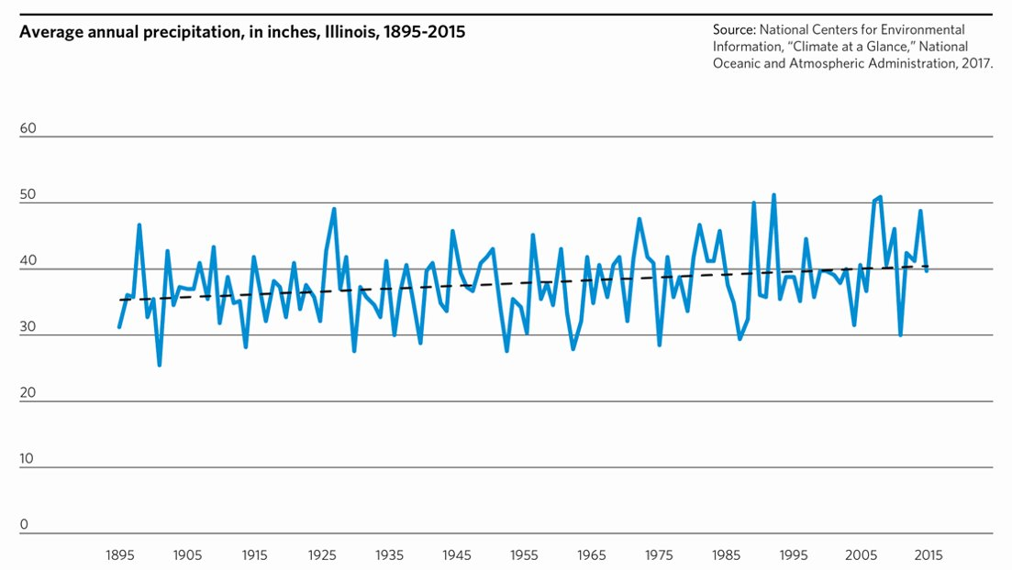

Slide 9
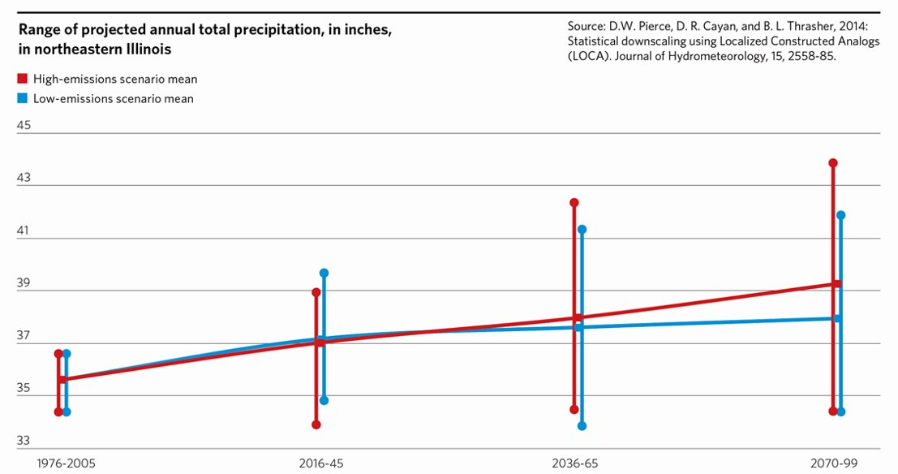

Slide 10
Comparison of rainfall amounts in Northeast Illinois
Older standard
Updated Bulletin 70
Notes:
Slide: Adaptation side, focus on flooding (NB: due to data already prepared)
Switching to the adaptation side of things
Current research shows that the number of storms in Illinois producing over 2 inches of rain has nearly doubled over the past century.
As heavy rainstorms become more frequent and stronger than in the past, municipal drainage systems designed from outdated standards often fail, resulting in flooding and financial losses.
Published in 1989, we’ve been using Bulletin 70 to design our stormwater infrastructure.
One of the storm frequencies to pay attention to is the 100 year, 24 hour storm as it’s what we use for designing stormwater detention facilities
And you can see here in light blue that that’s been estimated to be 7.58 inches.
Our newly updated rainfall frequency standards have increased the size of that same storm by an inch.
That might not seem like a big change, but when you look to see what storm event our current infrastructure will serve, we can see that it’s now closer to a 50-year storm event.
The level of service we are getting from our existing stormwater infrastructure is diminishing over time due to changing precipitation patterns.

Slide 11
Comparison of rainfall amounts in Northeast Illinois
Now closer to a 50-year, 24-hr storm
Older standard
Updated Bulletin 70
Notes:
Slide: Adaptation side, focus on flooding (NB: due to data already prepared)
Switching to the adaptation side of things
Current research shows that the number of storms in Illinois producing over 2 inches of rain has nearly doubled over the past century.
As heavy rainstorms become more frequent and stronger than in the past, municipal drainage systems designed from outdated standards often fail, resulting in flooding and financial losses.
Published in 1989, we’ve been using Bulletin 70 to design our stormwater infrastructure.
One of the storm frequencies to pay attention to is the 100 year, 24 hour storm as it’s what we use for designing stormwater detention facilities
And you can see here in light blue that that’s been estimated to be 7.58 inches.
Our newly updated rainfall frequency standards have increased the size of that same storm by an inch.
That might not seem like a big change, but when you look to see what storm event our current infrastructure will serve, we can see that it’s now closer to a 50-year storm event.
The level of service we are getting from our existing stormwater infrastructure is diminishing over time due to changing precipitation patterns.

Slide 12
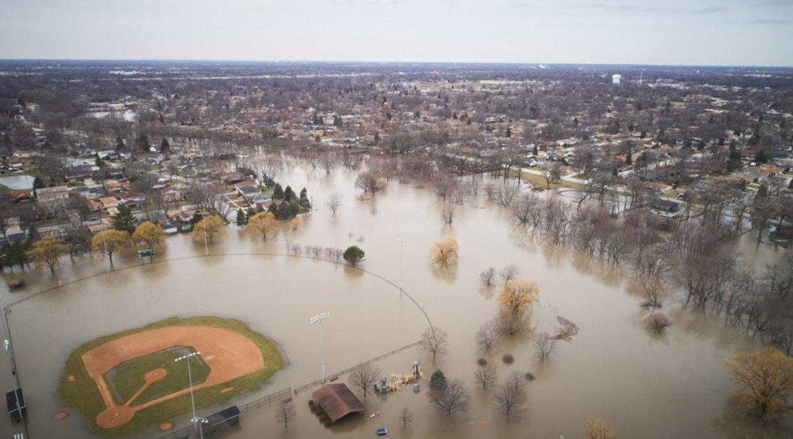

Slide 13
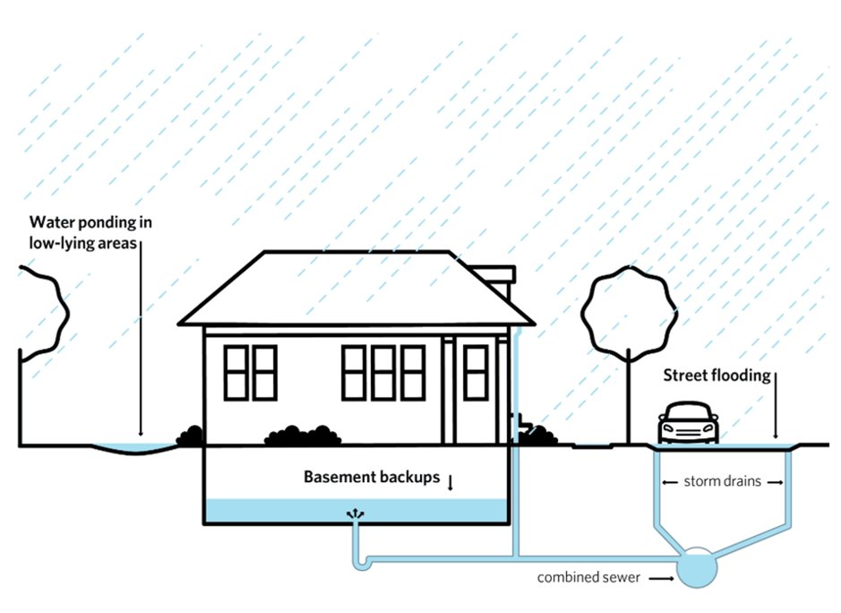

Slide 14
Solutions

Slide 15
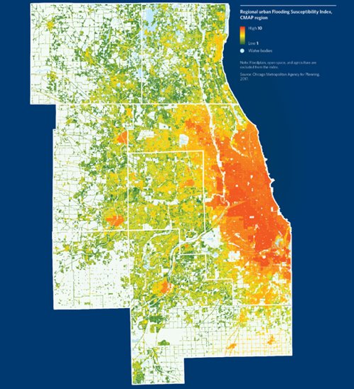
Flood Susceptibility Index (FSI)
CMAP tool used to predict areas where urban flooding may occur
Based on topography, soils, development patterns, historical flood data, and other sources
Available for download, may be clipped and rescaled to find local hot spots

Slide 16
ON TO 2050
Gather local flood data and communicate risk
Continue to update stormwater ordinances and standards
Participate in the Community Rating System (CRS)
Pursue property acquisition and voluntary buyouts in flood-prone areas
Integrate stormwater management into land use and transportation plans

Slide 17
ON TO 2050
Gather local flood data and communicate risk
Publicly-accessible flood data is rare
Public education
–> shape the conversation

Slide 18
ON TO 2050
Continue to update stormwater ordinances and standards
Consider tying some standards to regularly updated reports, guidelines, etc.

Slide 19
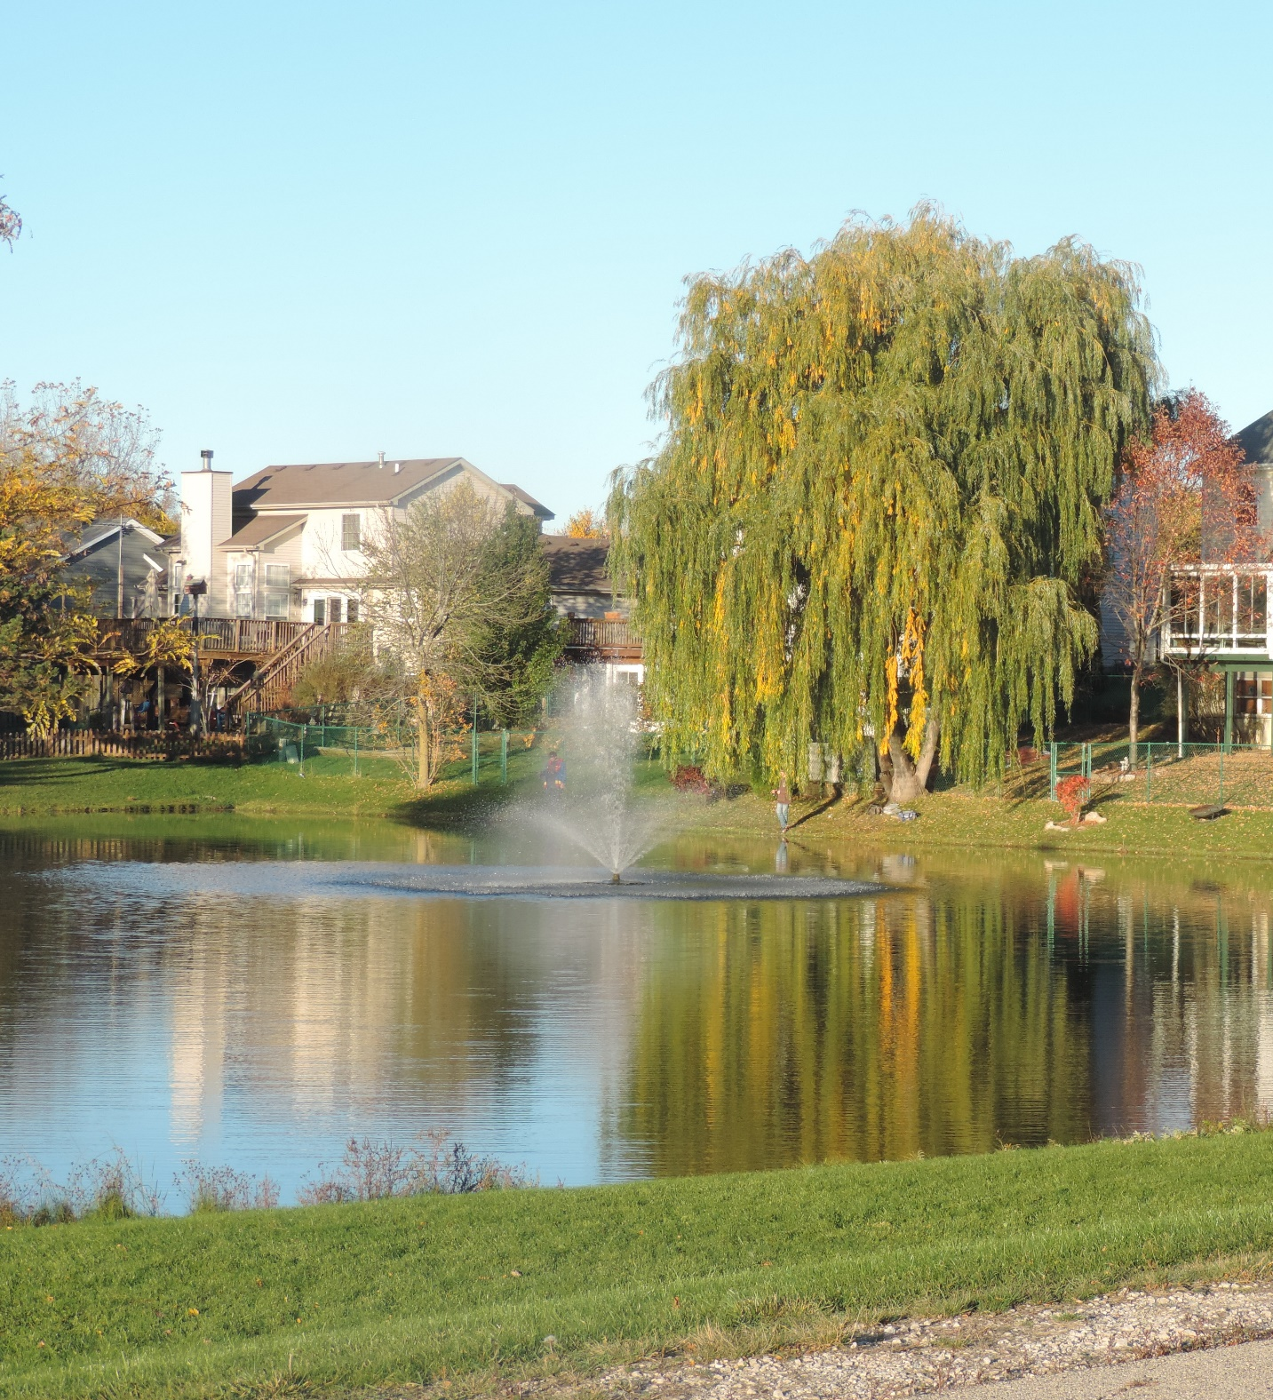
ON TO 2050
Participate in the Community Rating System (CRS)

Slide 20
ON TO 2050
Pursue property acquisition and voluntary buyouts in flood-prone areas

Slide 21
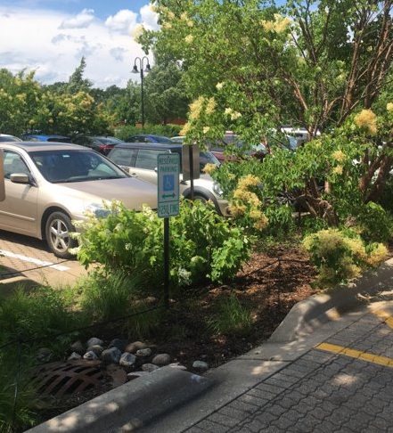
ON TO 2050
Integrate stormwater management into land use and transportation plans

Slide 22
Jared Patton, AICP (312) 386-8623 jpatton@cmap.illinois.gov

