Slide 1
Addressing the Financial Burdens from Climate Change Focusing on Flooding Issues
Jerad Chipman, AICP
Senior Planner
Village of Montgomery

Slide 2
Floodplain in Montgomery

Slide 3
Montgomery’s Flood History
Flood of 1996
Parkview Estates Property Acquisition.
Flood of 2013
Community Ratings System (CRS) Program Initiation.

Slide 4
What is CRS
National program developed by FEMA.
Credits are earned for achievements and programs that go above and beyond the minimum requirements for participation in the National Flood Insurance Program (NFIP).
The goal is to reduce flooding and therefore the burden placed on the NFIP.

Slide 5
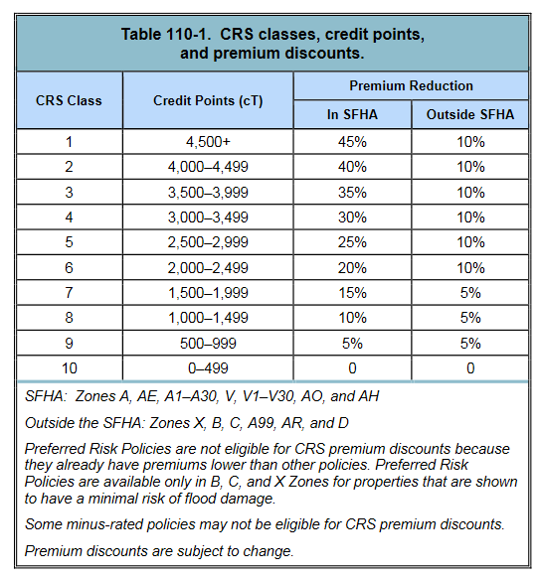
CRS Continued
Benefits of CRS
How to acquire a CRS rating.
Maintaining your municipal CRS rating.

