Slide 1
State, Local and Tribal Program Overview
Elizabeth Doris
Laboratory Program Manager: State, Local, and Tribal Programs
June 22, 2017
Notes:
My name is Erin Nobler and I’m the lead of the Solar Technical Assistance Team under the Soft Cost Portfolio of the Solar Program. Based on this, you may see that a lot of the examples I provide will be from that program. I’m going to provide a brief overview of our programs through recent efforts and project examples.
A similarity you will see as I go through this presentation, is that FEMP and S&L both draw upon the depth of the lab to bring the best possible information to the audience. As with FEMP: To meet the needs of the end user, we draw on the most relevant technology programs, tools and knowledge to reach our audience.

Slide 2

40 Years of Clean Energy Research
Nearly 1,700 employees, including more than 300 early-career researchers and visiting scientists
World-class facilities, renowned technology experts
Nearly 750 partnerships
Campus operates as a living laboratory
National economic impact of $872 million annually
Notes:
NREL is one of 17 DOE National Laboratories, and the only one whose core mission revolves around renewable energy, energy efficiency, grid integration
Located in Golden, CO
NREL started in 1977 as the Solar Energy Research Institute (SERI), spurred by national concern during the 1973 oil embargo, and in response to the Solar Energy Research, Development and Demonstration Act of 1974.
President Jimmy Carter visited SERI in 1978, and in 1979 said, famously, “No one can ever embargo the sun or interrupt its delivery to us.” In 1991, President George H.W. Bush elevated SERI to a U.S. Department of Energy National Laboratory and changed its name to the National Renewable Energy Laboratory (NREL).
The lab research and development focused on clean, secure, domestic energy, with economic viability.
Today, NREL’s groundbreaking clean energy research and development spans from foundational science, to research and development, to discovery and invention of methods, to components and energy delivery systems. Energy analysis informs R&D.
Mission: NREL develops clean energy and energy efficiency technologies and practices, advances related science and engineering, and provides knowledge and innovations to integrate energy systems at all scales.

Slide 3
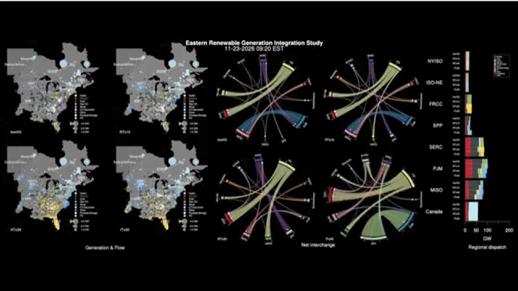
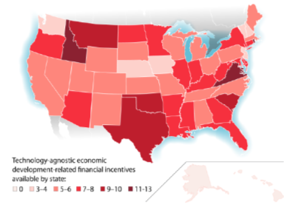
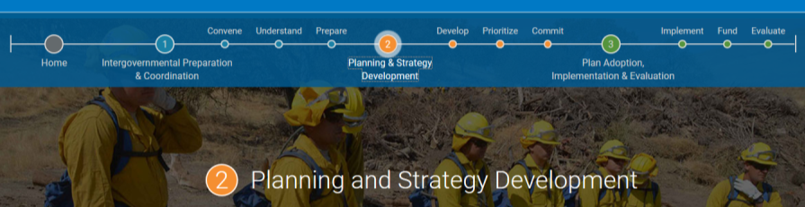
Analytics and Best Practices
Outside of direct engagement, you can always access NREL research.
Notes:
Erin to add findings 1 bullet each on these reports
ERGIS: 30% RE is doable without updating the current grid
Economic Development: This report documents over 900 existing clean energy-related economic development laws, financial incentives (technology-agnostic and clean energy focused), and other policies such as agency-directed programs and initiatives across the states; focuses on those policies most directly related to expanding new and existing manufacturing
Resilience Roadmap: planning tool for governments – walks through different considerations and prompts to determine when and how to engage stakeholders in the process

Slide 4
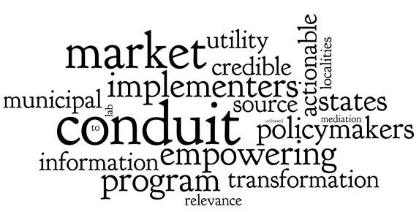
Effective Jurisdictional Decision Support
Timely, credible, and digestible information to support
activities for state, local, and tribal decision-makers.
Notes:
One of the primary goals of the State, Local and Tribal programs at NREL is to accelerate clean energy transition by deliverable relevant technologies and information to support development in state, local and tribal markets. This may sound extremely familiar as it’s similar to the effort FEMP provides to federals facilities and organizations.
We do this primarily through three strategies:
data development and sharing for decision support
Analytics
and direct technical assistance.
Our goal is to be a conduit between the lab and various decision making stakeholders: policymakers, program implementers and utility decision-makers. And we really try to do with through credible, relevant and actionable information for decision support.

Slide 5
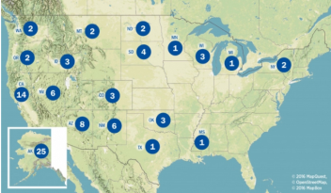






Audience Entry Point: Decision Support Technical Assistance
NREL brings world class decision grade information to jurisdictions:
Six currently available programs by jurisdiction and technology type
Over 1,800 completed requests since 2009
Impact measurement built in
Integrated into measured capacity building pipeline
Jurisdictions inquiries inform research agenda.
City carbon abatement potential (new!)
Policy development strategies (Energy Policy)
National Community Solar Guidebook (2012)
Notes:
We always start with the audience in mind, that’s the entry point. And we really try to meet the audience where we are - instead of just giving them technology, we also focus on the decision making information beyond that – include policies, programs, resources and case studies, among other things
We have six programs that do this: 1) Office of Indian Energy 2) Wind Exchange 3) Cities LEAP 4) Clean Cities (transportation) 5) SolSmart (jurisdictional solar technical assistance and designation program) 6) Solar Technical Assistance Team (state-level agency solar technical assistance)
I will discuss some projects in more detail in the following slides, but I did want to point out our reach:
TA is increasing in scope and scale. Over 200 requests in 2016 alone.
153 tribal
30 solar
4 cities leap
Countless contacts with Clean Cities through the Tiger Teams
And in 2017 we anticipate the numbers will be even higher and with a broader reach (SolSmart program has sped up and in the first six months, NREL has interacted with over 50 jurisdictions with their solar policy questions as they work toward the program designation.

Slide 6
Audience Entry Point: Decision Support Technical Assistance
NREL brings world class decision grade information to jurisdictions:
Six currently available programs by jurisdiction and technology type
Over 1,500 completed requests since 2009
Impact measurement built in
Integrated into measured capacity building pipeline
Jurisdictions inquiries inform research agenda.
City carbon abatement potential (new!)
Policy development strategies (Energy Policy)
National Community Solar Guidebook (2012)
Now available:
Solar Energy Innovation Network (SEIN)
Notes:
We always start with the audience in mind, that’s the entry point. And we really try to meet the audience where we are - instead of just giving them technology, we also focus on the decision making information beyond that – include policies, programs, resources and case studies, among other things
We have six programs that do this: 1) Office of Indian Energy 2) Wind Exchange 3) Cities LEAP 4) Clean Cities (transportation) 5) SolSmart (jurisdictional solar technical assistance and designation program) 6) Solar Technical Assistance Team (state-level agency solar technical assistance)
I will discuss some projects in more detail in the following slides, but I did want to point out our reach:
TA is increasing in scope and scale. Over 200 requests in 2016 alone.
153 tribal
30 solar
4 cities leap
Countless contacts with Clean Cities through the Tiger Teams
And in 2017 we anticipate the numbers will be even higher and with a broader reach (SolSmart program has sped up and in the first six months, NREL has interacted with over 50 jurisdictions with their solar policy questions as they work toward the program designation.

Slide 7
COMMON QUESTIONS
1 | What are the energy efficiency measures that are likely to yield the biggest savings in my jurisdiction?
2 | What are the high priority RE projects for my jurisdiction?
3 | What is the sector level breakdown of energy and emissions data for my jurisdictions (or sub jurisdictions)?
4 | What is the makeup of low income housing in my jurisdiction? What is the energy burden?
5 | Is solar technology affordable for my jurisdiction? What’s the Savings to Investment ratio for my people?
6 | What are the costs and outputs of renewable facilities under different financial structures?
7 | What are the jobs and other economic development impacts of renewable energy projects in my jurisdiction?
8 | What are the costs and benefits to various audiences of a single community solar project?
9 | What incentive levels are necessary to improve system economics?
10 | What are the market impacts of different policy scenarios?
11 | Other:

Slide 8
Data (Planning, M&V) | ResStock (Eric Wilson) | What are the measures that are likely to yield highest savings in my jurisdiction?
 | Cities-LEAP (Megan Day) | What is the sector level breakdown of energy and emission data for my jurisdiction (or sub jurisdictions to me)? What is the makeup of low income housing in my jurisdiction?
 | SIR Calcs (Monisha Shah) | What is the savings to investment ratio for solar in my jurisdiction?
Tools (Program implementation, understanding tradeoffs) | SAM (Nathan Blair) | What are the costs and outputs of renewable facilities under different financial structures?
 | JEDI (David Keyser) | What are the jobs and other economic development impacts of renewable energy projects in my jurisdiction?
 | Community Solar Business Case (Amy Hollander) | What are the costs and benefits to various audiences of a single community solar project?
 | CREST (Paul Schwabe) | What incentives/policies are necessary to improve system economics?
 | dGen (Pieter Gagnon) | What are the market penetration impacts of different policy scenarios?
You can reach NREL staff listed via email: first.last@nrel.gov. To navigate tools, use stat@nrel.gov
Notes:
Missing from here - GST

Slide 9
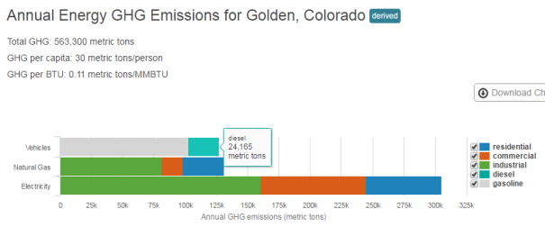
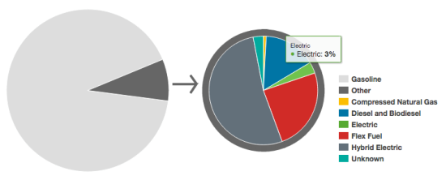
City Energy Profiles
CITIES-LEAP
Cities Leading through
Energy Analysis and Planning
Identified market need:
City decision makers need standardized, localized data
and analysis to make more strategic energy decisions.
Research and analysis:
Developed new, replicable methodology and estimated electricity, natural gas, and
fuel consumption,
vehicle miles traveled, and
actual vehicle fuel types in
more than 23,400 U.S cities.
Newest additions:
PV potential, building stock characterization, top five energy consuming industries, GHG
conversions for each city.
Emissions Summary for Golden, Colorado in 2013
Light-Duty Alternative Fuel and Conventional Vehicles in Oakland, California
apps1.eere.energy.gov/sled, www.energy.gov/eere/cities
Notes:
First up with the Cities LEAP project which is an effort through the Office of Strategic Programs
This project focused on identifying the need for standard data in order to make strategic energy decisions at the local level
Through this effort, we developed a new methodology for collection data and created city energy profiles for over 23,000 cities across many sectors
Derived data - top down, instead of bottom up (MIT methodology adapted to energy use called "iterative proportional fitting"
We are using this dataset for national level analyses of what would the national impact be of cities taking particular action AND for direct support to 10 localities on pathways for using the data to support decisions

Slide 10
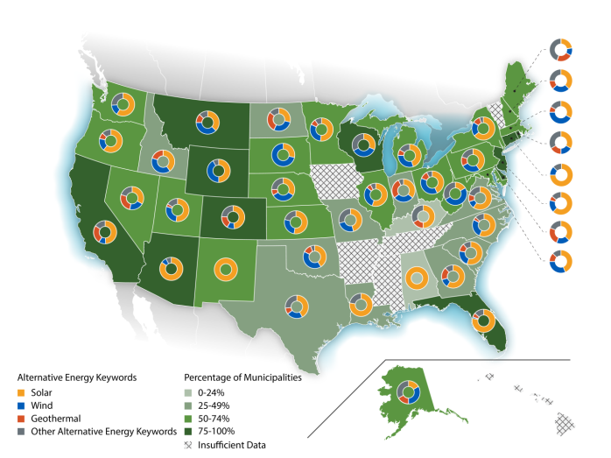
What are other localities doing in clean energy?
http://www.nrel.gov/docs/fy17osti/66120.pdf
Notes:
So once the data is collected, the next strategy is analysis with the purpose of informing policy decisions
Through the Energy Policy and Systems Analysis program (EPSA), we developed a baseline analysis of energy policy at the local level.
Municipal governments are working to strategically determine their energy future – however the understanding of codes, which is the main method of policy enforcement at this level, is limited. This analysis serves as a bassline of codification related to clean energy policies in the US.
By developing a baseline, decisions makers are able to gain a better understanding of alternative energy and sustainable transportation policies occurring across the country, and in states and municipalities with similar resource or market potential.

Slide 11
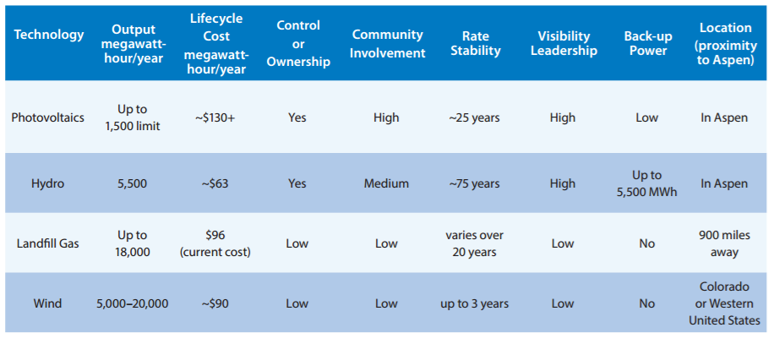
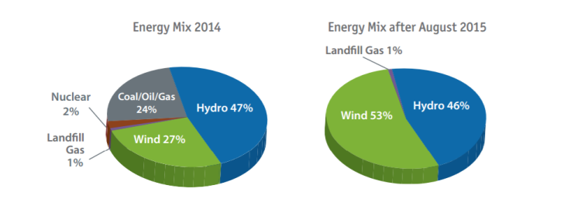
How can we get to 100% RE?
http://www.nrel.gov/docs/fy15osti/62490.pdf
Notes:
A great example of a project that led direction to decision making, is the Aspen project that was done by Joyce McLaren, one of our senior policy analysts here at the lab.
NREL helped aspen figure out how to get to 100% clean energy which they did in 2015
We brought our expertise but made sure to use their stakeholder engagement process already in place
REOpt was the primary tool used for the analysis (which, as you know, FEMP significantly contributed to)
It was used to inform these engagements
This project is a great example of us meeting the audience where they are - when we work with communities we consider other things besides just the technical analysis. Here, for example, community involvement and visibility were important factors in the decisionmaking, along with the Lifcycle cost analysis of the technologies.
(Aspen chose something that we would not have anticipated or advocated for (they bought RECS) - this proves that we're neutral in our assistance and informing role)

Slide 12
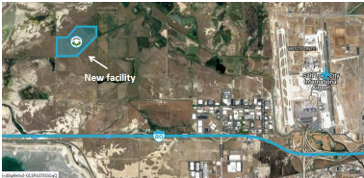
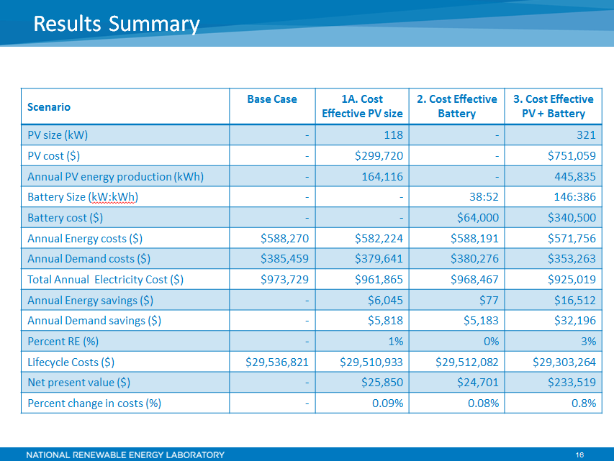
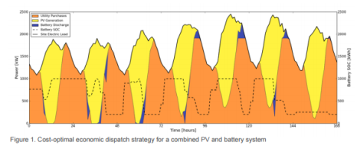
Resiliency, Storage, and Cost: Oh My!
Notes:
Here is another example out of our Solar Technical Assistance Team program that highlights the use of data, tools and analysis to inform decision making.
This was a request that came from the state of Utah, in regards to the screening of a soon to built correctional facility near Salt Lake.
The analysis experts, Emma Elvquist in particular, used the ReOpt tool – which is heavily supported by FEMP, to inform this analysis.
Emma was able to provide solid information to the state on the opportunities to use solar PV and storage on the new facility. We received really positive feedback from the customer here on the usefulness of the analysis (and how easy it was to digest) as well as the neutrality of the information. They mentioned on more than one occasion that they appreciated the fact that we weren’t just selling them solar, rather helping them understand the economic impacts of including it as part of the facility.

Slide 13
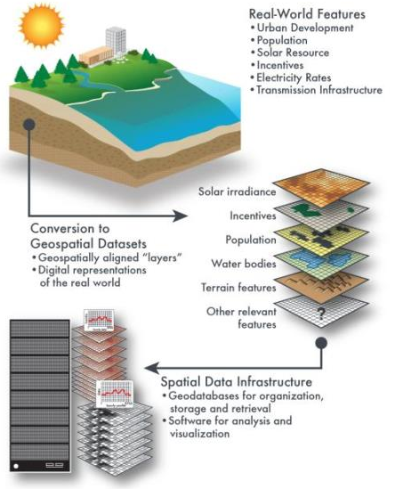
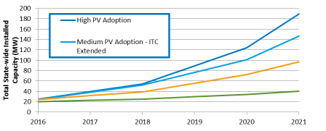
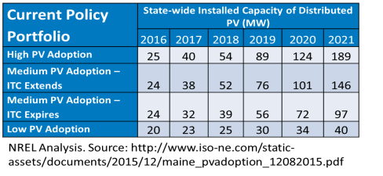
What happens when I…?
The dGen family of models forecasts state, utility, or city-specific customer adoption of distributed generation technologies for residential, commercial, and industrial entities.
Notes:
-Something important that I wanted to point out, was the long list of EERE-supported tools that we’ve developed to create that credibility in decision support.
-we can reach way into the NREL arsenal of expert tools to understand energy markets and what policy or regulatory changes may effect them
-This is a DG example
-By having our collection of tools and analysis experts at the ready, we can provide credible, vetted decision making information into the hands of the decision makers who need it, all in a timely manner.

Slide 14
What’s Next
Notes:
So, now I’ll go through some project highlights that focus on our program strategies of
data development and data sharing
analytics and
direct technical assistance.

Slide 15

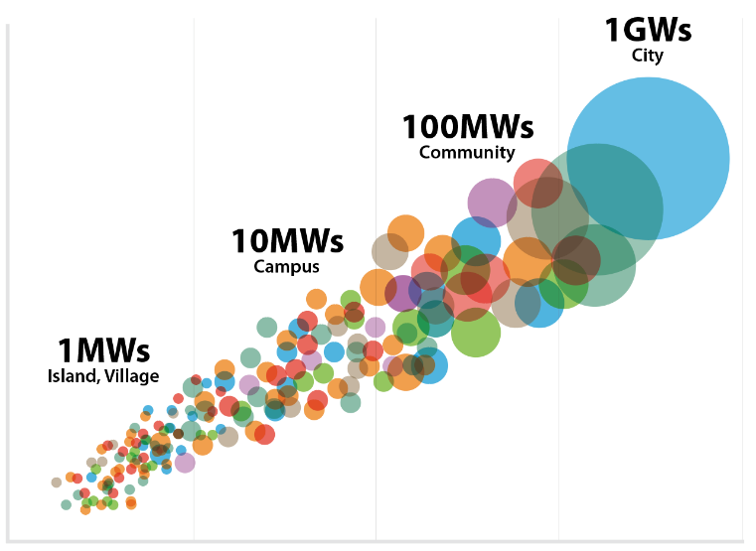
Innovation at a Scale that Matters
Tomorrow
Today
Notes:
We have a lot of examples in the village and campus level, and we have even started to develop examples at the community and city level.
Next up, we’re looking for holistic solutions that are high impact for multiple communities – providing impact at a scale that we haven’t reached yet

Slide 16
Thank you!
Erin.nobler@nrel.gov
303-275-4634
Elizabeth.Doris@nrel.gov
Lab Program Manager
State Local and Tribal Program
Project Contacts:
Cities LEAP: Megan Day/Elizabeth Doris
Municipal Codes: Elizabeth Doris
Resiliency: Eliza Hotchkiss
ReOpt (Resiliency Analysis): Kate Anderson
dGen and state policy evaluation: Ben Sigrin
Solar Technical Assistance Team: Erin Nobler
Clean Cities: Wendy Dafoe
Aspen 100%: Joyce McLaren
Notes:
So with that, I’ll stop there b/c I don’t want to take up too much time. I’m happy to speak to any of these projects in more detail. Thank you!

Slide 17
COMMON QUESTIONS
1 | What are the energy efficiency measures that are likely to yield the biggest savings in my jurisdiction?
2 | What are the high priority RE projects for my jurisdiction?
3 | What is the sector level breakdown of energy and emissions data for my jurisdictions (or sub jurisdictions)?
4 | What is the makeup of low income housing in my jurisdiction? What is the energy burden?
5 | Is solar technology affordable for my jurisdiction? What’s the Savings to Investment ratio for my people?
6 | What are the costs and outputs of renewable facilities under different financial structures?
7 | What are the jobs and other economic development impacts of renewable energy projects in my jurisdiction?
8 | What are the costs and benefits to various audiences of a single community solar project?
9 | What incentive levels are necessary to improve system economics?
10 | What are the market impacts of different policy scenarios?
11 | Other:

Slide 18
Tools

Slide 19
What are the energy efficiency measures that are likely to yield highest savings in my jurisdiction?

Slide 20
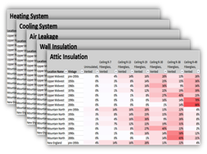
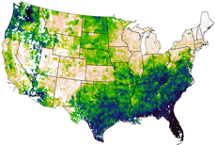

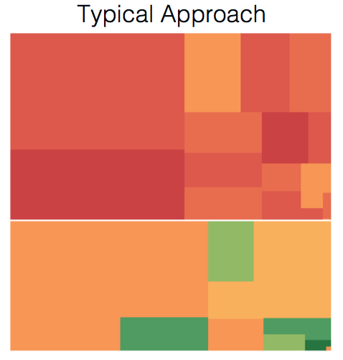
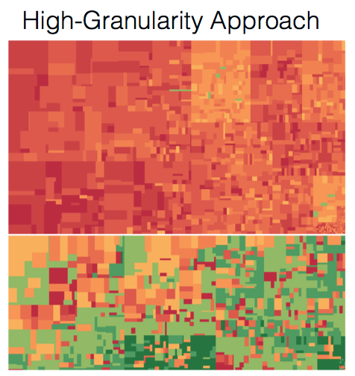
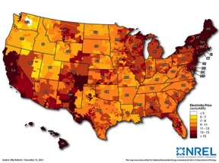

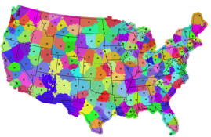
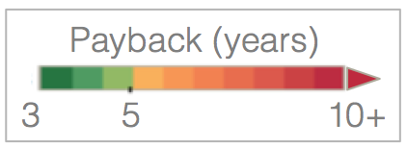
ResStock
Problem
Solution
Typical Approach
Building
Characteristics
10s–100s of thousands of
statistically representative models
High-Granularity
Census Data
Baseline
Buildings
Efficiency
Upgrades
Costs
Climate
Locations
NREL supercomputer or Amazon Cloud
(The heatmaps above show the payback period for insulating wall cavities in various segments of the housing stock in Washington and Oregon.)
Typical, non-granular analysis of energy efficiency potential can lead to incorrect “all-or-nothing” cost-effectiveness results.
ResStock’s highly granular approach leads to more nuanced results—and enables identification of opportunity targets within the building stock for particular efficiency measures.

Slide 21
Actionable results for states and cities
Cost-effective savings for Virginia
Top 10 Upgrades
Upgrade Electric WH to HPWH
Utility bills
1.5
billion dollars per year
Notes:
Sound bite: “If U.S. homeowners made all cost-effective energy efficient upgrades (based on NPV>0) we could save 245,000 GWh/yr. Energy upgrades include situation-specific combinations of central AC, furnaces, HPs, water heaters, lighting and appliances at the time of replacement, as well as insulating walls, insulating ceilings, and performing air sealing and duct sealing.”
Sound bite: Fact sheets will be published this fall/winter, showing state-specific impacts of cost-effective EE upgrades
“Cost-effective” means the upgrade has positive net present value for the home owner, using a 3% real discount rate and 30 year analysis period
Map explanation: Bubble area represents the aggregated economic potential for each state. Bubble color represents the economic potential as a percentage of statewide electricity
******** Supplemental Information *********
Map was generated using ResStock, a data-driven tool for modeling the entire U.S. housing stock with unprecedented granularity (millions of simulations on NREL’s supercomputer)
- Results: Actionable analyses and visualizations of U.S. energy efficiency potential
- Leverages: A dozen public and private data sources (e.g. EIA RECS, Census/Housing Survey, Codes, Dept. of Homeland Security data), and DOE’s flagship energy simulation engine (EnergyPlus).
- Acknowledgement: ResStock was developed with support from BTO and other partners. Results on these slides are from a 2016 analysis supported by DOE-BTO and DOE-EPSA.
Economic potential includes electricity savings resulting from all upgrades in single-family detached homes that result in a positive net present value for the home owner, using a 3% real discount rate and 30 year analysis period.
Key assumptions for this analysis are listed below.
Technical and economic potential are presented as annual energy savings rather than cumulative energy savings over a number of years.
Economic potential calculations include net replacement costs at wear out assuming full turnover of the stock of equipment and appliances (over the 30-year analysis period). Cost-effectiveness is evaluated using costs and benefits from the building owner’s perspective rather than a utility or societal perspective.
For NPV calculations, 30 years of future cash flows (utility bill savings, equipment replacement at end of life, and residual value) are brought to the present using a 3% real discount rate.
The packages used to estimate overall economic potential were constructed using NPV as the cost-effectiveness metric.
The same economic calculations are used for both owner-occupied and tenant-occupied homes. For tenant-occupied housing, it is assumed that either the building owner pays the utility bills or rent can be increased by an amount equal to utility bill savings.
State, utility, and local incentives (e.g., rebates) were not included in the economic analysis, due to the large number of unique incentives that exist. The federal income tax credit for residential energy efficiency was included and assumed to be available in future years (capped at $500 per household).
The scope of this analysis is limited in the following ways:
The analysis covers single-family detached housing only. The housing stock characteristics tool developed for ResStock currently is limited to single-family detached housing and excludes all multifamily buildings (including duplexes and townhomes) as well as mobile homes.
House counts and housing characteristics are a snapshot based on circa-2012 data; projections of future construction and changes in housing characteristics were not included in this analysis.
Geographic scope is limited to the 48 contiguous U.S. states and Washington, D.C. Sources of housing characteristics and consumption data (particularly the Residential Energy Consumption Survey) for Alaska, Hawaii, and U.S. territories tend to have low sample sizes, resulting in high uncertainty in the data.

Slide 22
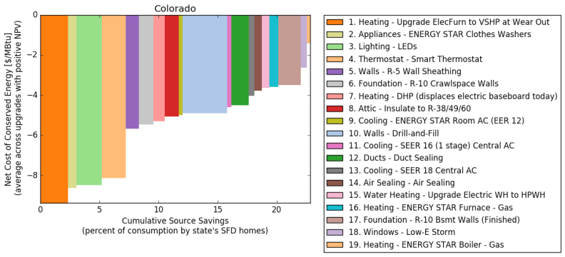
What about using less?
Figure 8. Electric Efficiency Supply Curve for Colorado
Source: Wilson, E., et al. Electric End-Use Energy Efficiency Potential in the U.S. Single-Family Housing Stock. January 2017. National Renewable Energy Laboratory.
http://www.nrel.gov/docs/fy17osti/65667.pdf

Slide 23
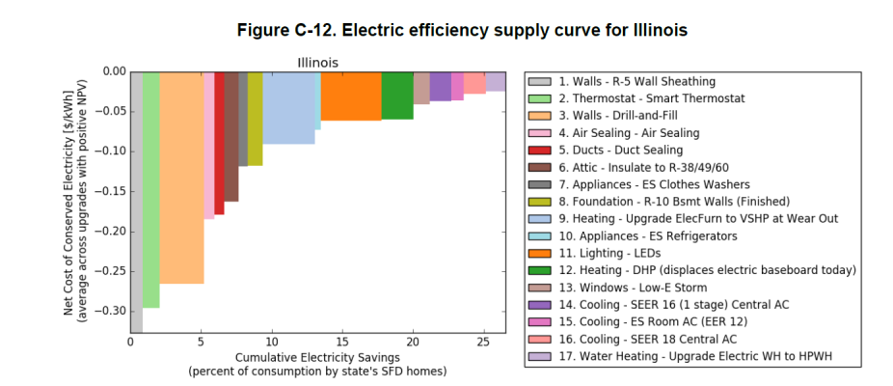
Illinois Resi Supply Curve

Slide 24
What are the high priority RE projects for my jurisdiction?

Slide 25










REopt Inputs and Output
Drivers
Goals
Minimize Cost
Net Zero
Resiliency
Economics
Financial Parameters
Technology Costs
Incentives
Utility Costs
Energy Charges
Demand Charges
Escalation Rate
Resources
Renewable Generation
Solar PV
Wind
Biomass, etc.
Technologies
Technology Mix
Technology Size
Conventional Generation
Electric Grid
Fuel Supply
Conventional Generators
REopt
Energy Planning Platform
Techno-economic Optimization
Operations
Optimal Dispatch
Optimized Minimum
Cost Solution
Energy Storage
Batteries
Thermal storage
Water tanks
Technology Options
Project Economics
CapEx, OpEx
Net Present Value
Dispatchable Technologies
Heating and Cooling
Water Treatment
Energy Conservation Measures
Electric Loads
Thermal Loads
Water Demand
Loads

Slide 26
Using RE to Extend Probability of Surviving Outage
NREL evaluated thousands of random grid outages and durations throughout the year and compared number of hours the site could survive with a diesel generator and fixed fuel supply vs. generator augmented with PV and battery
 | Generator | Solar PV | Storage | Lifecycle Cost | Outage
1. Base case | 2.5 MW | - | - | $20 million | 5 days
2. Lowest cost solution | 2.5 MW | 625 kW | 175 kWh | $19.5 million | 6 days
3. Proposed system | 2.5 MW | 2 MW | 500 kWh | $20 .1million | 9 days
Lowest cost solution
Proposed system
(given site goals & constraints)
Base case
Notes:
NREL evaluated thousands of random grid outage occurrences and durations throughout the year
Compared number of hours site could survive with diesel gensets and fixed fuel supply only vs. gensets augmented with PV and battery
Found PV and battery gave site 90% probability of surviving an additional 1 at no cost and an additional 4 days at minimal additional cost
Basecase includes 4,500 gallons of fuel

Slide 27
Miami University of Ohio
Evaluate low-carbon, cost effective master plans for the campus
Technologies included: PV, GSHP, thermal and electrical storage, CHP/HRSG
Evaluated staged implementation of the technologies to meet progressing carbon reduction goals and future load profiles
Required modeling of existing steam plant, detailed load analysis, evaluation of multiple detailed engineering reports, and detailed modeling of PJM large customer tariff
Year | Project | Coal | Carbon Goal
2014 | GSHP Western Ph. 1 (done)
2015 | East Quad SHC
2016 | North Quad SHC | 7000 ton max
2017 | GSHP Western Ph. 2
2020 |  |  | 80% of 2008
2025 | GSHP Western Ph. 3 | No coal | 70% of 2008
 | GSHP North Campus
 | New boilers, CHP
2030 |  |  | 50% of 2008
2040 |  |  | 25% of 2008

Slide 28
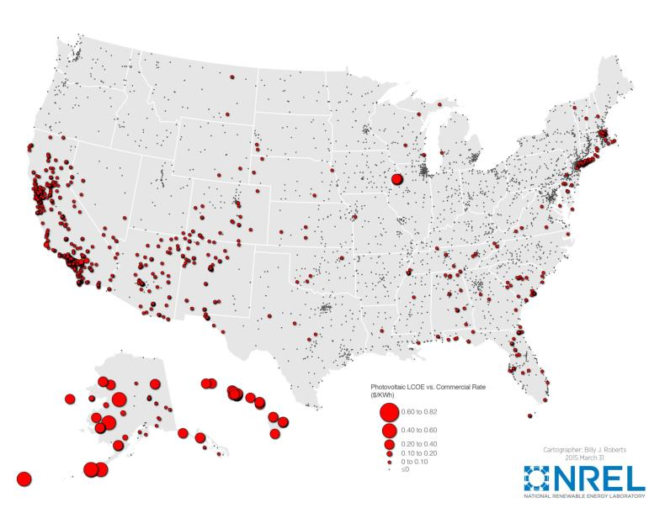
PV Levelized Cost of Electricity Compared to Utility Rate
Project opportunity
PV size
Energy Produced
Cost Savings

Slide 29
What is the sector level breakdown of energy and emission data for my jurisdiction (or sub jurisdictions)?

Slide 30
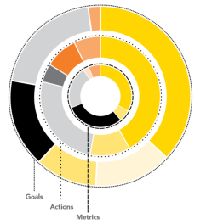
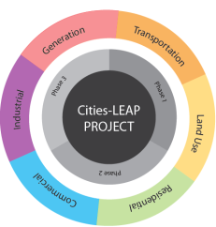
Cities Leading through Energy Analysis and Planning
FOUNDATIONAL RESEARCH
City-Level Energy Decision Making: Data Use in Energy Planning, Implementation, and Evaluation in U.S. Cities
CITY ENERGY PROFILES
Developed new, replicable methodology and generated a publicly available city energy profile for every U.S. city
CITY ENERGY FUTURES
Aggregate, national economic and GHG impact of suites of city energy actions
FUNDING OPPORTUNITY ANNOUNCEMENT
Three awardees pursuing innovative approaches to incorporating
energy data in city decision making recently announced

Slide 31
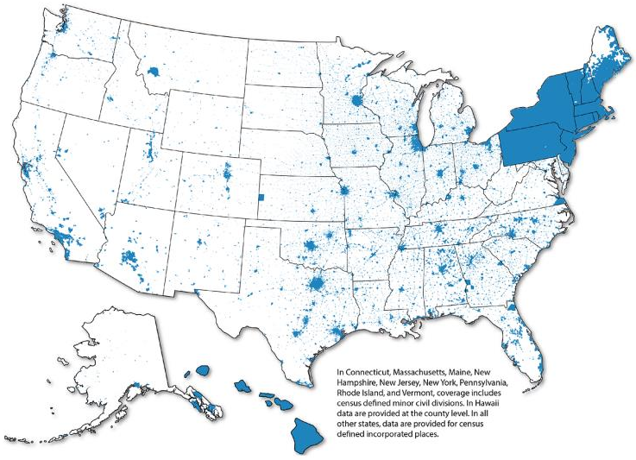
Cities-LEAP City Energy Profile Coverage
23,400+ U.S. Cities

Slide 32
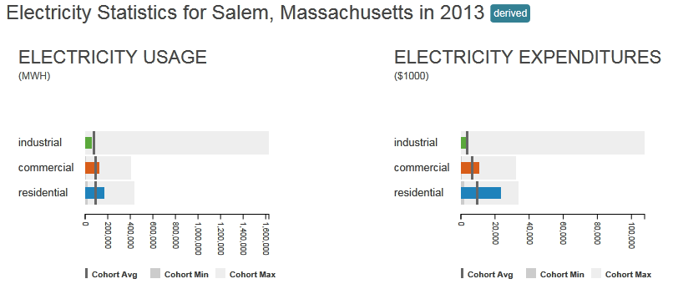
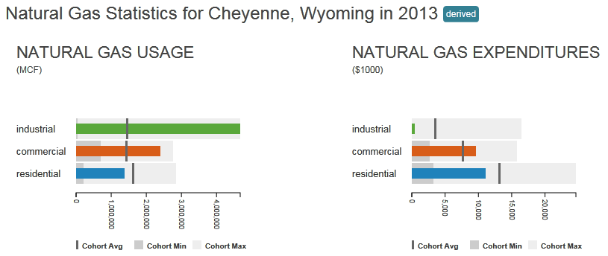
City Energy Profiles: Electricity, Natural Gas
Learning about the energy market in your city and similar cities can lead to more strategic energy decisions toward a clean energy future.

Slide 33
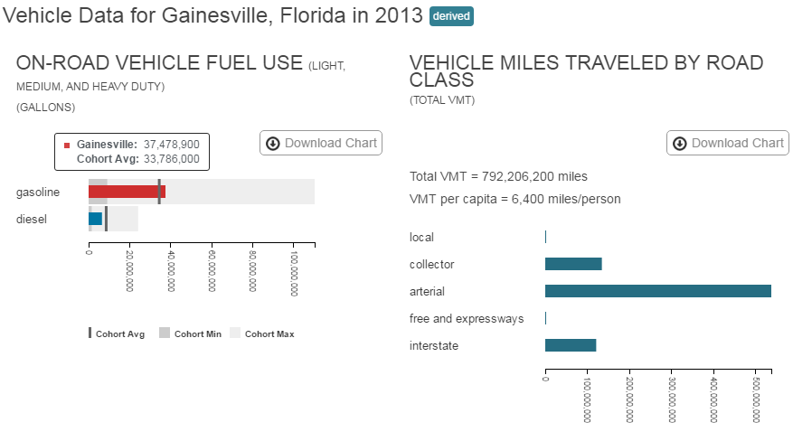
City Energy Profiles: Fuel Use, VMT

Slide 34
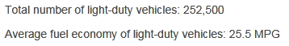
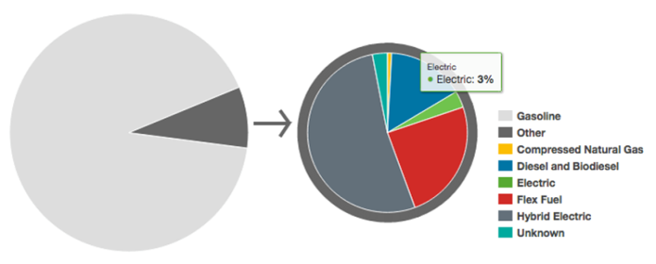
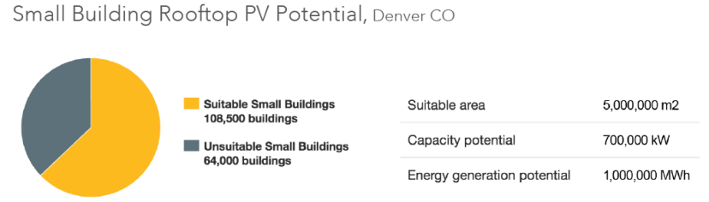
City Energy Profiles: Fuel Type, PV Potential
Light-Duty Alternative Fuel and Conventional Vehicle, Oakland, CA

Slide 35
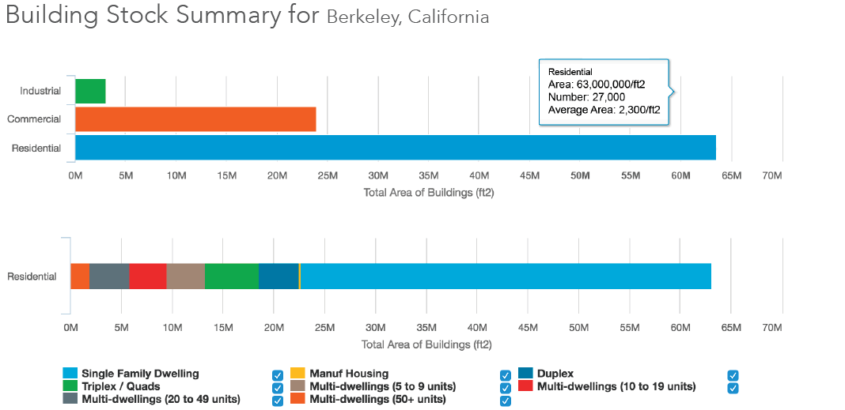
City Energy Profiles: Building Stock Characterization
http://apps1.eere.energy.gov/sled/#/.

Slide 36
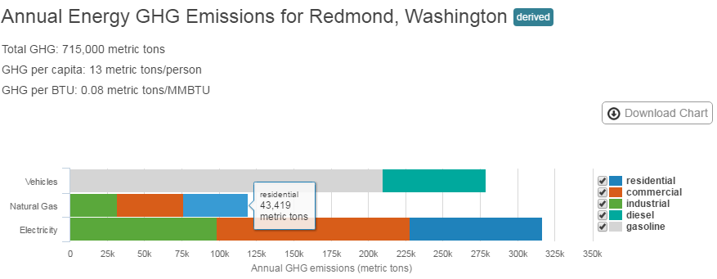
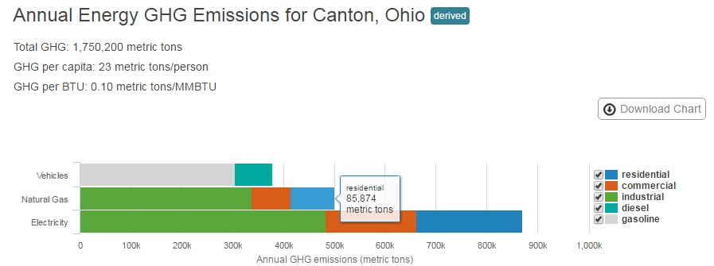
City Energy Profiles: Greenhouse Gas Emissions Summary

Slide 37
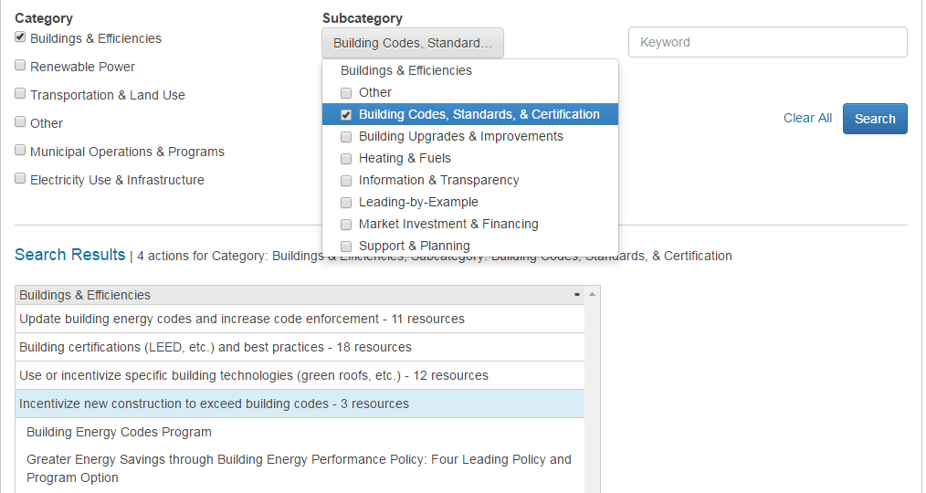
Local Energy Action Toolbox

Slide 38
What is the makeup of low income housing in my jurisdiction? What is the energy burden?

Slide 39
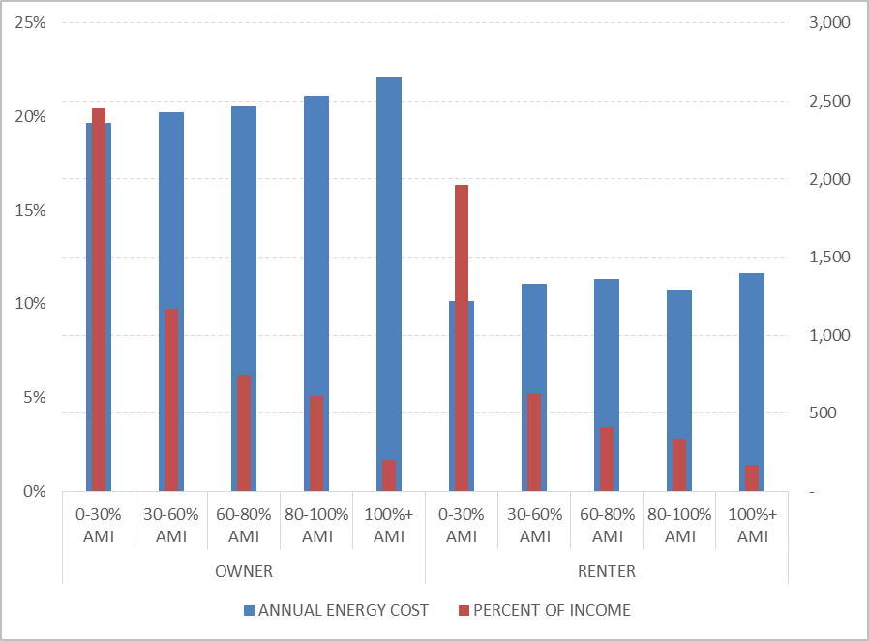
Cities-LEAP Energy Burden Estimates – Carrboro, NC
(Preliminary, unpublished analysis. Do not circulate.)

Slide 40
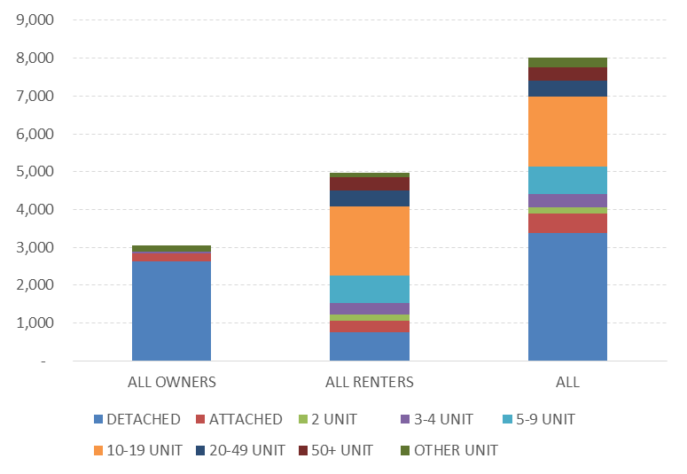
Cities-LEAP: Number of Housing Units by Type, Carrboro, NC
(Preliminary, unpublished analysis. Do not circulate.)

Slide 41
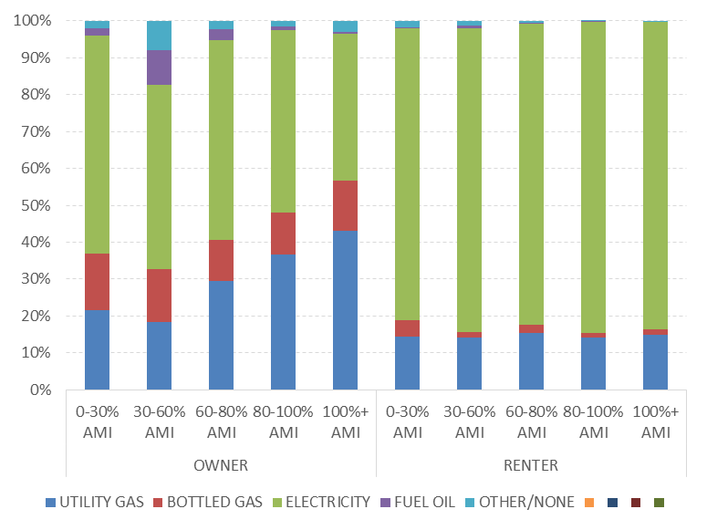
Cities-LEAP: Percentage of Housing Units by Fuel Type, Carrboro, NC
(Preliminary, unpublished analysis. Do not circulate.)

Slide 42
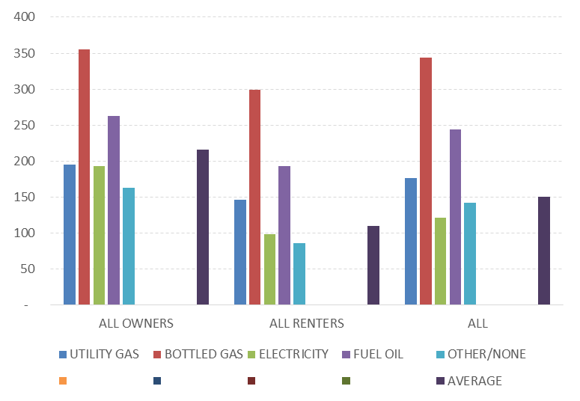
Cities-LEAP: Avg. Monthly Energy Expenditures by Heating Fuel Type, Carrboro, NC
(Preliminary, unpublished analysis. Do not circulate.)

Slide 43
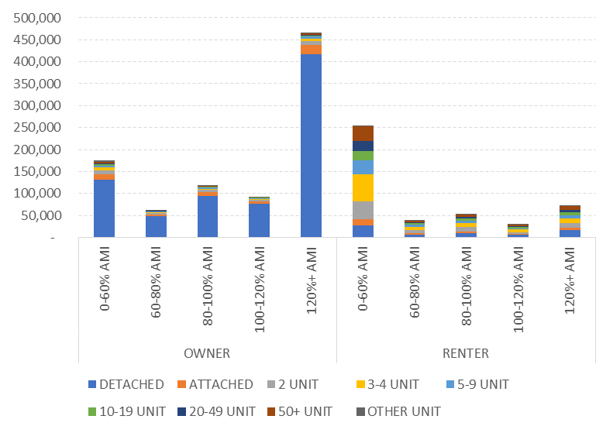
Cities-LEAP: Number of Housing Units by Housing Type, CT
(Preliminary, unpublished analysis. Do not circulate.)

Slide 44
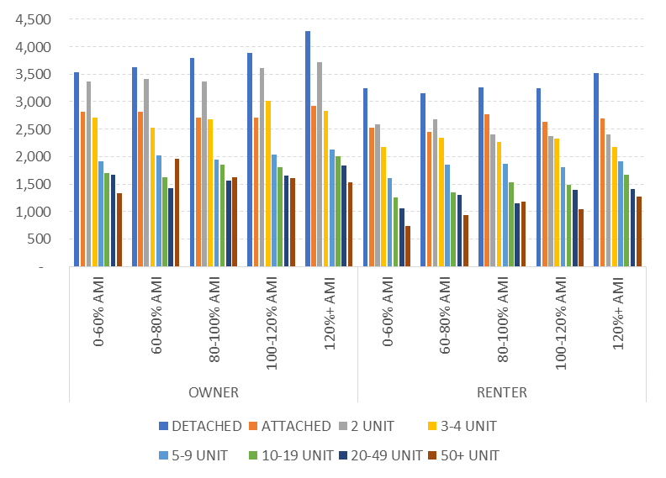
Cities-LEAP: Average Annual Energy Expenditures ($/yr), CT
(Preliminary, unpublished analysis. Do not circulate.)

Slide 45
Is Solar Tech Affordable for my Jurisdiction? What is the Savings to Investment Ratio for my people?

Slide 46
What is an SIR?
Savings to Investment Ratio (SIR) calculates whether a PV system owner recovers its investment through electricity savings and federal and state incentives
NREL has built an analysis tool to calculate the SIR for a residential PV system in all 50 states using the following formula:
Lifetime Present Value of: 1) Electricity bill savings 2) O&M costs, 3) State incentives, if any ($/kWh)
Savings to Investment Ratio for PV Systems
1) Upfront PV system investment 2) tax credit, if any, 3) state grant
The tool is designed to allow stakeholders the ability to explore the cost-effectiveness of solar in their communities

Slide 47
How is the Electricity Savings Calculation made?
State Average Annual Electricity Production of Residential PV System
X
Average State Residential Electricity Rate)
– Annual O&M Costs
+ Annual State Incentives
Σ(
)
Savings on your Electricity Bill

Slide 48
Default Assumptions
Category | Assumptions
Net Metering Credits | Assumes customers receive full net-metering credit at the state residential average electricity prices from EIA.
System Costs | Default residential PV system price range of residential of $2/W-$4/W based on costs reported in both the NREL Benchmark Report and the GTM report for distributed PV systems.
System Lifetime | PV system useful life is estimated to have a range between 25 - 40 years based on research from NREL.
System O&M Costs | Default O&M costs and degradation rate from NREL technical report
State Capacity Factors | Average Residential state-level capacity factors are based on NREL internal analysis for the ReEDS model
State Residential Electricity Rates | Default electricity escalation rate based on EIA AEO 2016, National Average Residential End-Use Electricity Price increase from 2015-2040.
Discount Rate | A 3% social discount rate was assumed to capture the time value of the savings over the lifetime of the system.

Slide 49
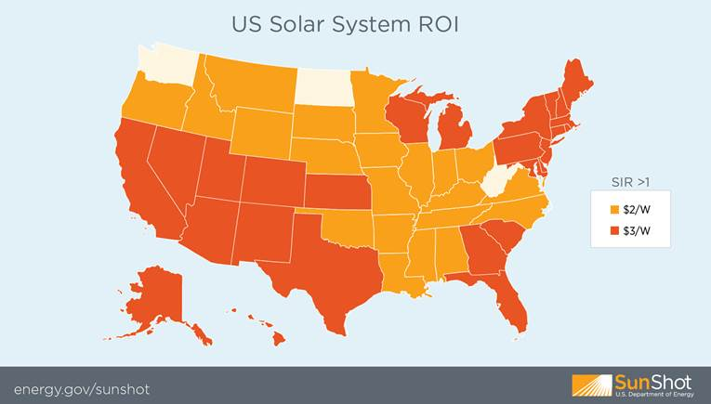
SIR Results of Two Cost Scenarios
Note: Uses a 30 year analysis period and a 30% federal tax credit
Notes:
The savings to investment ratio is a unit to measure cost effectiveness. The SIR includes the life of the measure at 25 to 40 years. If the investment is equal to the energy savings the payback is greater than one in the orange states assuming the price per watt is $3.

Slide 50
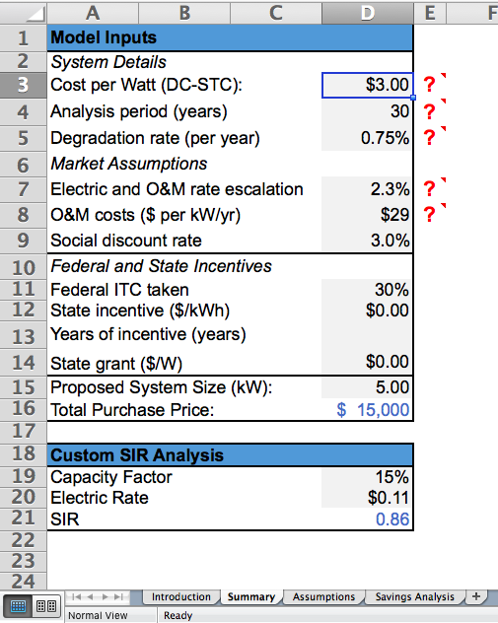
Customize Your Own Assumptions
Each state can customize any of the assumptions in the grey cells on the “Summary” tab, including:
System and O&M costs, analysis period, discount and escalation rates
Federal and state incentives,
State solar resource (capacity factor) and average electricity rate

Slide 51
What are the costs and outputs of renewable facilities under different financial structures?

Slide 52

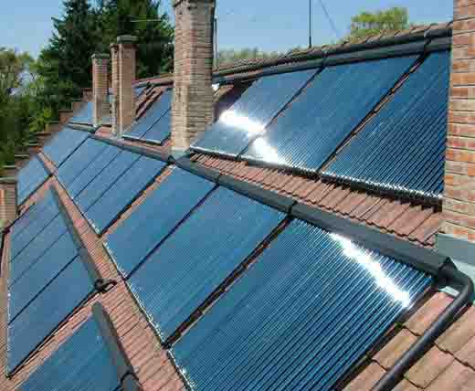
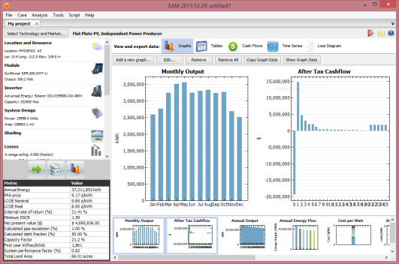




System Advisor Model
The System Advisor Model (SAM) is a free user-friendly computer program that calculates a renewable energy system’s hourly energy output over a single year, and calculates the cost of energy for a renewable energy project over the life of the project.
These calculations are done using detailed performance models, a detailed cash flow finance model, and a library of reasonable default values for each technology and target market.
Technologies SAM can model:
Photovoltaics (Flat plate, CPV)
Solar Water Heating
Concentrating Solar Power (Trough, Tower, Linear Fresnel, Dish Stirling)
Geothermal
Wind (Small + Utility scale)
Biomass Power
Weather Data
System Specs
Energy Production
Cost Data
Utility Rates & Incentives
Financing Options
Annual, Monthly, and Hourly Output, LCOE, NPV, Payback, Revenue, Capacity Factor
+
»
+
+
+
»

Slide 53

System Advisor Model (SAM)

Slide 54
What are the jobs and other economic development impacts of renewable energy projects in my jurisdiction?

Slide 55

JEDI PV – Jobs and Economic Development
PURPOSE: Estimate the economic impacts of constructing and operating photovoltaic power generation at the local and state levels.
TYPE: Spreadsheet-based impact model
TAKEAWAY: Economic impacts for one, or, a portfolio of projects
CONTACT: JEDISupport@nrel.gov
http://www.nrel.gov/analysis/jedi/download.html
Notes:
Project Description
The Jobs and Economic Development Impact (JEDI) models are user-friendly tools that estimate the economic impacts of constructing and operating power generation and biofuel plants at the local (usually state) level.
Based on project-specific or default inputs (derived from industry norms), JEDI estimates the number of jobs and economic impacts to a local area that could reasonably be supported by a power generation project. For example, JEDI estimates the number of in-state construction jobs from a new wind farm.
The intent of the Jobs and Economic Development Impact (JEDI) models is to construct a reasonable profile of investments (e.g., solar plant construction and operating costs) to demonstrate the employment and economic impacts that will likely result during the construction and operating periods.
While most of the JEDI Models look at a single project, say a small commercial rooftop PV installation, Scenario JEDI looks at a deployment scenario over time. For example: What is the impact of 10 MW of solar installed over a 5 year period that is split between utility, residential and commercial installations?
The type of analysis offered by scenario JEDI is particularly interesting to state and local policymakers, as it offers information on how a deployment scenario may impact your community in terms of jobs and economic development. We are careful to say that the estimates derived from JEDI are not guaranteed.

Slide 56
What are the costs and benefits to various audiences of a single community solar project?

Slide 57

Community Solar Scenario Tool
NEW
PURPOSE: Evaluate economics of a community solar project from a customer’s perspective as well as the sponsoring utility
TYPE: Spreadsheet-based model
TAKEAWAY: “First cut” analysis of different community solar options for utility, state and local advocates.
CONTACT: john.nangle@nrel.gov
www.nrel.gov/tech_deployment/tools_community_solar.html
Notes:
The community solar scenario tool is one of the newest solar modeling capabilities developed here at NREL. The STAT team started seeing several requests for information about analyzing shared solar programs, so we built this tool for a specific request from Michigan, then modified it for a request from Columbia, Missouri, then worked to make it a more general tool that could stand alone.
This model allows smaller municipal utilities, electric cooperatives, and state and local advocates to see how various inputs--such as system size, location, and project costs—will impact the economics of a project and from both a potential customer's perspective as well as the sponsoring utility’s. This tool really provides a “first cut” analysis of different community or shared solar program options, so anyone looking for more complex financial modeling options should turn to SAM.
<Exit to website>
You can access this tool on NREL’s website from the “Deployment” tab in the top navigation. Then, select “Models and Tools” on the left and you can find it in the renewable Energy Technologies section of the page. As you can see, it is available as a downloadable Microsoft Excel file. I will just flip through the tabs quickly since using the tool is pretty straight-forward. If this is something you are interested in, please plan to attend our in-depth webinar covering what you can learn from this tool on Wednesday, August 13.
<Return to slides>
Again, I want to emphasize that this tool is really meant for small municipal utilities who are doing a first-pass analysis. With that in mind, we are certainly open to suggestions for improvement, so if you do spend some time with this tool, please let us know your thoughts.

Slide 58
What incentives/policies are necessary to improve system economics?

Slide 59

Cost of Renewable Energy Spreadsheet Tool (CREST)
PURPOSE: Cash flow model to assess solar projects, design cost-based incentives, evaluate impacts of tax incentives and other support structures
TYPE: Spreadsheet based
TAKEAWAY: Less technical, back of the envelope LCOE estimates without engaging a detailed SAM run.
CONTACT: re.finance@nrel.gov
https://financere.nrel.gov/finance/content/crest-cost-energy-models
Notes:
CREST models are designed for use by state policy makers, regulators, utilities, beginning developers or investors, and other stakeholders. The models allow users:
To estimate the Year One cost of energy (COE) and levelized cost of energy (LCOE) from a range of solar, wind and geothermal electricity generation projects,
To experiment with the process of setting of cost-based incentive rates;
To observe the effects of different economic drivers on a given renewable energy project's COE and LCOE;
To comprehend the relative economics of generation projects with differing characteristics, such as project size, resource quality, location (e.g. near or far from transmission) or ownership (e.g. public or private.)

Slide 60
What are the market impacts of different policy scenarios?

Slide 61

Policy and Program RE Impacts: dGen
The dGen family of models forecasts state, utility, or city-specific customer adoption of distributed generation technologies for residential, commercial, and industrial entities.
Notes:
[STATE EXAMPLES ON THIS PAGE]
Talking point:
-we can reach way into the NREL arsenal of expert tools to understand energy markets and what policy or regulatory changes may effect them. This is a DG example

Slide 62
Other!

Slide 63
Cost of Renewable Energy Spreadsheet Tool (CREST)
PURPOSE: Cash flow model to assess solar projects, design cost-based incentives, evaluate impacts of tax incentives and other support structures
TYPE: Spreadsheet based
TAKEAWAY: Less technical, back of the envelope LCOE estimates without engaging a detailed SAM run.
CONTACT: re.finance@nrel.gov
https://financere.nrel.gov/finance/content/crest-cost-energy-models
Notes:
CREST models are designed for use by state policy makers, regulators, utilities, beginning developers or investors, and other stakeholders. The models allow users:
To estimate the Year One cost of energy (COE) and levelized cost of energy (LCOE) from a range of solar, wind and geothermal electricity generation projects,
To experiment with the process of setting of cost-based incentive rates;
To observe the effects of different economic drivers on a given renewable energy project's COE and LCOE;
To comprehend the relative economics of generation projects with differing characteristics, such as project size, resource quality, location (e.g. near or far from transmission) or ownership (e.g. public or private.)

